Slide 1
Summary of MD w29
Pressure vs ultimate intensity
Results of extracted samples
Progress with coatings and MBBs
M.T. for SPSU

Slide 2
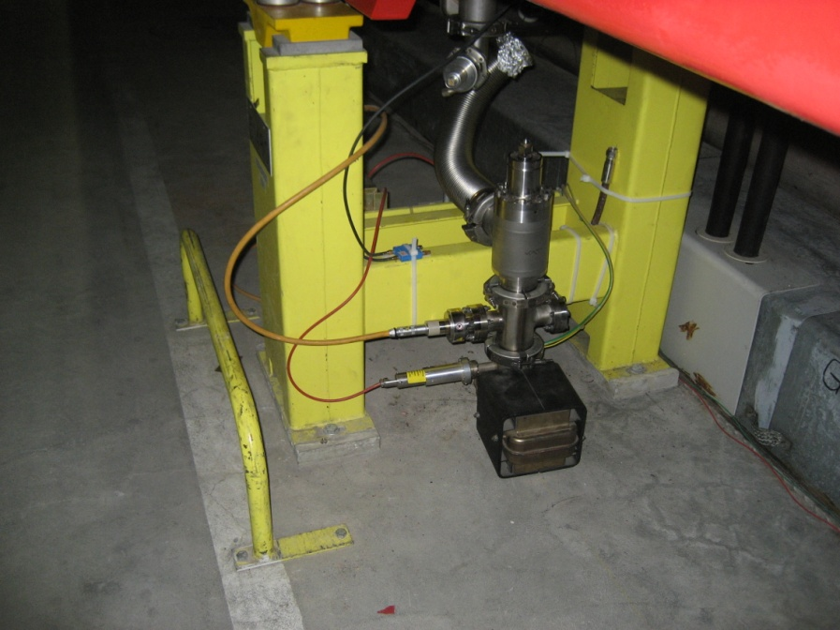
MDw29: Problems in the MD
2 strip electrodes on Kapton foil removed at last minute: outgasssing was too high (about 2E-5 mbar), since the Kapton was not recently pre-baked for degassing
Only 2 ECM operational: CNe13 and CNe65
No StSt liner operational
Only 25 ns beam (failure of dipole on Friday)
isolated vacuum vessel with gauge and ion pump was placed below the dipoles, as close as possible to the usual measuring system

Slide 3
Once again strong outgassing from a “new” dipole
“fresh” dipole
P [mbar]
a-C liners
Old coated
MBB
Ref. MBB
Isolated vacuum vessel
Conclusions:
MBB after insertion (cleanliness?) needs long conditioning. No 4x72 450GeV in the run.
No perturbation from beam and operation on isolated vessel: we really measure p

Slide 4
2x72
1x72
2x72 26GeV
3x72 26GeV
P [mbar]
Conditioning mainly on the new MBB, not much effect on others (already conditioned) , slowly up to 3x72, 450GeV……and up to ultimate intensity

Slide 5
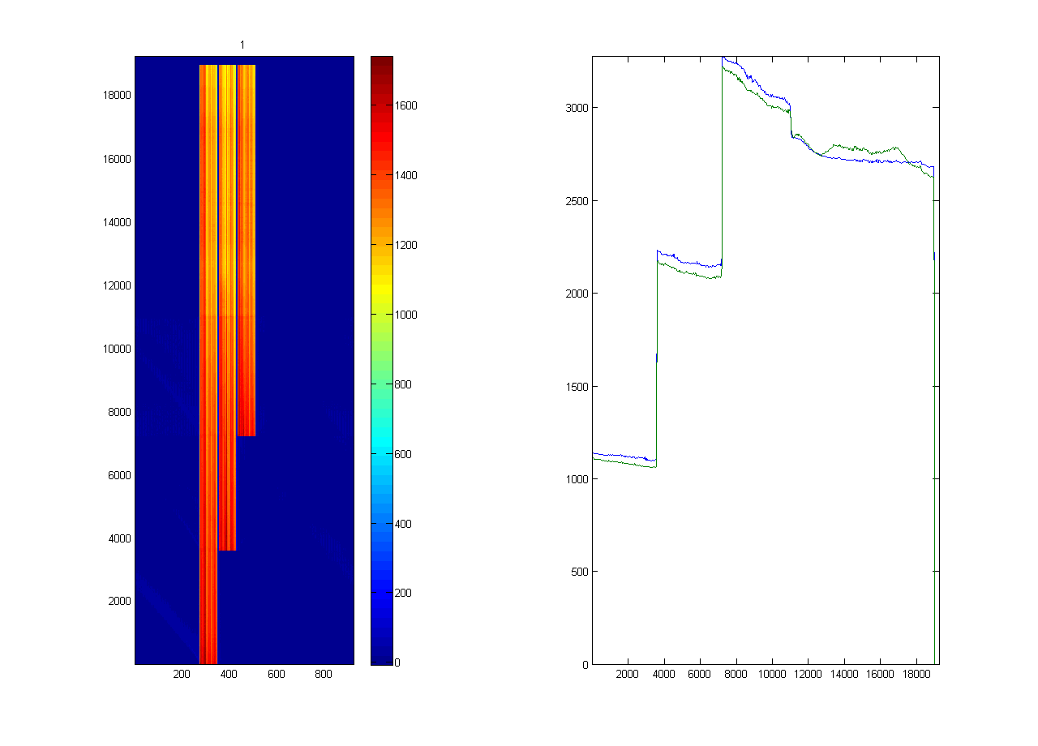
Ultimate intensity 3x72, 450GeV 25ns
1.37E11 p/b
1.48E11 p/b
1.2E11p/b
P [mbar]

Slide 6
Pressure as a function of protons per bunch at 3x72 450GeV, 25 ns

Slide 7
…on linear vertical scale

Slide 8
Sample left in SPS vacuum (in UHV below liner) for 7 weeks
XPS
7.2% O
10% O
(13.7% O
but
presence
of Cu…from
substrate)
-- Aging in the machine without exposure to the beam is faster than in air (Al foil) in the lab; increase of O (effect or cause?)
-- The identical (CNe65) liner does not show aging in ECM signal

Slide 9
SEY along the mobile sample
CNe14 (produced 08/05/08, in air 4 months up to 24/09/08, inserted SPS 4 months, extracted 26/01/09)
Aging up to 1.55 at the center is related to e-cloud irradiation
Aging from 1.1 (initial value) to 1.3 on the edge is related possibly to the residual gas only. As for samples stored in the MBB pumping port and below liners
CNe57 (produced 15/3, inserted same w11, in SPS 4months, extracted w29)
Minor aging in the center (0.92 to 1.0)
Aging from 0.92 (initial value) to 1.3, as all samples stored in the SPS vacuum
Central region (irradiated?) does not age fast if it is initially clean, but non-irradiated (?) regions age: keep it 1 month in unbaked UHV in the transfer system and re-measure
StSt , cleaned EtOH
Inserted , extracted
- Shows conditioning due to e-cloud in the center

Slide 10
Coatings
1 MBB chamber ready with new coating inserted (insertion OK from SEY of witness samples; 2 parallel scratches in the coating due to the wheels of the heavy coil and some additional dust)
RF shields to be coated (only between the 2 coated MBB)
Plasma spray: ordered 2 plates 200mm x 200mm for degassing test and dielectric strength
Next (long term):
  Developments for coating in the dipole (permanent magnet and hollow cathode)
  2 MBA chambers
  Coatings for more aging tests in the lab

Slide 11
Dipoles w35
-Displacement of dipoles with old coating 51530, 51550 to 60270 and 60290
-Displacement of uncoated dipole from 51470 (or 51490) to 51550
-Insertion of 3 dipoles with new coating in: 51470, 51490, 51530
RF shields with a-C coating in 51480 (between 51470/51490)
No RF shields on MBB and Quadrupole between 51510/51530, 51530/51550, 51550/51570
MBB51470
MBB51490
MBB51530
51550
268
177
085
096
QD
RF antennas
loops
MBB51470
MBB51490
MBB51530
51550
268
QD
No RF shields

Slide 12
Next liners :
StSt
a-C
grooves
DLC
KEK (S.Kato)
w35
w35
2011
w35?

