Slide 1
Single bunch MD on 5-6th August: short preliminary summary
MD participants: T. Bohl, W. Hofle, E. Metral, B. Salvant, E. Shaposhnikova, K. Cornelis, G. Rumolo, T. Argyropoulos + …
Many thanks to PSB, PS and SPS OP teams, BI team
(T. Bogey, C. Boccard, J. Albertone, R. Steinhagen, L. Jensen)

Slide 2
MD on 5th August ultimate intensity
intensity ~2x10¹¹, ε_{H}=2.5 μm, ε_{V}=3.5 μm, ε_{L}=0.35 eVs, τ=3.8 ns → very close to ultimate LHC beam parameters
V₂₀₀=2 MV, 26 GeV/c (no acceleration)
vertical chromaticity scanning (Benoit), ξ_{H}=0.15:
bunches transversely stable (octupoles on) for 0 < ξ_{V} < 0.3
instability at injection and sharp losses during the WS measurements (octupoles off) for ξ_{V} < 0.05
slow longitudinal instability above 1.9x10¹¹
more unstable with 800 MHz on, scanning of phase between the two RF systems (200 MHz and 800 MHz) did not help

Slide 3
MD on 6th August part I: small transverse emittances
intensity from PS ~3.5x10¹¹, ε_{L} =0.35 eVs, τ=3.8 ns, ξ_{H}=0.25
Part I: ε_{H}~1.5 μm, ε_{V}~1.5 μm: scanning of ξ_{V} (Benoit) in two ways: (1) with constant value and (2) as a step
ξ_{V} =0 → very sharp losses at injection to 2.2x10¹¹ – not visible on BCT (first point at 10 ms)
ξ_{V} =0.3 → only small losses at injection - max 3.4x10¹¹
(with almost linear change in losses in ξ_{V} range 0.0-0.3)
step in ξ_{V} on FB from 0.3 → threshold of 0.15 (tbc)
longitudinal instability with and without 800 MHz, slightly better for 2 MV increased after 100 ms to 3 MV (as for LHC nominal beam)

Slide 4
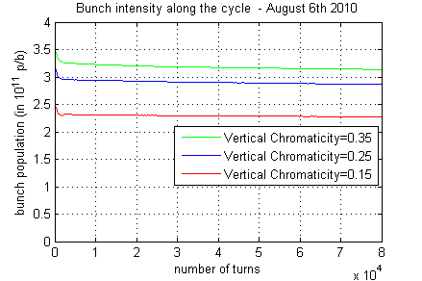
Looking for the transverse instability threshold in chromaticity
Initial intensities ejected from the PS were all between 3.4 and 3.6 x10¹¹ p/b (in fact 3.5, 3.4 and 3.56 x10¹¹ p/b) but beware of the different calibration between BPMs in the PS and SPS)
→ attempt to assess pattern of losses for high chromaticity:
- 1 % lost between PS and SPS
- 6 % lost within the first 2000 turns in SPS
- 2 % lost on the reamining of flat bottom in SPS

Slide 5
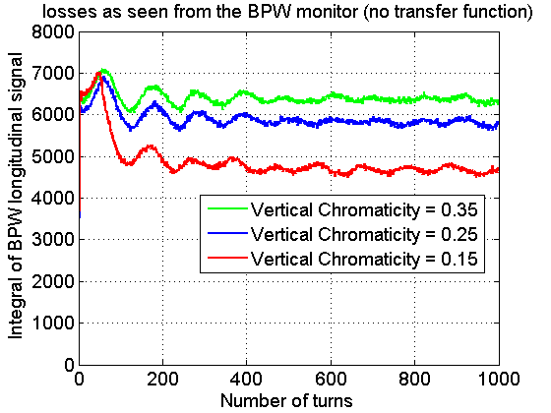
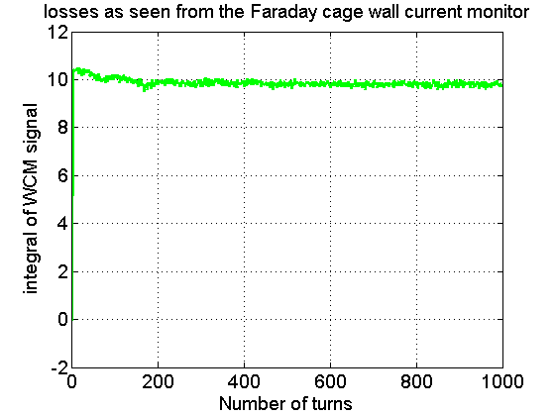
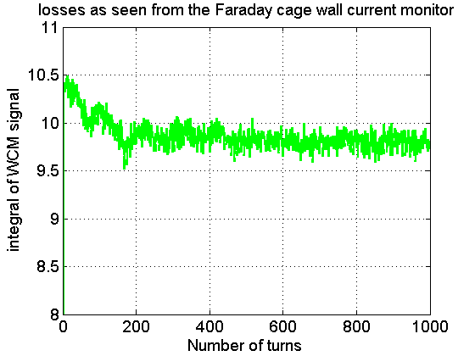
Trying to understand these losses: wideband pickup (BPW) wall current monitor (WCM)
Vertical chromaticity =0.35
→Initial BPW “intensities” consistent with PS ejection intensities (3.5, 3.4 and 3.56 10¹¹ p/b)
→Systematic losses of about 6% within the first 200 turns
→Sharp 20 % losses at around 100 turns if chromaticity is too low (red curve)
Zoom

Slide 6
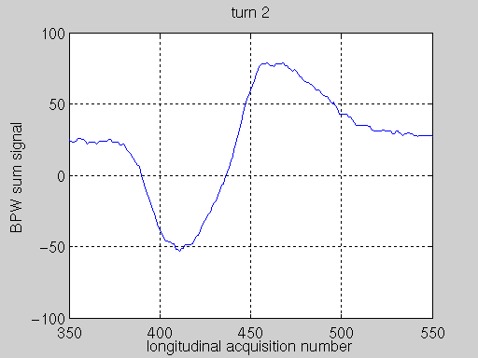
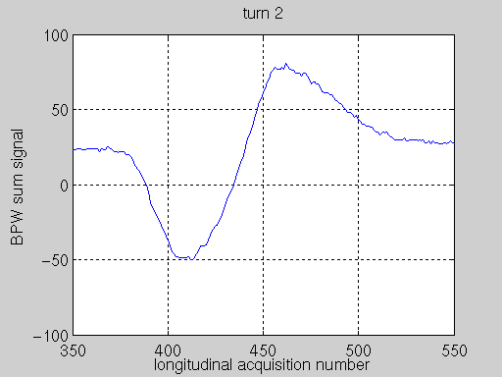
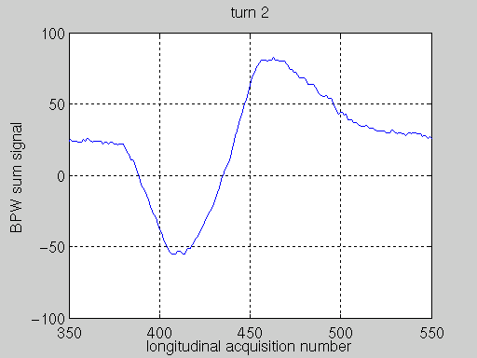
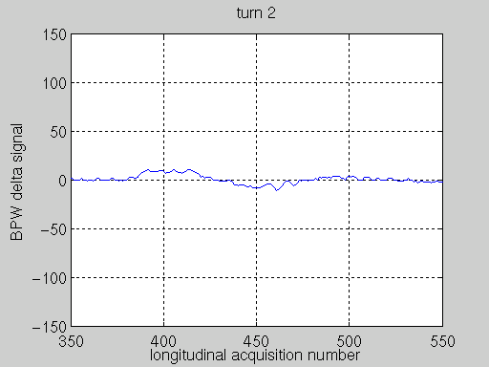
BPW sum and delta signals (raw)
Vertical Chromaticity =0.35
Vertical Chromaticity =0.25
Vertical Chromaticity =0.15
Small losses
Small losses
Large losses
→The coherent vertical instability takes about 50 turns to develop, and can not be held responsible for the very quick losses. However, they are likely to lead to losses when chromaticity is low (0.15). After 100 turns, the coherent motion is damped.

Slide 7
MD on 6th August part II: nominal transverse emittances
intensity from PS ~3.5x10¹¹, ε_{L} =0.35 eVs, τ=3.8 ns, ξ_{H}=0.25
Part II: ε_{H}~3.0 μm, ε_{V}~3.0 μm: scanning of ξ_{V} on flat bottom (Benoit):
ξ_{V} =0.0 → very sharp losses at injection to 2.25x10¹¹ – not visible on BCT (first point at 10 ms)
ξ_{V} =0.3 → only small losses at injection – max 3.2x10¹¹ (with almost linear change in losses between)
step in ξ_{V} on FB → threshold at ξ_{V} =0.05 (higher than for small emit.)
All measurements were done with 800 MHz on (350 kV, bunch shortening mode) and 2 MV increased after 100 ms to 3 MV (as for LHC nominal beam) → not directly comparable with Part I (small emittances)

Slide 8
Summary
Data is in the process of analysis (B. Salvant)
Ultimate intensity seems to be OK even with quite low chromaticity
Sharp losses at injection for highest intensities are most probably due to a very large space charge tune spread (∆Q=0.15 for nominal emittances!), chromaticity seems to help(?)
The TMCI threshold has been found as a function of chromaticity changed in steps (0.05) on FB. Clear coherent signals in this case (W. Hofle)
Higher TMCI threshold is expected (from theory and simulations) for smaller transverse emittances, opposite effect was observed. Data on FB for small and nominal transverse emittances are not directly comparable (RF) → more measurements
More (dedicated) studies of longitudinal instability and its cure needed (RF team)

