Slide 1
Coatings and coating systems
Two main strategies to coat the vacuum chambers for the magnets of the SPS:
The chamber is OUTSIDE the magnet
The chamber is kept INSIDE the magnet
CHAMBER INSIDE MAGNET
CHAMBER OUTSIDE MAGNET
Coating temperature limited to 150oC
coating temperature > 150oC
work independent of shutdowns
Coating limited to shutdowns
Radiation issues
no radiation issues
Chemical treatment limited and expensive
easy chemical cleaning
not necessary to open dipoles
welding/machining after coating and open/close dipole
high production rate requires large space and many coating systems
very high production rate (~40 chambers/week with LSS system)

Slide 2
Coatings and coating systems
Two main strategies to coat the vacuum chambers for the magnets of the SPS:
The chamber is OUTSIDE the magnet
The chamber is kept INSIDE the magnet
CHAMBER INSIDE MAGNET
CHAMBER OUTSIDE MAGNET
Magnetron sputtering (with permanent magnets)
Magnetron sputtering (magnetic field by external solenoide)
Magnetron sputtering (with the dipole’s field)
Plasma Assisted Chemical Vapour deposition. (PACVD)
Hollow Cathode Discharge sputtering

Slide 3
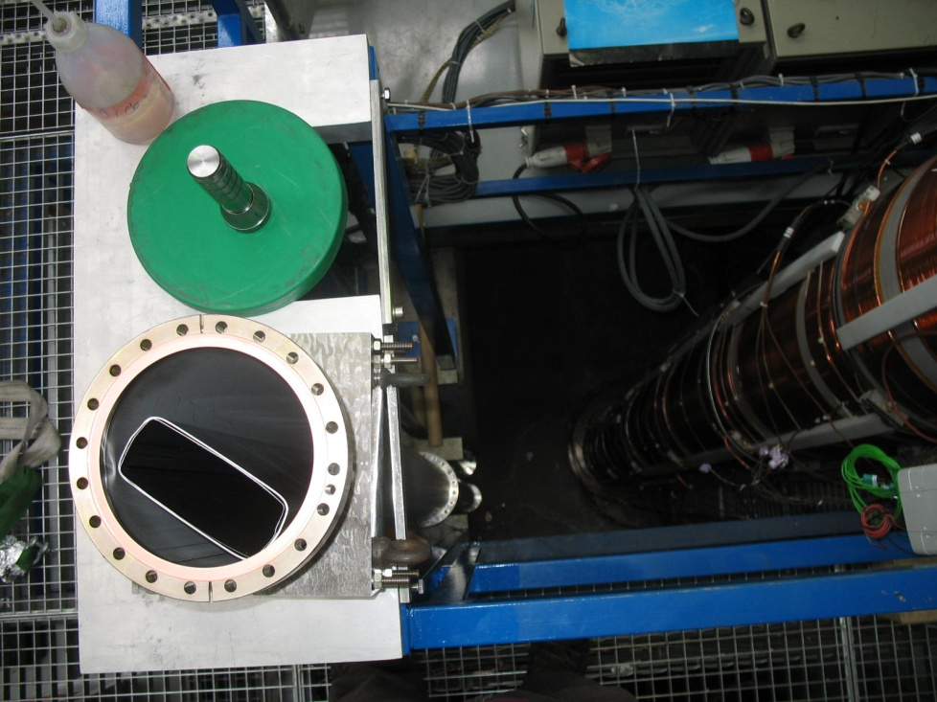
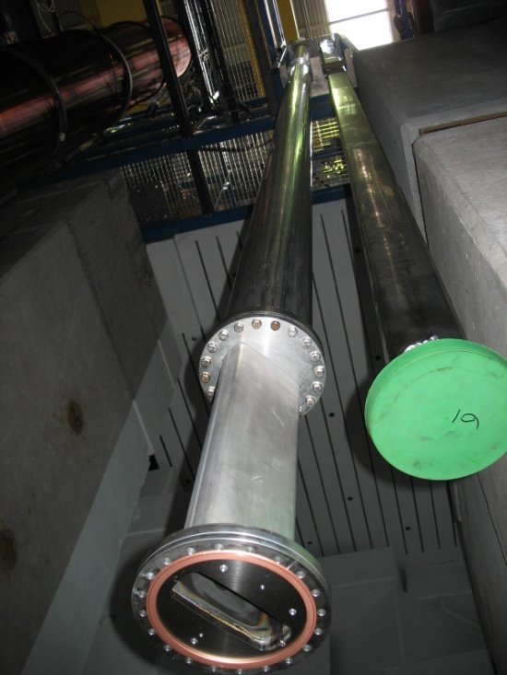
Coatings and coating systems
CHAMBER OUTSIDE MAGNET:
Magnetron sputtering (magnetic field by external solenoide)
External solenoide
Housing vacuum chamber
MBB vacuum chamber
Bottom extention with MBB crossection

Slide 4
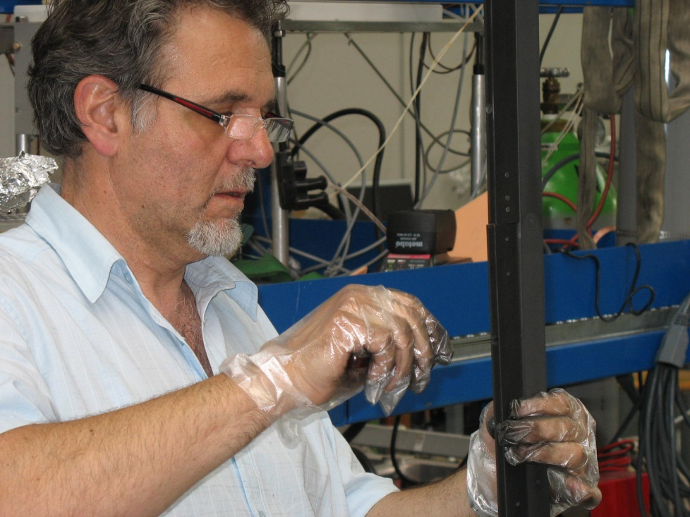
Coatings and coating systems
CHAMBER OUTSIDE MAGNET:
Magnetron sputtering (magnetic field by external solenoide)
Rectangular graphite cathode 60mm wide and 7400 mm long (built from 30x1000 mm pieces)

Slide 5
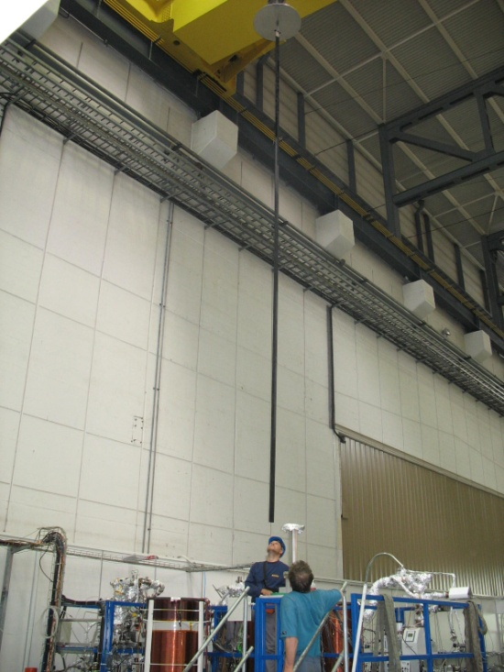
Coatings and coating systems
CHAMBER OUTSIDE MAGNET:
Magnetron sputtering (magnetic field by external solenoide)
Rectangular graphite cathode 60mm wide and 7400 mm long (built from 30x1000 mm pieces)

Slide 6
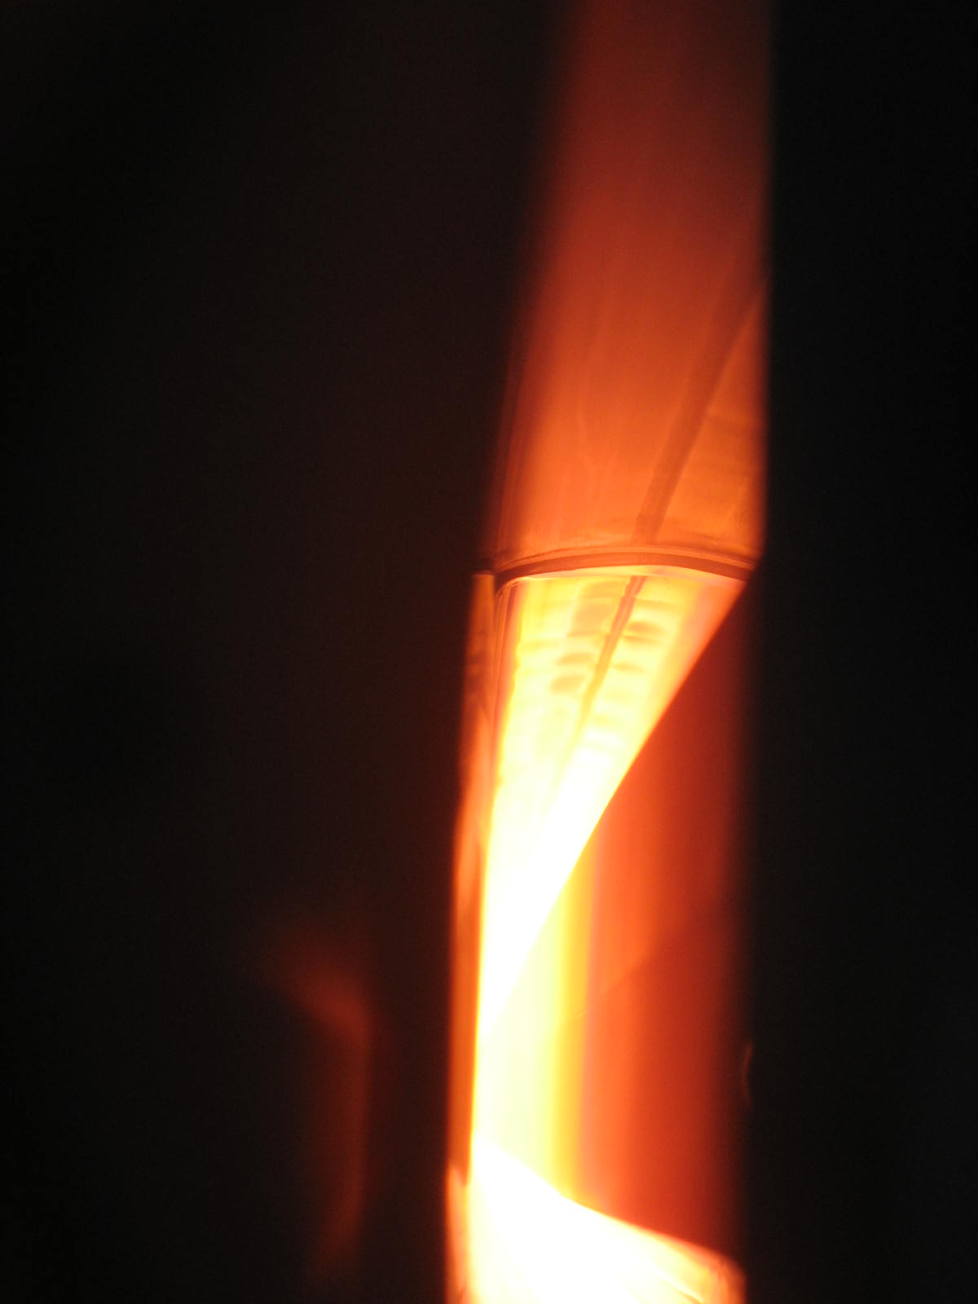
Coatings and coating systems
CHAMBER OUTSIDE MAGNET:
Magnetron sputtering (magnetic field by external solenoide)
Rectangular graphite cathode 60mm wide and 7400 mm long (built from 30x1000 mm pieces)
Very stable and uniform discharge
Substrate temperature ~230ºC
Good thickness uniformity

Slide 7
Coatings and coating systems
CHAMBER OUTSIDE MAGNET:
Magnetron sputtering (magnetic field by external solenoide)
Rectangular graphite cathode 60mm wide and 7400 mm long (built from 30x1000 mm pieces)
Very stable and uniform discharge
Substrate temperature ~230ºC
Good thickness uniformity
SEY~1.0 after coating. No ageing after 70 days in N2.

Slide 8
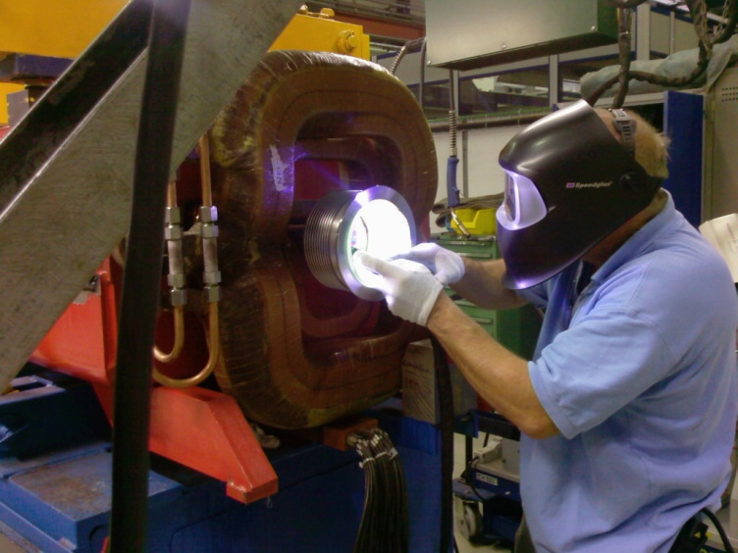
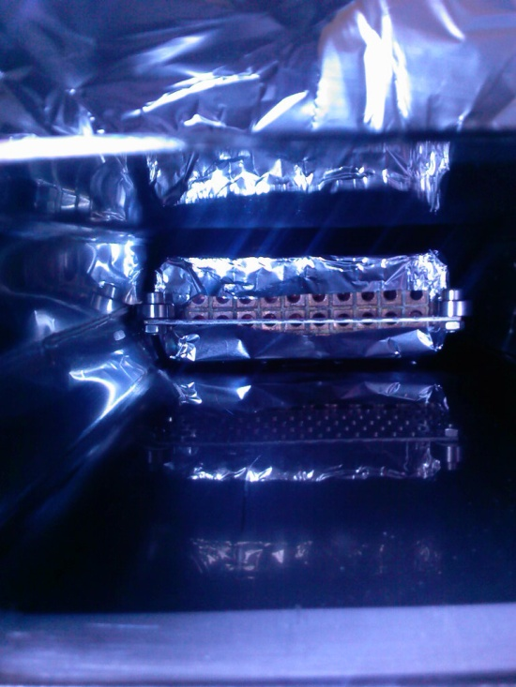
Coatings and coating systems
CHAMBER OUTSIDE MAGNET:
Magnetron sputtering (magnetic field by external solenoide)
Rectangular graphite cathode 60mm wide and 7400 mm long (built from 30x1000 mm pieces)
Very stable and uniform discharge
Substrate temperature ~230ºC
Good thickness uniformity
SEY~1.0 after coating. No ageing after 70 days in N2. NO AGEING AFTER MBB ASSEMBLING

Slide 9
Coatings and coating systems
CHAMBER OUTSIDE MAGNET:
Magnetron sputtering (magnetic field by external solenoide)
Rectangular graphite cathode 60mm wide and 7400 mm long (built from 30x1000 mm pieces)
Very stable and uniform discharge
Substrate temperature ~230ºC
Good thickness uniformity
SEY~1.0 after coating. No ageing after 70 days in N2. NO AGEING AFTER MBB ASSEMBLING

Slide 10
Coatings and coating systems
CHAMBER OUTSIDE MAGNET:
Magnetron sputtering (magnetic field by external solenoide)
Conclusions
Coating the tubes outside the magnets works
Installation in the magnets do not pollute the chamber
The possibility to coat at high temperature is a plus
Weak point: fragile cathode
Next steps
Coat MBA tubes
Design a more robust cathode
Start the design of the large scale production system? (design office)

Slide 11
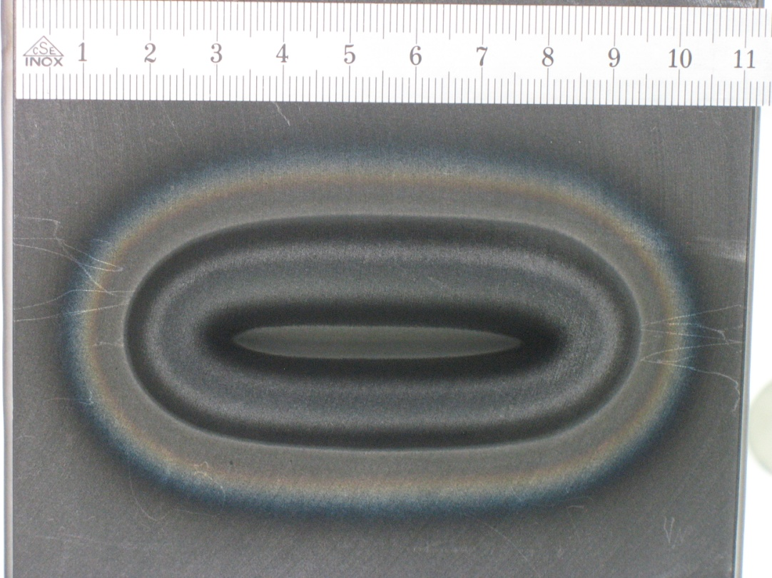
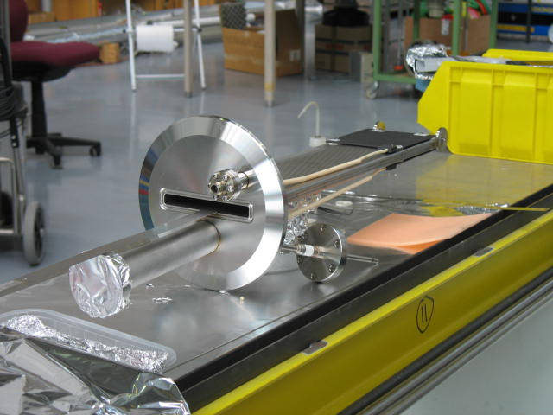
Coatings and coating systems
CHAMBER INTSIDE MAGNET:
Magnetron sputtering with permanent magnets
Graphite cathode
Slit to insert the permanent magnetic system
Magnetic circuit and cathode erosion

Slide 12
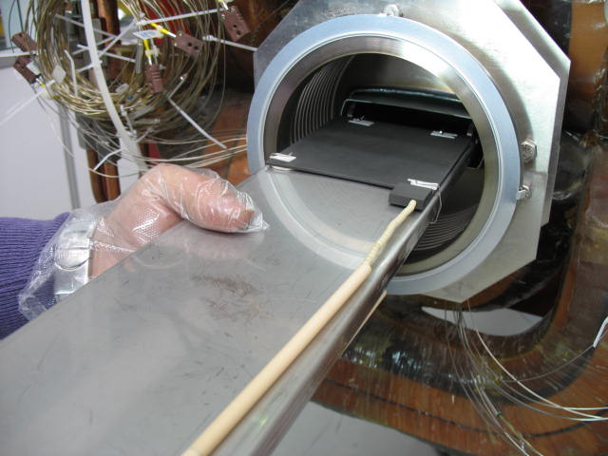
Coatings and coating systems
CHAMBER INTSIDE MAGNET:
Magnetron sputtering with permanent magnets
Magnetic circuit and cathode erosion

Slide 13
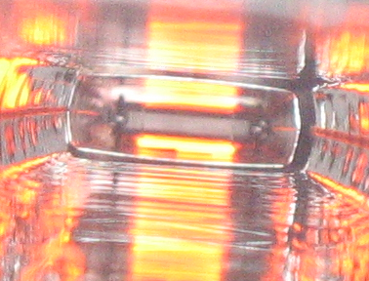
Coatings and coating systems
CHAMBER INTSIDE MAGNET:
Magnetron sputtering with permanent magnets
Graphite cathodes
plasmas
Magnetic circuit and cathode erosion

Slide 14
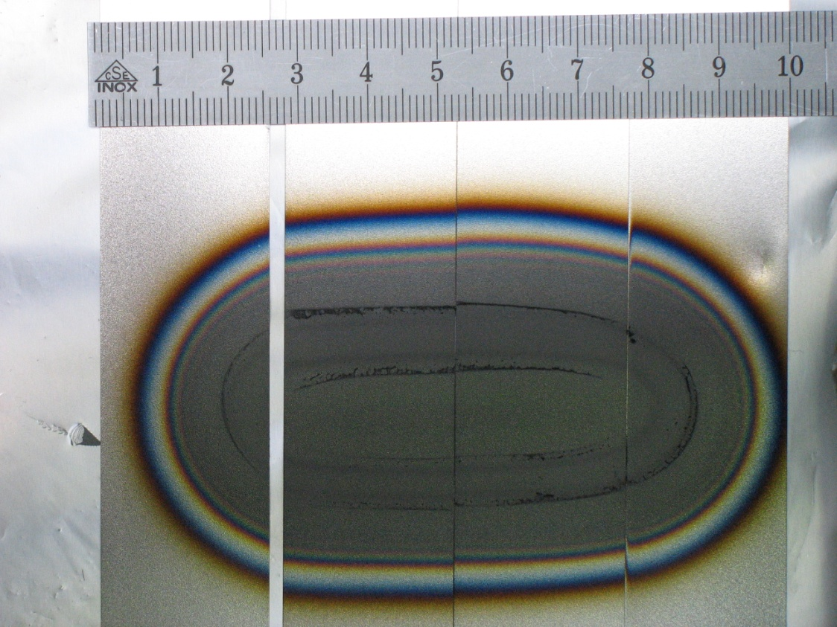
Coatings and coating systems
CHAMBER INTSIDE MAGNET:
Magnetron sputtering with permanent magnets
Relief
sample
Magnetic circuit and cathode erosion

Slide 15
Coatings and coating systems
CHAMBER INTSIDE MAGNET:
Magnetron sputtering with permanent magnets
Relief: fractal like: due to ion bombardment during coating?
SEY:
0.98 after coating;
1.05 after 3.5 months in lab (Al foil)
sample
Magnetic circuit and cathode erosion
How to avoid this relief?
Avoid localized ion bombardment by displacing the magnetic system

Slide 16
Coatings and coating systems
CHAMBER INTSIDE MAGNET:
Magnetron sputtering with permanent magnets
Conclusions
Magnetron sputtering with permanent magnets is promising
Low ageing (due to ion bombardment?)
If we master the relief, it is worth to invest in a longer prototype
Next steps
Coating with constant displacement of the magnetic system
Built and test a 1 meter long prototype
If it works, build a 6.4 meter long prototype.

