Slide 1
Insertion of 2 MBB with new coated vacuum chambers during technical stop week 35
J. Bauche for the SPSU study group, 24 June 2010

Slide 2
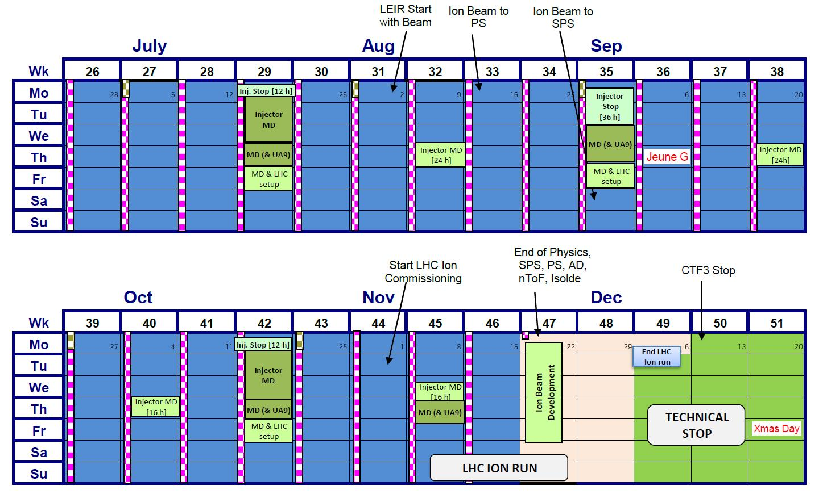
Accelerator Schedule v1.7
Access 19/07 from 8:00 to 20:00
Access from 30/08 - 8:00 to 31/08 - 20:00

Slide 3
Magnet exchanges for coating during TS week 35
Uncoated magnet
‘Old’ coated magnet
‘New’ coated magnet
51530
51550
60270
60290
Waterleak

Slide 4
Summary of magnet exchanges foreseen during TS week 35
Chronology | Position | Magnet IN | Magnet OUT | Motivation | Status
1 | 60290 | MBB 096 | MBB 273 | Magnet maintenance + SPSU - test 'old' coating | Magnet removal needed (waterleak) - Magnet insertion proposed
2 | 60270 | MBB 085 | MBB 057 | SPSU - test 'old' coating | Proposed
3 | 51530 | MBB 289 | MBB 085 | SPSU - test 'new' coating | Confirmed
4 | 51550 | MBB 015 | MBB 096 | SPSU - test 'new' coating | Confirmed
1 | 13210 | QF 052 | QF 027 | Magnet maintenance | Needed (waterleak)
2 | 53310 | QD 159 | QD 182 | Magnet maintenance | TBC after repair during TS W29
3 | … | … | … | Magnet maintenance | TBC if no more breakdowns until then…

