Slide 1
Summary of ageing (increase of SEY) observations
Christina Yin Vallgren
TE-VSC
SPS-U team
2010-09-23

Slide 2
Summary of the coating configurations
Tube configuration. (lab samples for SEY investigation and vacuum characterization)
Liner configuration. (lab samples, SPS mobile sample)
MBB in-situ. (first MBB magnet coating in 2009)
MBB in liner configuration. (new MBB magnet coating 2010)

Slide 3
Location of the coatings for aging:
There are four main cases at the moment:
Lab situation
Ageing of samples in various controlled atmospheres.
SPS situation
Ageing of the liner.
Ageing of the MBB coating.
Ageing of mobile samples.

Slide 4
1. Ageing in a controlled atmosphere
Experimental procedures: storage in various atmosphere
Stored directly in polymer box: direct air contact. (not interesting for SPS, only for understanding what happens)
Wrapped with Al foil.
Stored in desiccators: dry air. (not interesting for SPS, only for understanding what happens)
Stored in static vacuum. (skip to save time/money: N2 is believed to be nmore relevant from experience of NEG storage)
Stored in N2.
Water vapor. . (not interesting for SPS, only for understanding what happens)
Some tests have already been done and we already have preliminary results, we need more tests to get more statistics.
Ageing between the coating done in liner configuration and in tube configuration seems to be different. => more investigation is ongoing.

Slide 5
2. Results on ageing of the liner
Currently, we have the results from:
ECM: CNe13 liner has been tested under operation in the SPS since Aug, 2008. No ageing is observed. Still in SPS
C-strip (has been tested during 5 MD runs): no ageing effect could been seen in ECM and in the samples cut and measured in the lab. Initial: 0.92, after 1 year in the SPS: 0.96 (after the extraction from SPS, transferred through air to the lab)
3 new a-C liners (used in the SPS in 2010) have now been cut. SEY will be done soon.
Conclusion about the liner: no sign of aging

Slide 6
3. Results on ageing of the first MBB coating (done in the dipole)
The measurements, which have been done so far:
Dynamic pressure rise measurements.
The dynamic pressure rise between the StSt MBBs and the coated MBBs shows no significant difference (static pressure is generally higher in coated)
RF transmission measurements
They show lower signal related to e-cloud in coated MBB than uncoated
No direct ECM measurements can be done.

Slide 7
3. Results for ageing of the first MBB coating (in the dipole)
MB040 has been cut open and inspected.
Initial SEY: 1.00
After 1 year operation and long term air exposure after the extraction from the SPS: 1.33.
The three witness samples which were stored in the pumping port (see the vacuum but not the beam) showed 1.30 after few months.
Clearly worse than the liners.

Slide 8
The different ageing between the liner and the MBB coating in-situ
High temperature during the deposition makes a-C more graphitic, rougher.. (more discussion can be found in the plan-to-published paper about a-C coatings.)
Different coatings => different ageing.

Slide 9
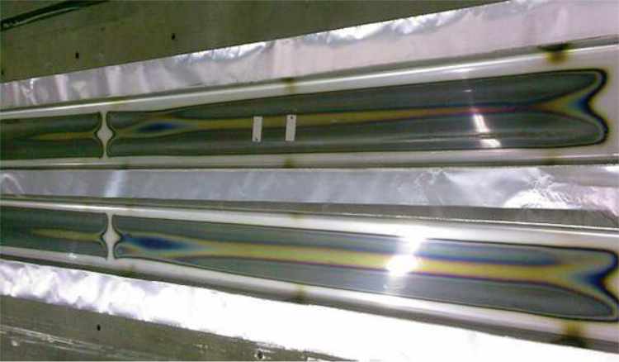
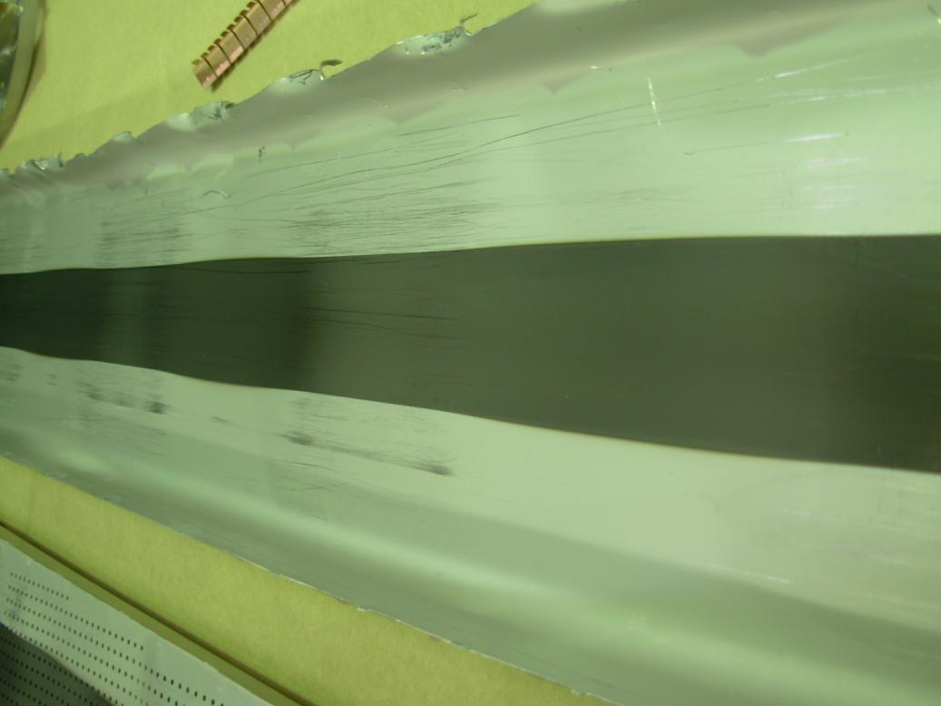
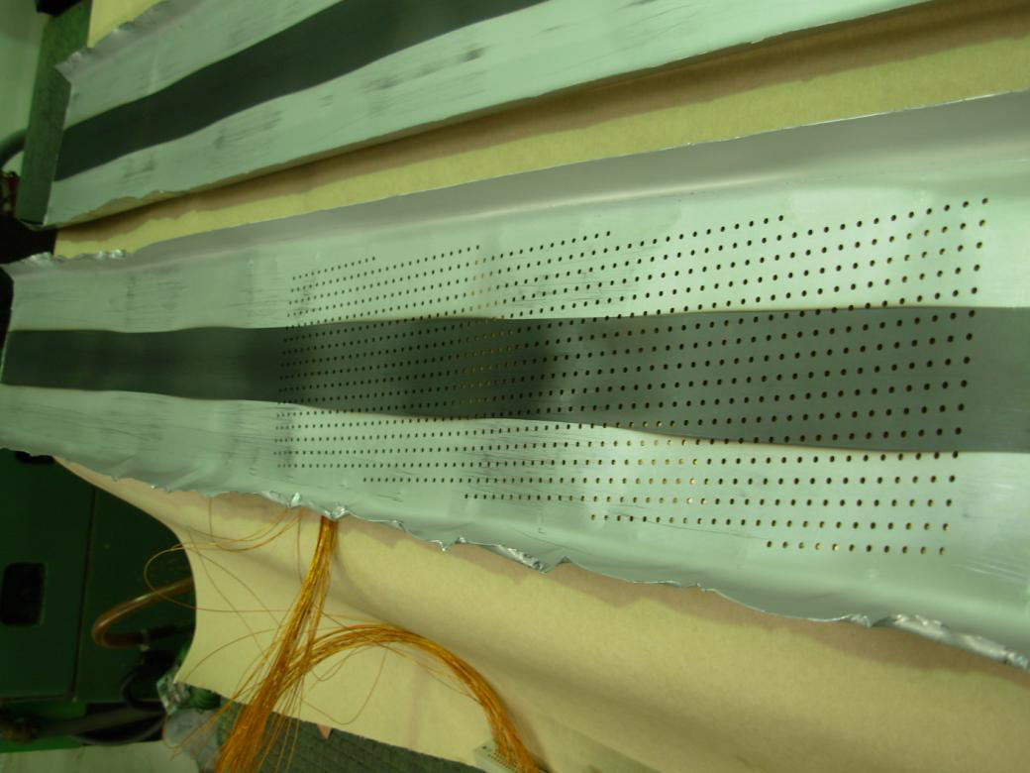
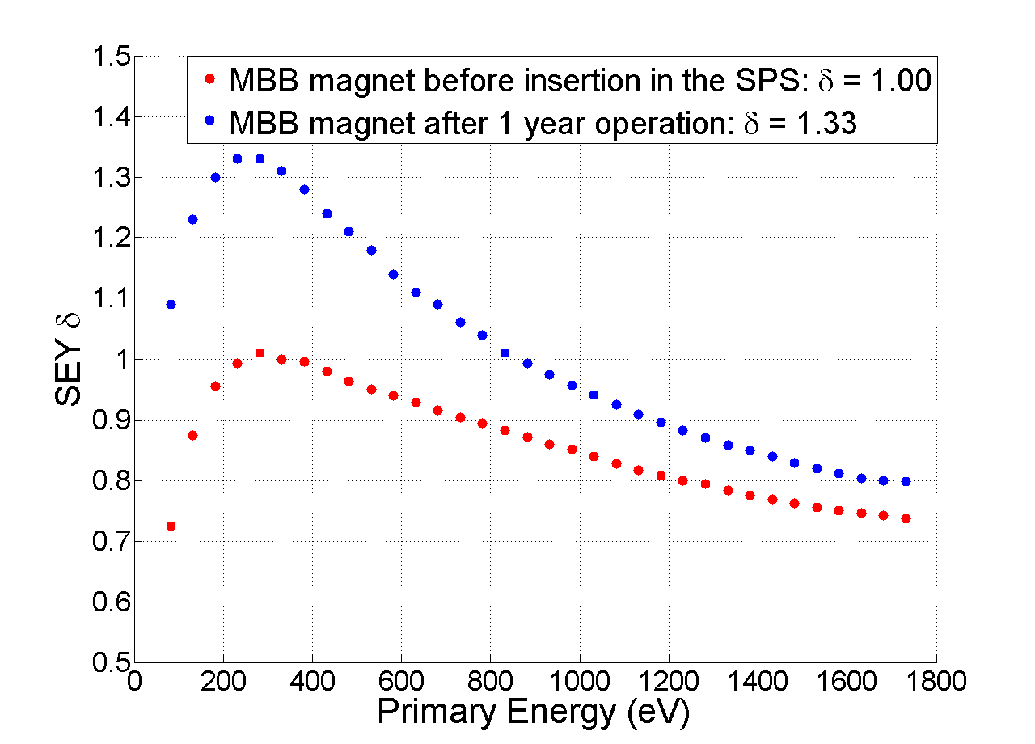
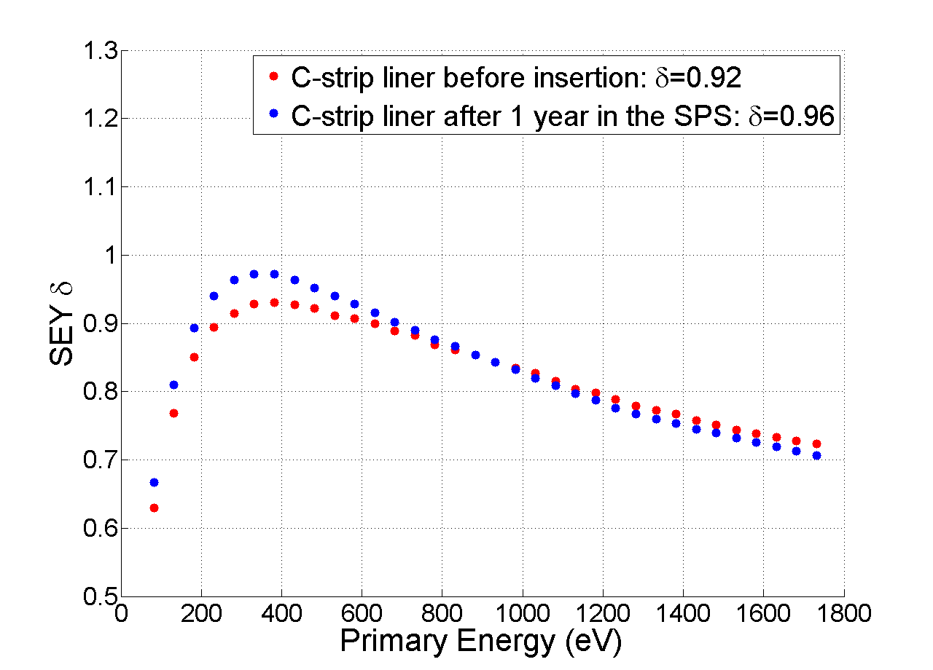
The different ageing between the strip liner and the MBB coating in-situ
MBB coating in-situ
C-strip liner

Slide 10
4. Results on ageing of mobile samples
Three mobile samples have been tested in the SPS:
StSt, inserted after cleaning
a-C1, exposed to air after coating for 2 months before insertion
a-C2, inserted few days after coating

Slide 11
4. Results on ageing of mobile samples
StSt

Slide 12
4. Results on ageing of mobile samples
2.a-C1

Slide 13
4. Results on ageing of mobile samples
3.a-C2

Slide 14
4. Results on ageing of mobile samples
StSt mobile sample:
E-cloud occurred in the chamber.
Conditioning due to the electron cloud bombardment can be seen in the central part of the sample.
Lower SEY (1.5) in the middle and higher SEY (>2.0) at the edges. As expected.
This experiment was also used to confirm the minimum coating width to suppress e-cloud in the SPS.

Slide 15
4. Results on ageing of mobile samples
a-C1 mobile sample:
Higher SEY (1.5) in the center and lower SEY (1.3) at the edges
Possible explanation: A high SEY is probably due to e-cloud bombardment on an aged a-C + active surface in bad vacuum (1e-4 mbar static vacuum during the transport) => increase of SEY.
This can be confirmed with experiment in the lab:
Procedure in the lab: (Plan)
Take an aged a-C sample.
Electron-bombard the surface with the same dose, calculated from ECM of StSt in the SPS (4e-3C/mm2).
Leave the sample in an unbaked-bad-vacuum (choose loadlock in the XPS).
Recheck the SEY.

Slide 16
4. Ageing of mobile samples
a-C2 mobile sample:
Low SEY (1.0) in the center and higher SEY (1.1-1.3) at the edges.
Difference compared to the previous case: e-cloud bombardment on a fresh a-C
This can be confirmed with experiment in the lab:
Procedure in the lab: (done)
Take a fresh a-C sample.
Electron-bombard the surface with the same dose, calculated from ECM of StSt in the SPS (4e-3C/mm2).
Leave the sample in an unbaked-bad-vacuum (choose loadlock in the XPS).
Recheck the SEY.
Results: No change in SEY.

Slide 17
Proposal for aging studies of a-C SEY: From Mauro and Pedro I
Which aging environment:
1. air with Al-foil as protection (case of dipole with vented chamber in the tunnel)
2. filling with N2 (storage of chambers prepared in advance)
3. SPS vacuum: how to address the problem?
If we store in a pumping port it will not see the beam: it is not the real situation.
The best is to have again liners ad see how they evolve or to put one or more coated sheets in a dipole (if it is accepted for aperture and so on)
We will have statistics on reproducibility of production and aging altogether

Slide 18
Proposal for aging studies of a-C SEY from Mauro and Pedro : II
For each coating run x 10 runs
SEY meas
Store in air
in Al foil 3 months
SEY meas
Store in air
in Al foil 6 months
SEY meas
Store in N2
3 months
SEY meas
Store in N2
6 months
50 samples and
10 containers
if we put 3/6 months together
SEY meas
SPS case to be decided?

