Slide 1
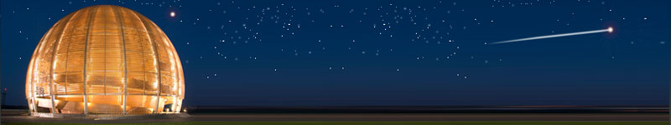
Heavy-ion desorption yields of amorphous carbon films bombarded with 4.2 MeV/u lead ions at LINAC3
Edgar Mahner, Donat Holzer, CERN
Technology Department, Vacuum, Surfaces and Coatings Group
Introduction
  Electron cloud, mitigation, SPS requirements
Thin film coating of amorphous carbon
  Surface morphology, secondary electron yield, outgassing rate
LINAC3 ion desorption results
  Experimental setup, yield measurements, overview of results
Conclusions

Slide 2
Electron cloud, mitigation, SPS requirements
Electron cloud
  The electron cloud effect, its impact on particle accelerators, and mitigation techniques have been intensively studied in many laboratories worldwide. Recent development work, ongoing and proposed research work can be found in
    ECM’08 (Electron Cloud Mitigation) Workshop, CERN, 20-21 Nov. 2008
    AEC’09 (Anti e-Cloud Coatings) Workshop, CERN, 12-13 Oct. 2009
Mitigation
  Possible mitigation techniques for present/future machines (e.g. PS2 at CERN) are grooved vacuum chambers, clearing electrodes, and coatings such as amorphous carbon (a-C), TiZrV (NEG), and TiN.
  At CERN, electron cloud studies are presently focused on the production and characterization of a-C coatings motivated by the SPS upgrade and the PS2 design.
Requirements
  The secondary electron yield (SEY) of the vacuum chamber is the most important parameter, SEY < 1.3 is necessary for the SPS for electron cloud suppression
  Beam pipe aperture reduction must be as small as possible, solution applicable to the existing stainless steel vacuum chambers inside 6.5 m long magnets, good vacuum properties (comparable outgassing to stainless steel) needed, no bakeout possibility in the SPS, no ageing (increase of SEY with time) after venting to air, long term stability.
  No pressure rise/desorption yield data are available for heavy ion interactions with a-C
  Considered as important information prior to the SPS coating (all magnets chambers) and for the upgrade/design of existing/future accelerator vacuum systems.

Slide 3
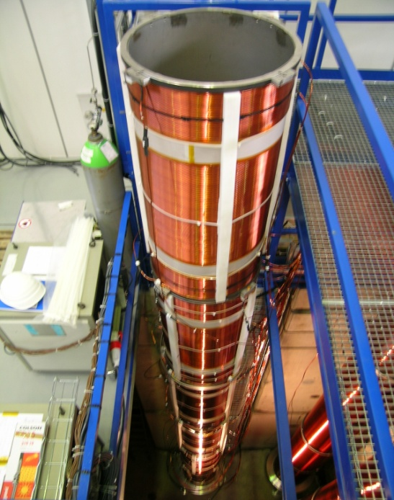
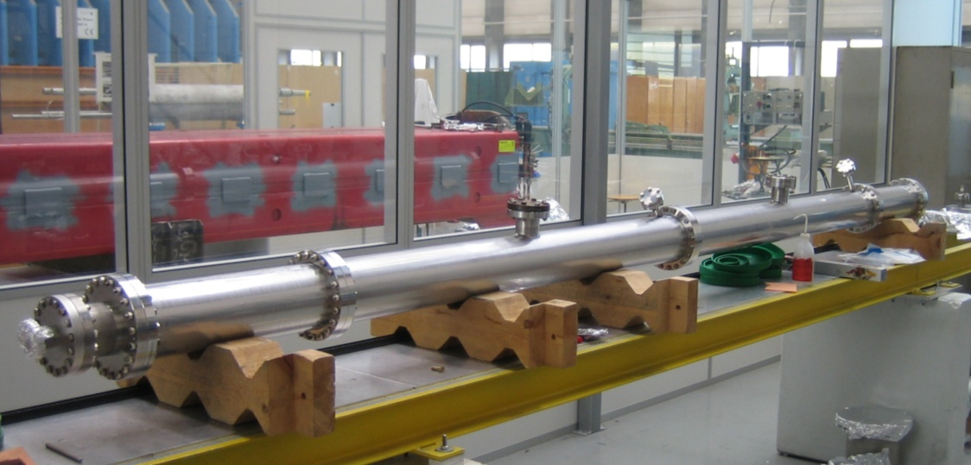
Thin film coating by DC magnetron sputtering
Graphite
rod
+
noble gas ion
Electron
C atom
+
+
+
+
+
+
+
-700V_{DC}
B-field
Sputter parameter for CNe63 (LINAC 3 chambers)
I = 1.71 A, U = -833 V, p = 1 x 10⁻² Torr (Ne)
  Cathode length: 4.8 m
    Sputter duration: 48 h
    Thickness: 510 nm
    SEY: δ_{max} = 0.93 (two samples)

Slide 4
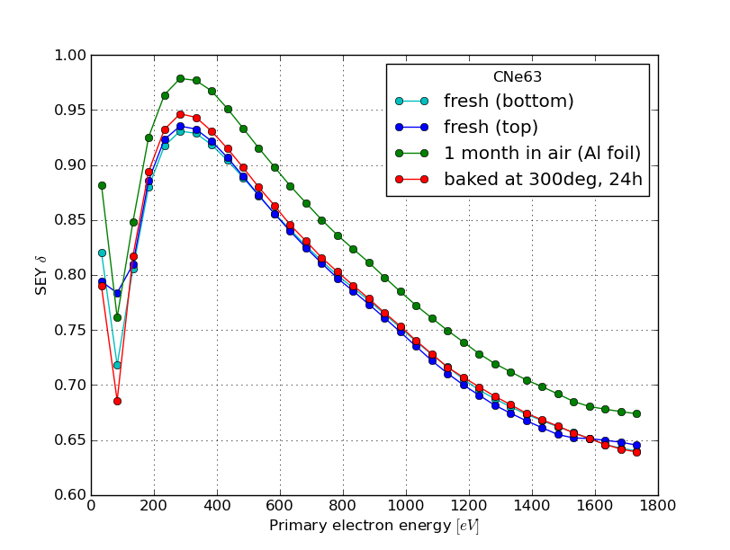
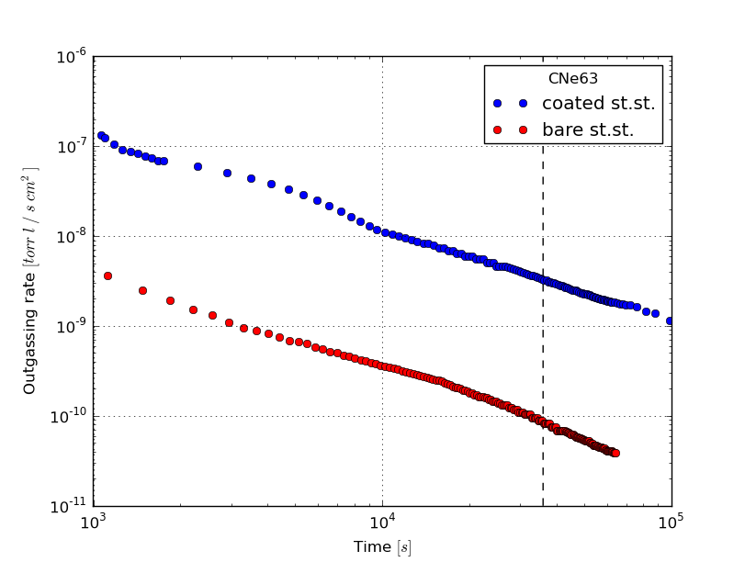
Secondary Electron Yield, Outgassing Rate
Secondary Electron Yield
δmax = 0.93 (new)
δmax = 0.98 (1 month in air)
δmax = 0.95 (1 month in air; 300°C, 24 h)
SEY < 1 very well suited for SPS application
Outgassing Rate (water vapour)
Q (coating,10 h) = 3.3 x 10⁻⁹ Torr.l.s⁻¹.cm⁻²
Q (bare st.st., 10 h) = 8.9 x 10⁻¹¹ Torr.l.s⁻¹.cm⁻²
A factor of ≈40 higher outgassing rate after 10 h of pumping, needs further studies for improvement

Slide 5
Surface morphology
LINAC3 chamber: compact film, good adhesion, no loose particles, thickness 510 nm

Slide 6
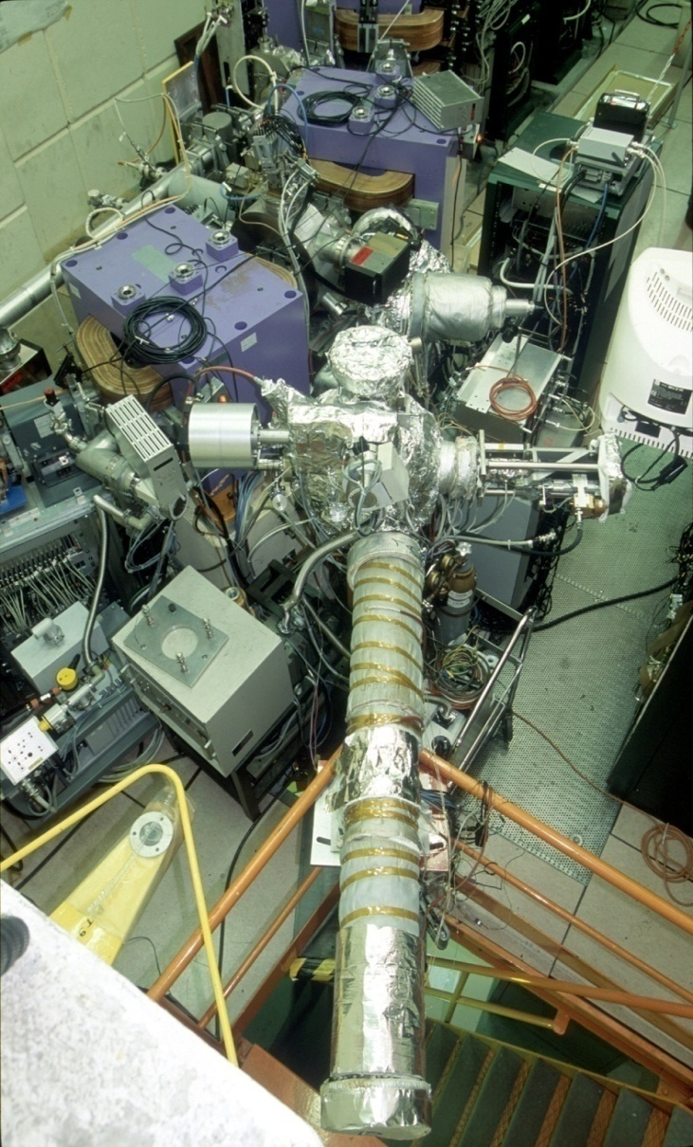
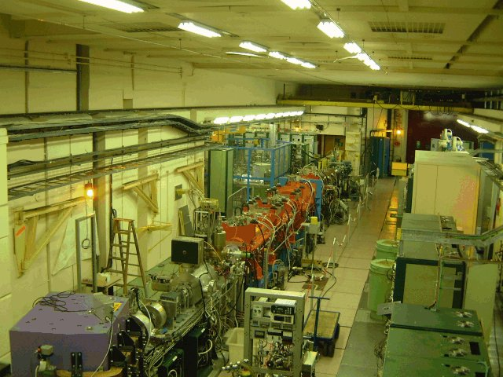
Dynamic vacuum studies of a-C in LINAC3
More information in PRST-AB 11, 104801 (2008), CERN AB Seminar (27.11.2008)
J. Hansen et al., CERN Report No. LHC/VAC-TN-2001-07 (2001).
E. M. et al., EPAC 2002, p 2568; PRST-AB 6, 013201 (2003);
PRST-AB 8, 053201 (2005).
ECR source
Low energy line
(2.5 keV/u)
Filter line
Stripper
IH Linac
RFQ
4.2 MeV/u
Medium energy line
(250 keV/u)
Particles: 1.5 × 10⁹ Pb⁵³⁺ or 10¹⁰ Pb²⁷⁺ @ 4.2 MeVu
Repetition time: 1.2 s
Impact angles studied: θ = 89.2°
Experiments since November 2000

Slide 7
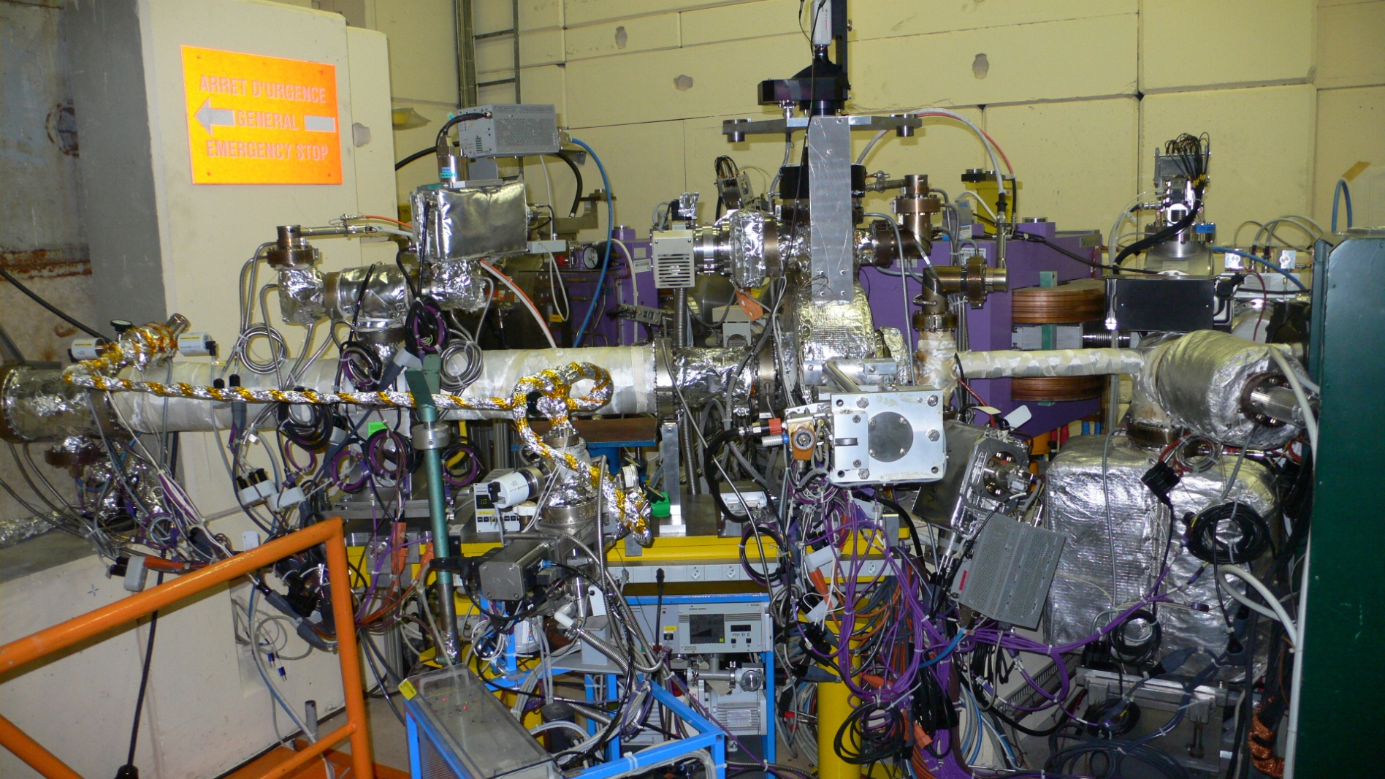
Experimental setup at CERN-LINAC3
Bakeable UHV system with 2 RGA’s, 2 BAG’s, gas injection system, MTV, full control of the linac
Static pressure: low 10⁻¹¹ Torr, Target: vacuum chamber (L = 1400 mm, ID 145 mm)
Projectiles: Pb⁵⁴⁺ ions with 4.2 MeV/u, impact angle: grazing or perpendicular

Slide 8
How do we measure desorption yields?
Pressure rise method
Beam cleaning (scrubbing)
4.2 MeV/u Pb²⁷⁺/ Pb⁵³⁺
single shots continuous bombardement
E. M., Phys. Rev. ST-AB 6, 013201 (2003)

Slide 9
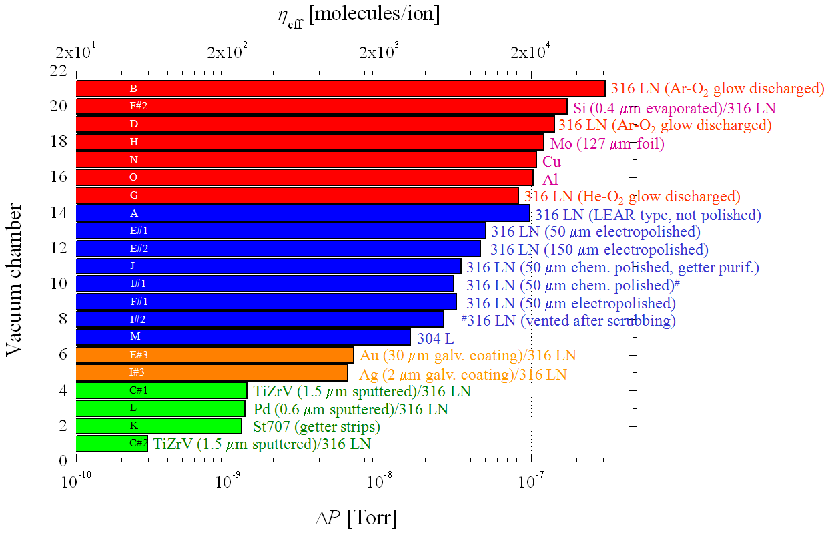
Summary of LINAC 3 data
21 different surfaces (15 different vacuum chambers)
Pb⁵³⁺, 4.2 MeV/u, grazing angle impact
E. M., Phys. Rev. ST-AB 11, 104801 (2008)

Slide 10
Desorption Yield of a-C after bakeout at 300ºC (24 h)
Pb⁵⁴⁺ @ 4.2 MeV/u, θ = 89.2°
CNe63/st.st., 300°C (24 h)
η = 6.9 x 10⁵ molecules/ion

Slide 11
Desorption Yield of a-C not baked
Pb⁵⁴⁺ @ 4.2 MeV/u, θ = 89.2°
CNe63/st.st., not baked
η = 4.6 x 10⁶ molecules/ion

Slide 12
Desorption Yield of a-C after bakeout at 150ºC (24 h)
Pb⁵⁴⁺ @ 4.2 MeV/u, θ = 89.2°
CNe63/st.st., 150°C (24 h)
η = 2.2 x 10⁶ molecules/ion

Slide 13
Comparison carbon coated – bare stainless steel

Slide 14
Review of heavy-ion induced desorption data
new data
a-C
E. M., Phys. Rev. ST-AB 11, 104801 (2008)

Slide 15
Energy scaling of the desorption yield
…is difficult since we have no theory and no data…
Very preliminary analysis
FLUKA simulation made by Helmut Vincke (SC/RP)
Unclear if η scales at SPS energies with dE/dx or not
Needs more simulations and experimental verification
Beam time proposal made to study a-C coatings with ions and protons at HiRadMat

Slide 16
Conclusions
Heavy-ion desorption yields of amorphous carbon
  First experiments with 4.2 MeV/u Pb ions at LINAC3 demonstrated very high yields.
  Desorption is dominated by CO2, CO, and H2 molecules.
  High desorption yields pose no problem for the SPS coating decision if lead ion losses are in a local SPS position far away from critical accelerator equipment as septa, kicker, and cavities.
MD proposal for the 2010 SPS heavy-ion run
  First in situ SPS pressure rise measurement with an orbit bump (discussed with Django) to lose 1-4 bunches of the Early Ion Beam (1.2 x 10⁸ ions/bunch) in an a-C coated SPS dipole magnet (position 51480). Or even take the Nominal Ion Beam with 52 bunches? The potential damage/activation should be investigated before.
Acknowledgements
  I want to acknowledge the "Carbon Coating Team" of the CERN VSC group, the members of the SPS Upgrade Study Team and the LINAC3 team for their excellent support and many fruitful discussions. The shown results are based on their dedicated work. The collaboration with the GSI material science and vacuum groups is also highly appreciated, as well as the FLUKA simulations by Helmut Vincke.

Slide 17
Spares

Slide 18
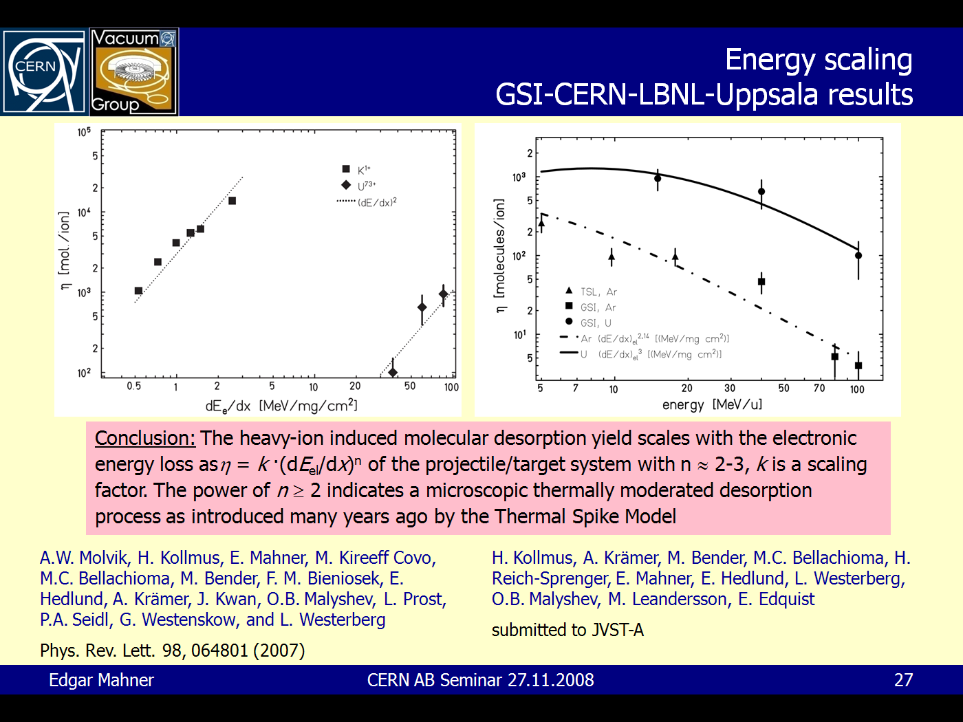
Spares

Slide 19
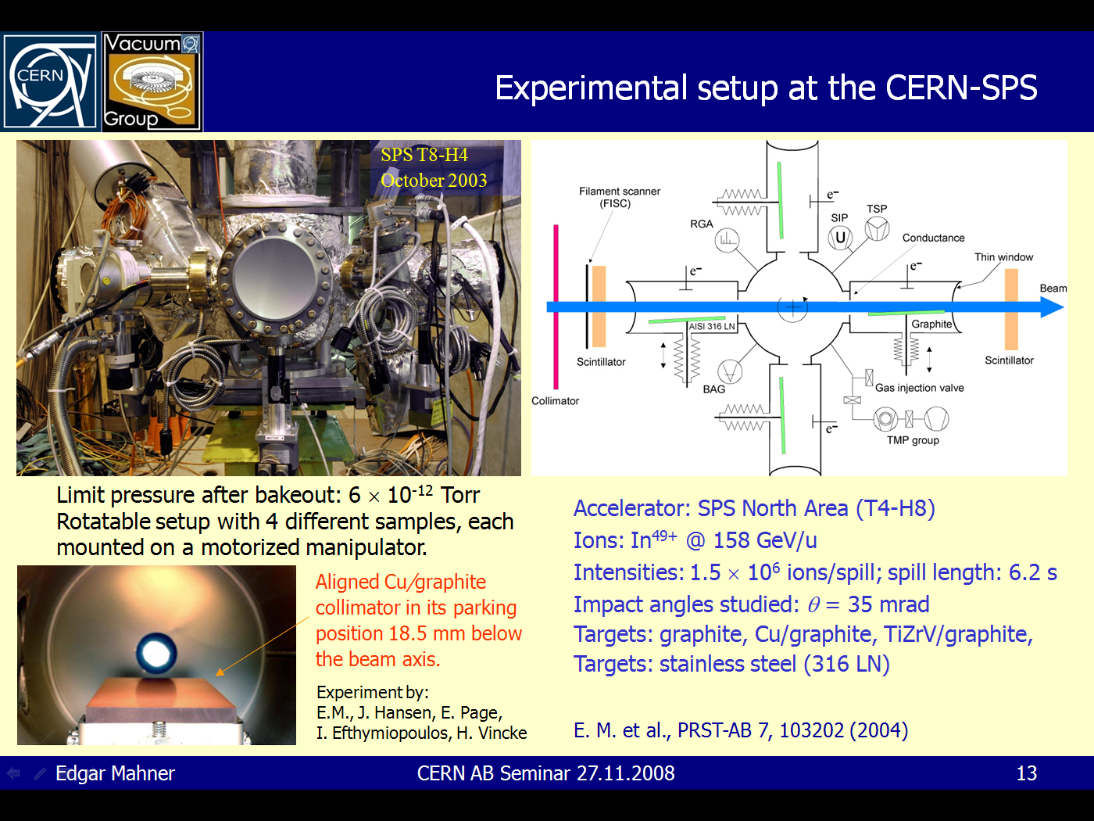
Spares

