Slide 1
Summary of SPS MDrun week35
SPS-U meeting 2010-09-23
Christina Yin Vallgren
SPS-U team

Slide 2
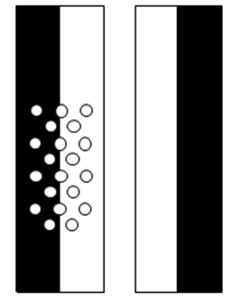
Summary
3 Nov 09:00 – 4 Nov 07:00
3 Nov 11:00 – 3 Nov 20:00: 1-4x36, 50 ns
3 Nov 21:00 – 4 Nov 07:00: 1-4x72, 25 ns
ECM liners: DLC, CNe70 half coated, CNe13 and Ref StSt.
MBB magnets: 3 new coated MBB

Slide 3
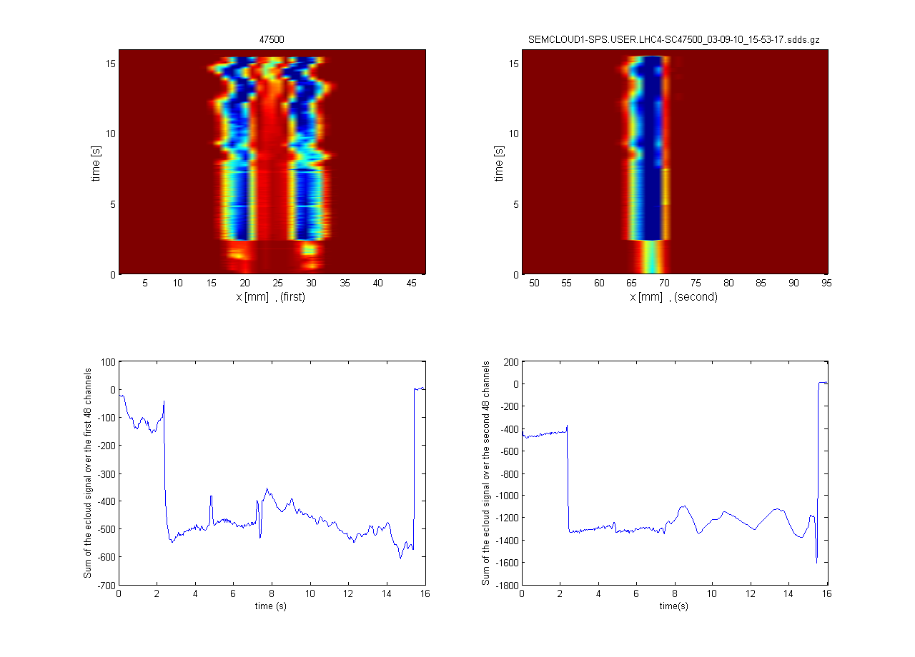
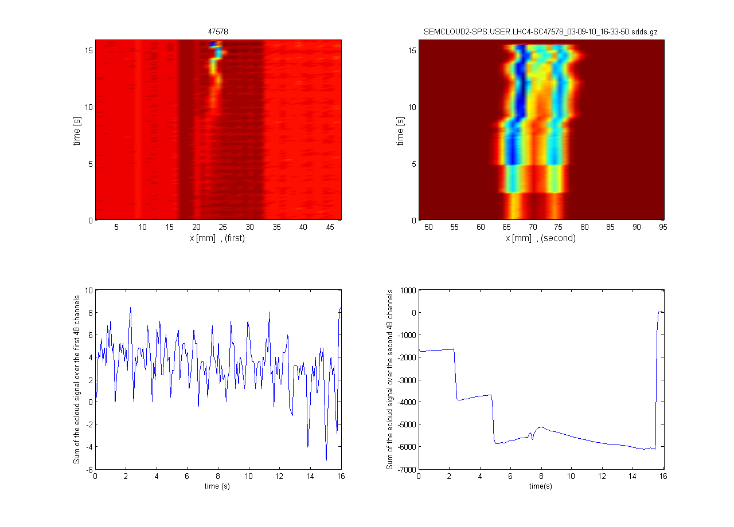
Observe:
Half coated liner gives half e-cloud! Sharp edge! This means: coating => completely suppress e-cloud.
Three stripes on ECM. Did the magnet have 25 A? Check the magnet next time!
DLC
CNe70 half coated
CNe13
StSt

Slide 4
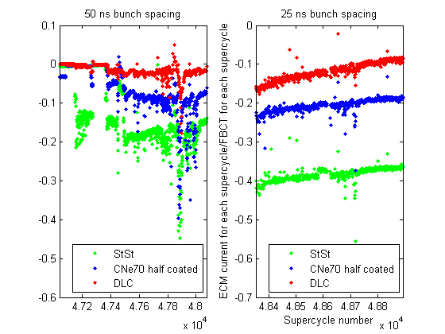
Summary:
CNe70 half coated v.s StSt:
half coated => half e-cloud
DLC: SEY = 1.8
StSt: SEY = 2.25
Low SEY => Low e-cloud
DLC conditions very fast.
From -0.2 to -0.1 after one night scrubbing with 25 ns 4x72 LHC nominal beam.
StSt 50 ns v.s StSt 25 ns
The difference: a factor of 3-5.
The same as the earlier experimental results.

Slide 5
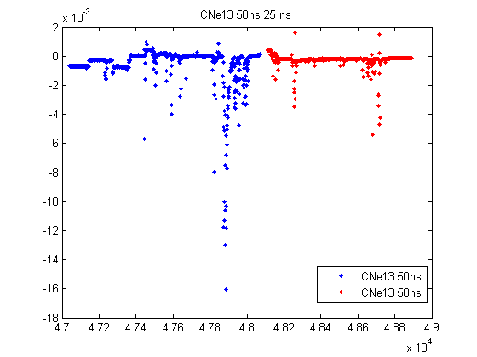
Summary:
CNe 13 liner:
Has been in the SPS since Oct, 2008.
No ageing effect at all!

Slide 6
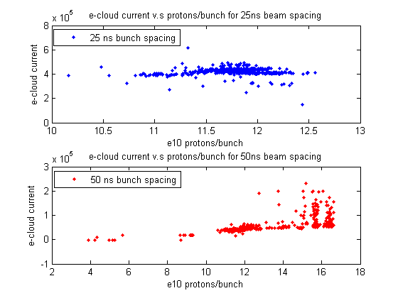
Summary: e-cloud current for each supercycle as a function of beam intensity (protons/bunch)
4x72 with 25 ns bunch spacing:
No clear linear correlation saying that the e-cloud signal increases with increasing of beam intensity.
10 times higher e-cloud signal with 25 ns than 50 ns.
4x36 with 50 ns bunch spacing:
A weak tendency: e-cloud signal increases with increasing of beam intensity. (A big scattering?)
Giovanni:
E-cloud signal decreases with increasing of beam intensity?
Maybe?
No clear proof for it yet!

