Slide 1
News from aging of SPS liner samples
SEY meeting 2010-10-06
Christina Yin Vallgren

Slide 2
Inspection of five liners extracted from the SPS
Liner | SPS operation time | δ _{initial}
StSt (Ref) | 1 year (5 MD runs) | 2.25
C-strip | 1 year (5 MD runs) | 0.92
C-Zr | 1.5 years (9 MD runs) | 0.95
CNe64 | 3 months (2 MD runs) | 0.95
CNe65 | 3 months (2 MD runs) | 0.95

Slide 3
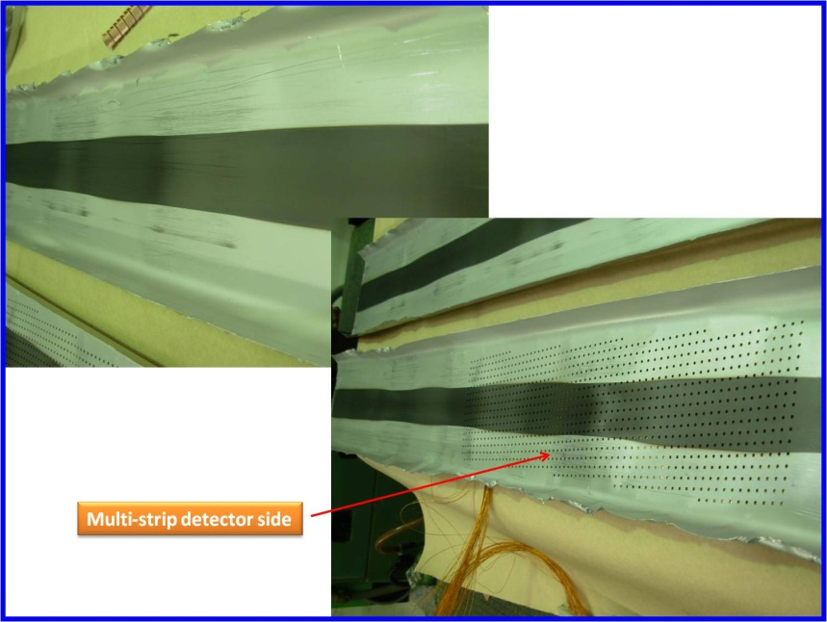
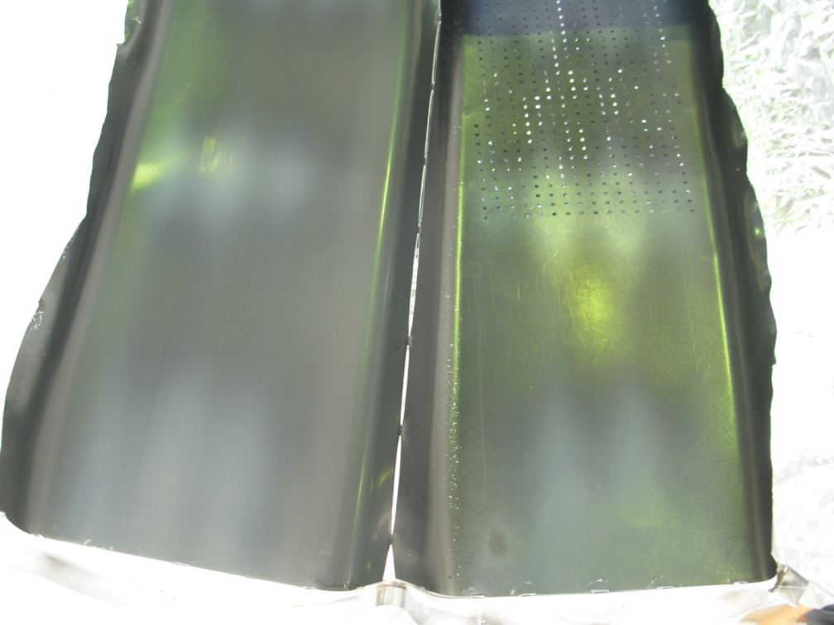
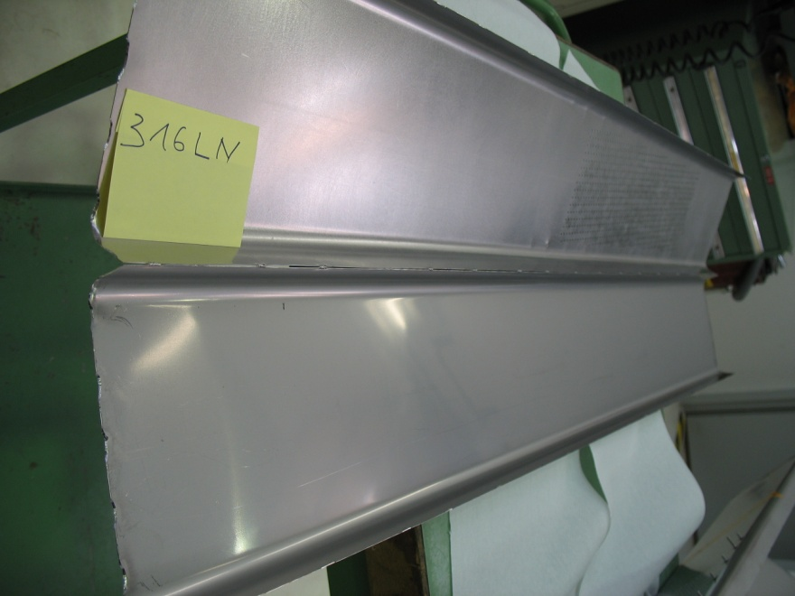
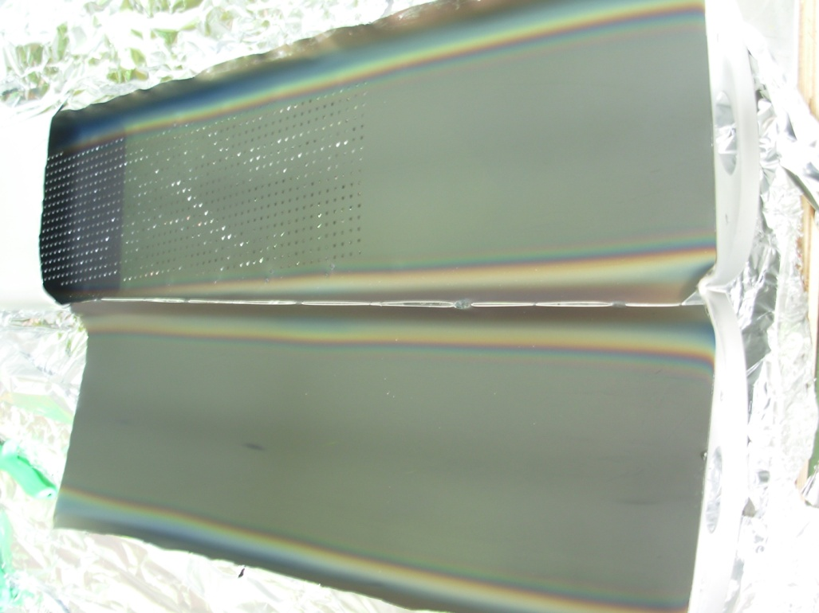
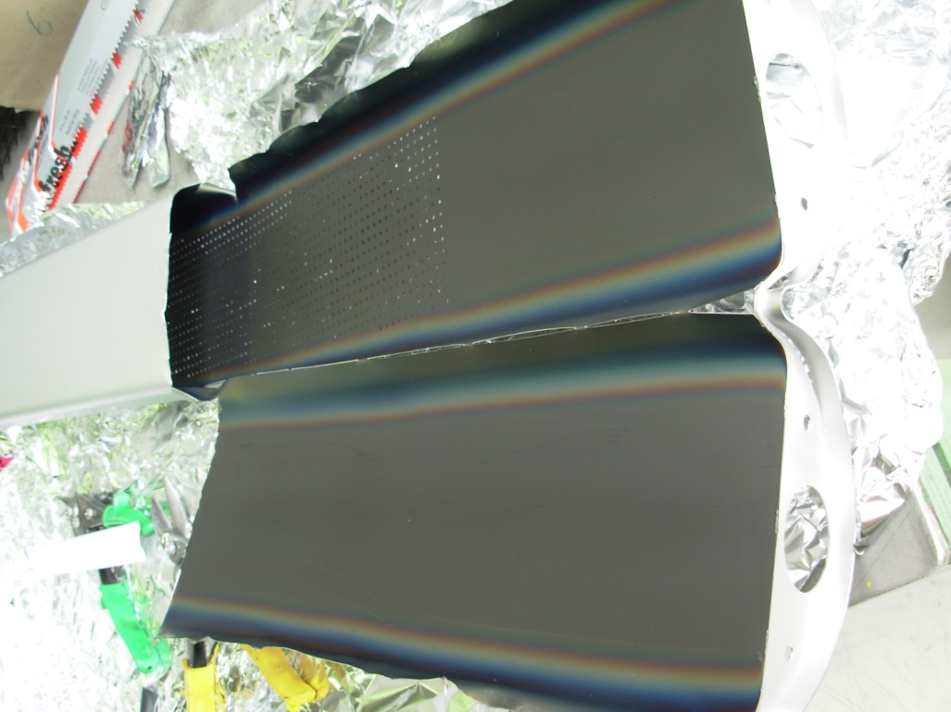
C-strip
C-Zr
a-C on rough Zr coating
For confirming necessity of coating width
Stainless Steel
Reference
CNe64
a-C number 64
CNe65
a-C number 65

Slide 4
Three New extracted liners: C-Zr, CNe64, CNe65

Slide 5
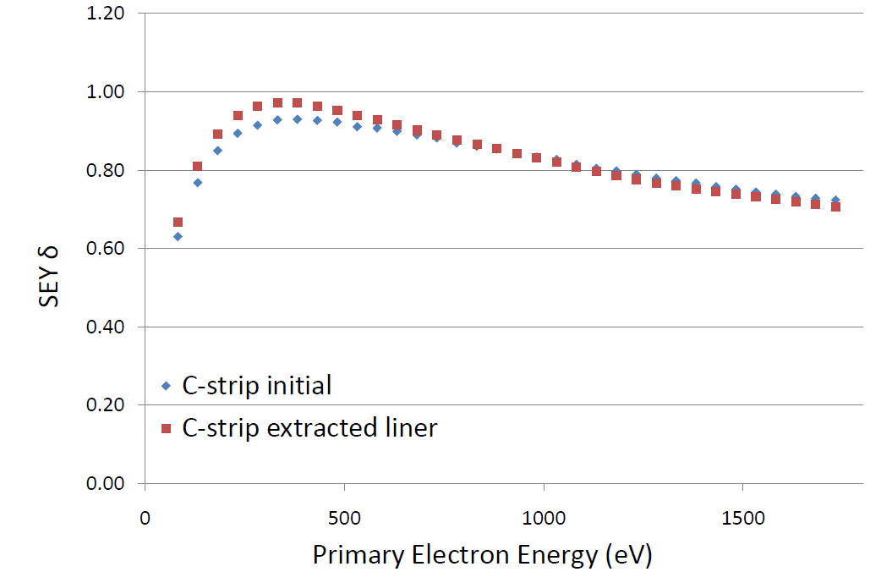
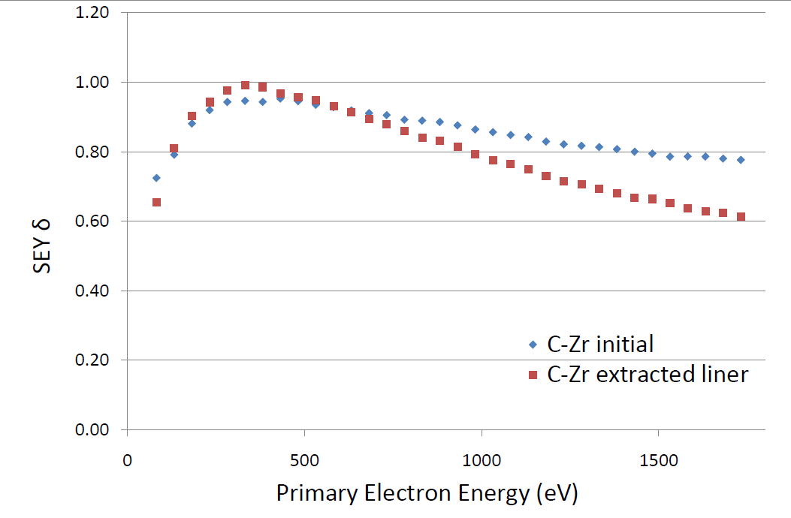
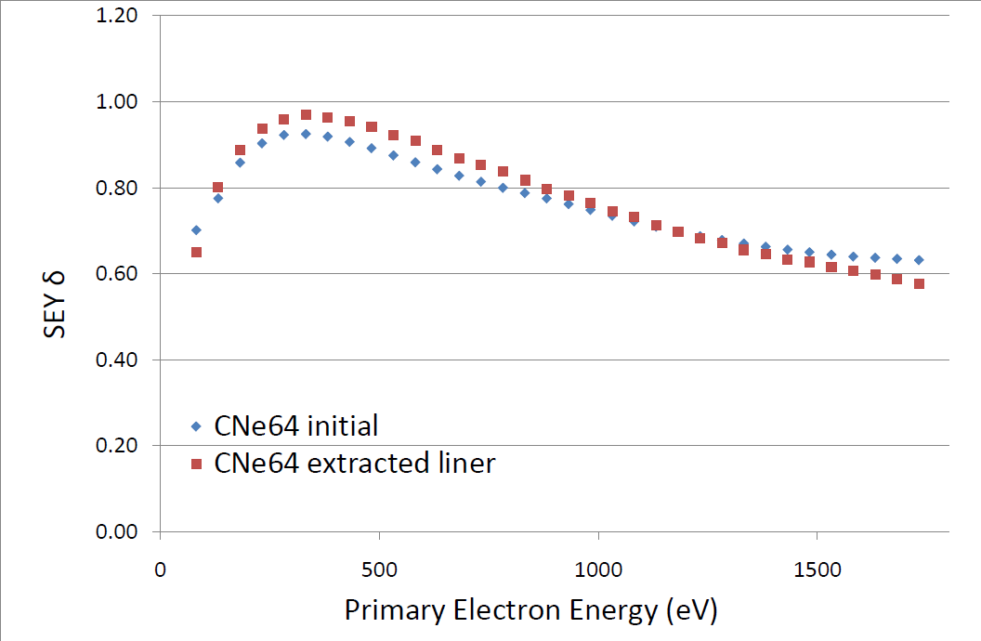
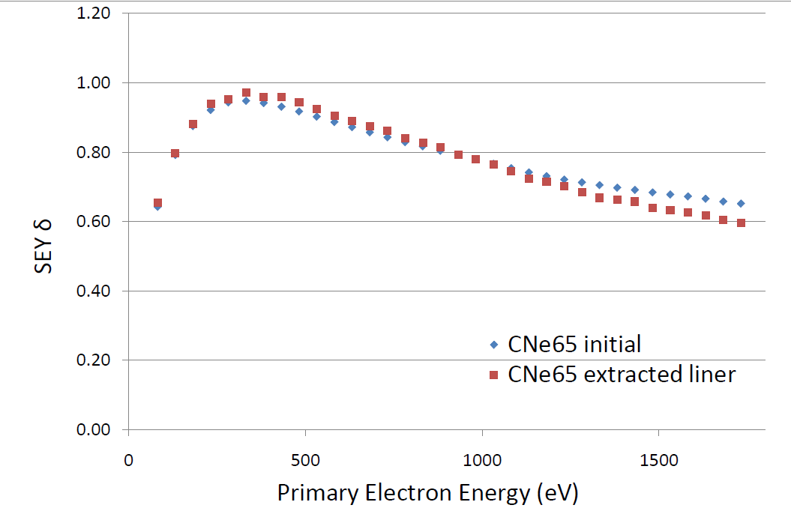
Summary: five extracted liners

