Slide 1
HEATING AND OUTGASSING OF SPS KICKERS: MD OF WEEK 17
M.J. BARNES (TE/ABT/FPS)
Acknowledgements:
L. Ducimetière, V. Mertens, V. Senaj

Slide 2
SCHEMATIC OF SPS & LHC ACCELERATORS SHOWING KICKER MAGNETS
SPS:
7 kicker installations;
19 kicker magnets;
with ~32m of magnetic material.

Slide 3
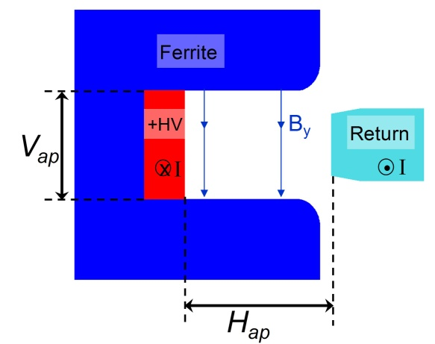
Summary for SPS Kicker Magnets

Slide 4
MKE: Longitudinal Real Impedance
The measurement data for Longitudinal Real Coupling Impedance, without serigraphy, is in reasonable agreement with the analytical approach (CERN-SL-2000-04 AP, by H. Tsutsui):– although the measurements are generally lower (to 1 GHz) than the analytical approach.
“Spikes” starting from a frequency of ~0.45 GHz when serigraphy is NOT applied: these spikes are suppressed by the serigraphy. However the serigraphy results in a high impedance spike at ~50 MHz (due to external circuit).

Slide 5
MKE6: MD of Apr 28 to Apr 29 2010
Interlocked by MKE4
Max temperature rise of ~12˚C (~8˚C, c.f. 20:00hrs, from 5:00hrs onwards);
Significant out-gassing starts at ~22:00hrs (BCT value=2);
Conditioning takes place and generally remains during MD.
Next slide

Slide 6
MKE6: MD of Apr 28 to Apr 29 2010
S3 shows highest pressure rise of ~2.7e-7mbar!!;
(Rapid) out-gassing follows SPS cycle;
Out-gassing increases with increasing intensity (e.g. at 22:30hrs when BCT 2->3).

Slide 7
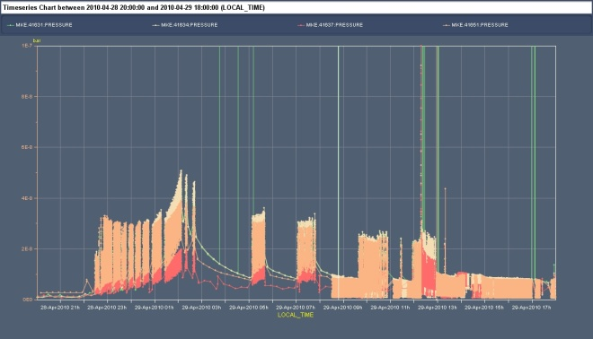
MKE4: MD of Apr 28 to Apr 29 2010
Interlocked
~5 hrs
Timber shows large noise spikes: Vacuum’s PVSS does not… (to be investigated further)
Max temperature rise of ~35˚C;
Significant out-gassing starts at ~22:30hrs (BCT->4);
Pressure goes up substantially after ~01:00hrs: probably due to temperature (55˚C reading) – so, in future, make high intensity MD while magnet is “cool”.

Slide 8
MKE4: MD of Apr 28 to Apr 29 2010
Vacuum gauge not working
S4 shows lowest pressure rise;
Highest pressure rise is ~3.2e-8mbar, i.e. almost an order of magnitude LESS than MKE6-(serigraphed);
(Rapid) out-gassing follows SPS cycle;
Out-gassing increases with increasing intensity (e.g. at 22:50hrs when BCT 3->4).

Slide 9
MKP: MD of Apr 28 to Apr 29 2010
Beam
TIDVG
QDA 11910
MKP1
MKP2
MKP3
MKP4
11931: 5 mags.
100mm x 61mm
Temp. probe
11936: 5 mags.
100mm x 61mm
Temp. probe (not correctly logged)
11952: 2 mags.
100mm x 61mm
11955: 4 mags.
140mm x 54mm
6 ˚C
Real longitudinal impedance is similar for MKP (theoretical) & shielded MKE (measured) up to ~600MHz.
Temperature rise of ~6˚C (~8˚C for [shielded] MKE6 to “steady-state”);

Slide 10
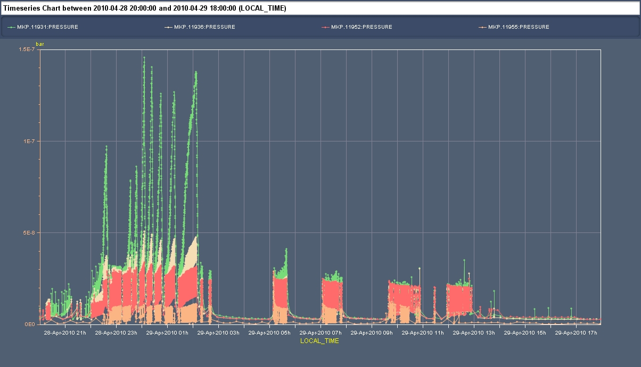
MKP: MD of Apr 28 to Apr 29 2010
Beam
TIDVG
QDA 11910
MKP1
MKP2
MKP3
MKP4
11931: 5 mags.
100mm x 61mm
Temp. probe
11936: 5 mags.
100mm x 61mm
Temp. probe (not correctly logged)
11952: 2 mags.
100mm x 61mm
11955: 4 mags.
140mm x 54mm
6 “slowly rising” peaks are caused by inject & dump on to TIDVG (near to MKP1)
All MKP magnets show similar pressure rise;
Highest pressure rise is ~3.2e-8mbar, i.e. similar to MKE4 & almost an order of magnitude LESS than MKE6.
(Rapid) out-gassing follows SPS cycle & increases with increasing intensity .

Slide 11
MKDV Temperature & Pressure for 12, 13 & 14th August 2008
8s resolution:
Note: Ecloud monitors show maximum Ecloud with 25ns bunch spacing.
Normally: MKDV1 temperature>MKDV2 and pressure < 6e-8 mbar (as per 25ns beam);
For 75ns beam MKDV2 temperature > MKDV1 and pressure < 6e-8 mbar;
For 50ns beam MKDV temperature is not an issue, but pressure is an issue!.
8s resolution for pressure.
Pressure < 6e-8 mbar (MKDV1 > MKDV2)

Slide 12
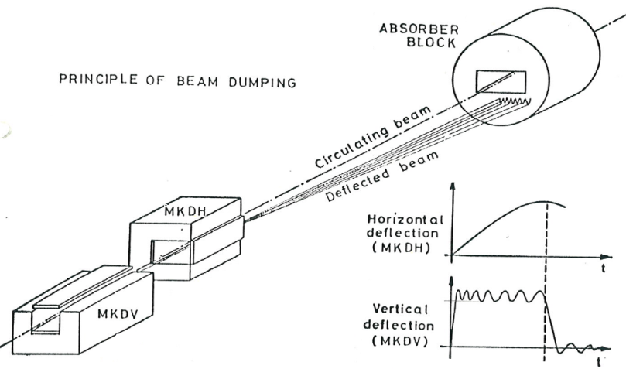
MKD: MD of Apr 28 to Apr 29 2010
(MKDH1/2/3)
(MKDV1/2)
MKDV1>MKDV2: MKDHs are low
MKDHs suddenly increase, why?...
All MKD magnets pressure generally < 2e-7mbar (< 2e-7mbar outside of period 23:20hrs to 23:35hrs);
(Rapid) out-gassing follows SPS cycle;
To do: compare above with out-gassing during August 2008 MD, with 25ns beam;
Highest pressure rise is MKDH1 (7e-7mbar) @ ~23:33hrs (dump?).

Slide 13
Conclusions
Carry out high intensity MDs before MKE4 magnets get hot, so as to avoid excessive out-gassing at high temperatures: temperature at PT100 sensors took ~5hrs to reach 70˚C (expected to be 3 to 4 hours with 4 batches) .
We may consider reducing temperature interlock from 70˚C to 55˚C to reduce chance of HV breakdown during such MDs??. -- temperature at PT100 sensors took ~4hrs to reach 55˚C;
Investigate if MKE6 (now serigraphed) exhibited such high out-gassing (10x MKE4), with 25ns bunch spacing, before all 3 magnets were serigraphed;
MKP magnets do not see to show significant heating (consistent with theoretical longitudinal real beam coupling impedance) or out-gassing (low out-gassing as per MKE4); are they good enough? Serigraphy is not applicable on MKD (too short cells -> HV problems).
Out-gassing of TIDVG graphite core during inject and dump (mainly a concern for adjacent MKP) – assembly in air and only 150° C bakeout – spare should be prepared using an improved bakeout procedure – add valves around to preserve conditioning during nearby vacuum interventions [see https://edms.cern.ch/document/1076008/1 ].
MKD magnets pressure < 2e-7mbar outside of period 23:20hrs to 23:35hrs (even with 4 batches) – MKDV1 (now has transition pieces) is slightly higher pressure than others. However MKDH1 shows high pressure (7e-7mbar) @ 23:33hrs (dump?) – needs further investigation. [Note that MKDH’s are laminated steel – thought to be not good for impedance].
More fully analyze April 2010 MD results (MKQH, MKQV. Compare MKE6 out-gassing with previous MDs) and make further MDs to get more complete picture.

Slide 14
SPS Longitudinal Impedance per Installation
MKE4 presently has significantly higher real longitudinal impedance than other SPS installations;
Serigraphy of the 5 MKE4 magnets will commence next “normal” (2010-2011) shutdown;
Plan is to replace one S and one L magnet at each SPS shutdown (using the normal operation year to convert the 2 spare magnets for the next shutdown) -- 3 shutdowns required!!
To accelerate serigraphy to 2 “normal” shutdowns, maybe buy another set of ferrite to prepare before the shutdown…..

Slide 15
Following slides were not presented but are included for completeness

Slide 16
Theoretical Real Longitudinal Beam Coupling Impedance, per Meter Length

Slide 17
MKE: Imaginary Longitudinal Beam Coupling Impedance

Slide 18
MKE: Imaginary Transverse Beam Coupling Impedance
Information re Transverse Impedance, and measurement techniques, can be found in:
Tom Kroyer’s presentation “Wire Measurements on the MKE Extraction Kicker Magnets” APC meeting 10/11/2006.
Shielding may increase transverse impedance at ~100MHz, but reduces transverse impedance above ~300MHz.

Slide 19
MKDH3: Imaginary Transverse Beam Coupling Impedance
Measurement
The real Transverse Dipolar Horizontal Impedance (TDHI) for MKDH3, derived from measurements, is shown. The theory is very different to the measurements, but theoretical calculations are only available assuming a ferrite core, and not for a laminated steel core.
Note: impedance per meter length of MKDH3
Imaginary
Theory
For comparison
Plot: courtesy of Benoit Salvant
Note: impedance per MKDH3
Real

Slide 20
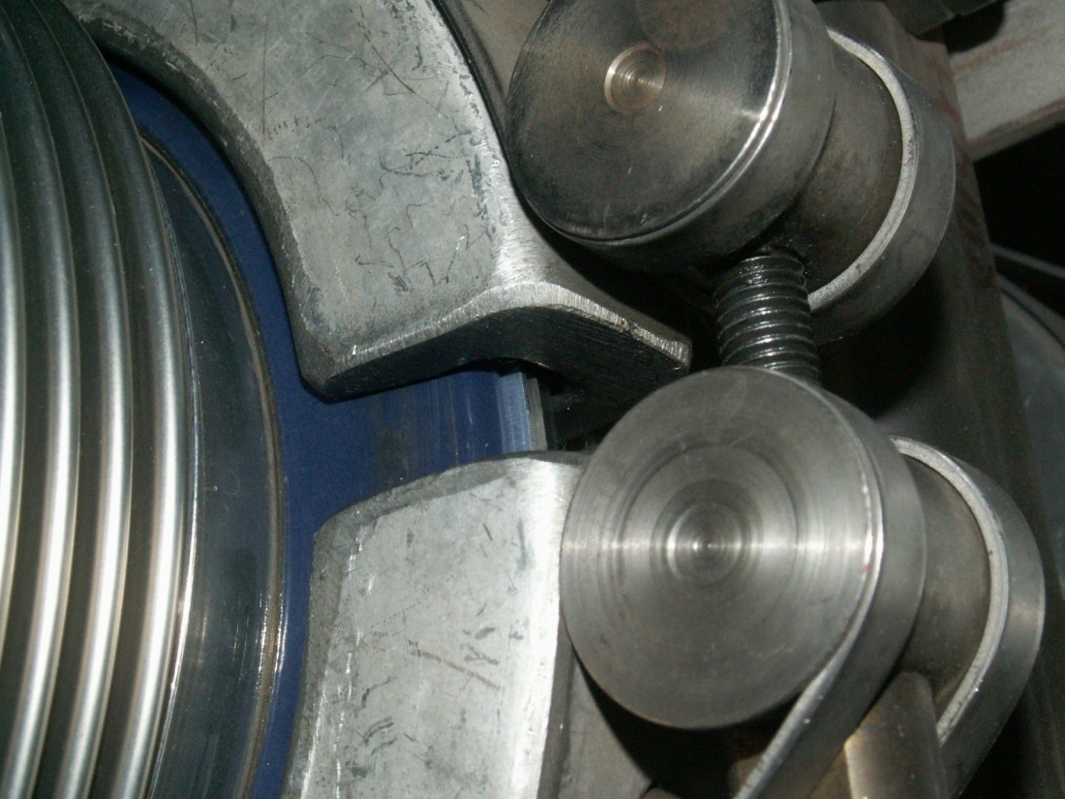
Enameled Flanges in Beam Pipe
There are several enameled flanges installed in-between bellows near some SPS kicker magnets (e.g. there is one enameled flange at MKE6 and several at MKDV/MKDH). These flanges break the (DC) electrical conductivity of the beam pipe connection between adjacent flanges.
Enameled Flange
Fritz Caspers confirmed that enameled flanges similar to these exist in the PS and, as a remedy, RF bypasses have been installed. See: https://edms.cern.ch/document/434204/1

Slide 21
Impedance Situation
All three MKE6 magnets now have serigraphed 8C-11 ferrites;
Serigraphy of the 5 MKE4 magnets will commence next “normal” (2010-2011) shutdown;
  Plan is to replace one S and one L magnet at each SPS shutdown (using the normal operation year to convert the 2 spare magnets for the next shutdown) -- 3 shutdowns required!!
  BUT potential problem of converting 2 spare magnets during operation: if problem is encountered with an installed magnet, there may not be an available spare.
MKDV:
  Transition pieces suppress the spikes in the RLCI of MKDV1 and thus are expected to reduce heating of ferrite of MKDV2 with 75 ns bunch spacing;
  Transition pieces may also reduce fast out-gassing. MDs, especially with 50 ns bunch spacing, will prove or disprove this;
  It is planned to install transition pieces for MKDV2 (MKDV1 installed in early 2009 has transition pieces). However we only have a spare MKDV1 (Vap=75mm, c.f. 83mm for MKDV2) – (Note: G. Arduini recommends that a spare MKDV1 is NOT used in place of MKDV2 [email to E. Chapochnikova, dated 17 October 2008]);
  Radiation level for MKDV2; transition pieces could be installed during “normal” shutdown (following 1 to 2 month cool-down) – BUT available manpower would not allow this to be carried out together with more MKE4 work than just swapping 2 magnets.
MKDH:
  Transition pieces to be installed, but spare only for MKDH3 (largest MKDH aperture);
  MKDH: The measured RLCI and TDHI are very different to theory: this is probably due to the theory using parameters for a ferrite core and not for a laminated (0.35mm) steel core
  MKDH uses laminated steel yokes – is a new dump system required (long term) without laminations?..
MKQH: MD data not presented here. Has non-ideal impedance measures implemented -> problems (HV, rise time).
Enameled flanges: check how many are installed in the SPS ….

Slide 22
Impedance Understanding & Reduction
Short-term:
Do systematic & comprehensive measurements for all kickers in or leaving lab (MKP-L to be measured soon); MKDH)
Add transition pieces (in lab) where still missing (MKP-L; now in clean-room. MKDH)
Medium-term:
Simulations of kicker impedances, with benchmarks where possible (MKE-L & MKE-S; MKP-L [coming soon]) – E. Metral’s Group.

Slide 24
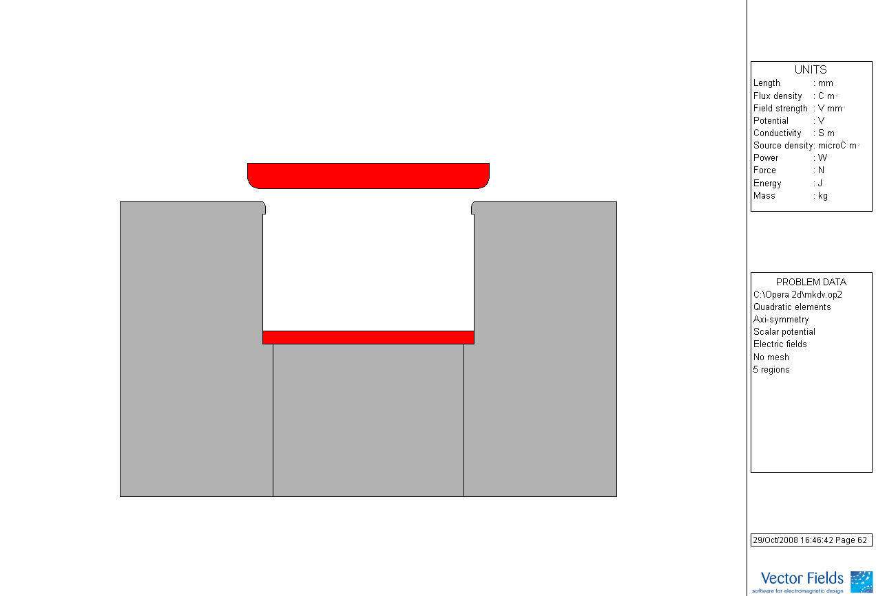
Summary of SPS Kicker Apertures, Materials & Out-gassing (MDs of Aug. & Oct. 2008)
Aluminium (Anticorodal 110) used for conductors.
^{A} Remnant field estimated to be <1 G for 8C11 and ≈5G for 4E2;
^{B} Except “L9” @ MKE6 ⇨4E2 ferrite (higher degassing rate
than 8C11)
Aluminium (Anticorodal 110) used for conductors.
^{A} Remnant field estimated to be <1 G for 8C11 and ≈5G for 4E2;
^{B} Except “L9” @ MKE6 ⇨4E2 ferrite (higher degassing rate
than 8C11)
Hap
Vap
FERRITE

