Slide 1
Beam observations during MD w42
participants:
T. Argyropoulos, T. Bohl, C. Bhat, G. Rumolo, M. Taborelli, E. Shaposhnikova, +
help from OP shift (+ K. Cornelis)

Slide 2
MD w42 – 19.10
50 ns and 25 ns spaced nominal LHC beam with correspondingly 1.3x10¹¹ and 1.15x10¹¹/bunch
Dedicated MD cycle → even for 50 ns spaced beam problems with
MKE heating: 54 deg with 1 batch (36 -> 24 bunches, 4 -> 2 -> 1 batches)
pressure (spike, 10 min recovery)
50 ns beam:
beam losses (4.5 – 9) %
transverse emittances: inj. H/V 2.5/2.9 ±0.4, extracted: 2.2/2.8 ± 0.4
At the beginning too long bunches from PS (80 MHz problem), losses during controlled emittance blow-up during the ramp

Slide 3
Transverse emittance for 25 ns spaced beam for different number of batches
C. Bhat
C. Bhat
Vertical emittance increases with number of batches
measurement time: t=0.55 s (26 GeV) and t=15.4 s (450 GeV)

Slide 4
MD on 19.10.2010 - no longitudinal blow-up: stable 50 ns beam
Nominal intensity: 1.3x10^11/bunch injected
1-4 batches
800 MHz on, usual phase shift relative to 200 MHz
nominal voltage program
T. Argyropoulous et al.

Slide 5
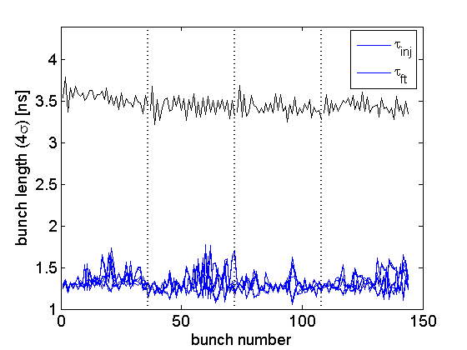
MD on 9.11.2010 - no longitudinal blow-up - unstable 50 ns beam
Injected bunch length (emittance) is significantly smaller!

Slide 6
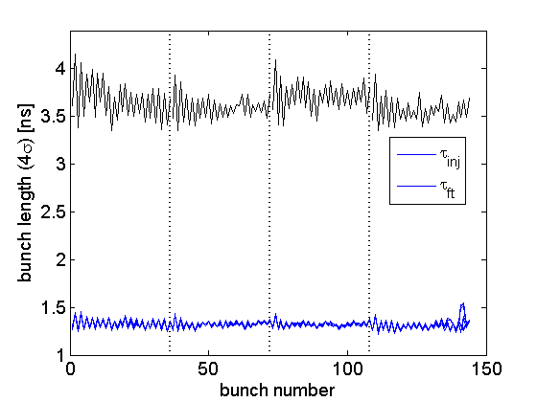
MD on 19.10.2010 - no longitudinal blow-up: 50 ns beam
…also unstable for shorter injected bunches?

Slide 7
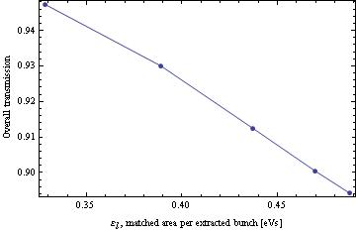
SPS transmission versus injected longitudinal emittance (25 ns beam)
H. Damerau et al
MD on 19.10.2010

Slide 8
Summary
There is a narrow window for the injected longitudinal emittance – losses increase for higher values and beam is unstable for lower.
In the latter case emittance blow-up is required even for stability of the 50 ns spaced beam
Need more accurate measurements of transverse emittance

