Slide 1
Plan for the winter intervention in SPS
New coatings
M.T. for SPSU

Slide 2
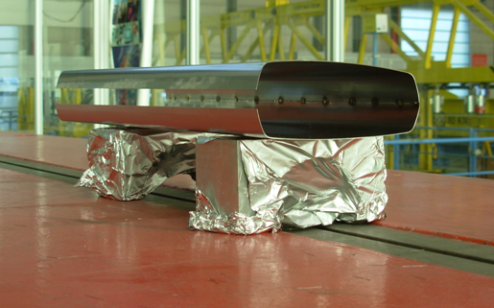
Plans for the winter break
ECM:
Extract DLC and insert grooves (Pivi) which are already mounted: what about Kapton foil?
Mobile sample:
  extract StSt (ideally before venting that sector), measure in the lab
  Insert a-C CNe57 (presently at 181)
-Magnets:
-no MBA
- one quadrupole chamber ready to be
inserted in the quadrupole (6/1)
- 4-6 shields (500 mm length x 0.7 mm
thickness) with a-C coating to be inserted
in SPS in position x1470 and x2150
(at the moment only sextant 5 is planned to be
opened)
-Vacuum:
- RGA with remote control under test, to be inserted in sextant 5 close to the ECM

Slide 3
SEY TiN (Oak Ridge NL), sample from J.Price measured at CERN

Slide 4
Toward MBB coating in the MBB dipole: SEY of coating made with permanent magnet (short prototype of 300 mm)
-No change after storage in air (Al foil) for one month
-Preparing to do 2 m length

Slide 5
Toward clearing electrodes materials:
- 2 samples 200 mm x 200 mm on 3 mm thick StSt (produced by Listemann AG);
about 100 µm plasma spray alumina
resistivity in air deceivingly small, 2.6MOhm, breakdown resistance about 1KV
resistivity in vacuum is 10GOhm, breakdown resistance about 4KV …before first breakdown
from KEK (Suetsugu): the degassing is about 50 times higher than copper
Issues: brittleness, coating a long chamber etc..
If we instead insert a strip…..
-What about anodic Al oxide? Commercially available hard anodization with 1.2KV breakdown resistance (50 µm thickness), would give a resistivity in the GOhm range for the geometry above : we will investigate also this option
- test of the principle in an ECM at 1.2KG? (asymmetries in the response to voltage and tests at low B in PS tests)

