Slide 1
e⁻ cloud simulations at SPS (update)
C.Octavio Domínguez, Giovanni Rumolo, Frank Zimmermann
14th December 2010 - e⁻ cloud simulations

Slide 2
SPS – ε scan – MBB approach
bs = 50 ns; ε_{max}= 230 eV; N_{b}=1.1 10¹¹ ppb; P = 9 nTorr;
R = 0.7; B = 2.025 T; σ_{z}= 11.8 cm;
ε_{Nx,Ny} [μm] | σ_{x} [mm] | σ_{y} [mm] | Onset
1.5 | 0.78912 | 029059 | 1.7
2.5 | 0.893224 | 0.37515 | 1.7
3.0 | 0.940968 | 0.410956 | 1.7
3.5 | 0.986403 | 0.443883 | 1.7
4.5 | 1.07151 | 0.503317 | 1.7
5.5 | 1.15033 | 0.556437 | 1.7
24.3 mm
e⁻ cloud monitor (elliptical approach)
70.0 mm
2
14th December 2010 - e⁻ cloud simulations

Slide 3
e⁻ cloud build up at B = 2.025 T
3
14th December 2010 - e⁻ cloud simulations

Slide 4
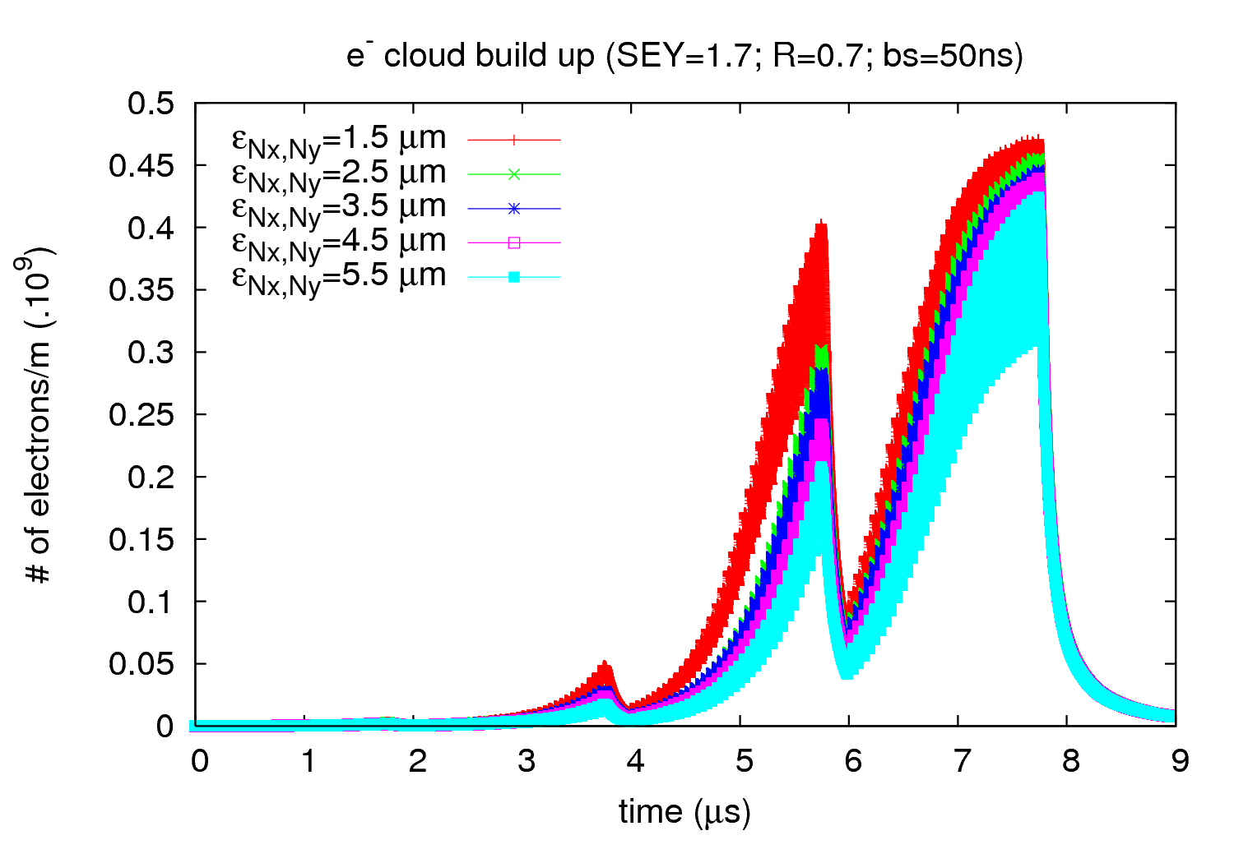
e⁻ cloud build up
4
14th December 2010 - e⁻ cloud simulations

Slide 5
e⁻ energy distribution at B = 2.025 T
5
14th December 2010 - e⁻ cloud simulations

Slide 6
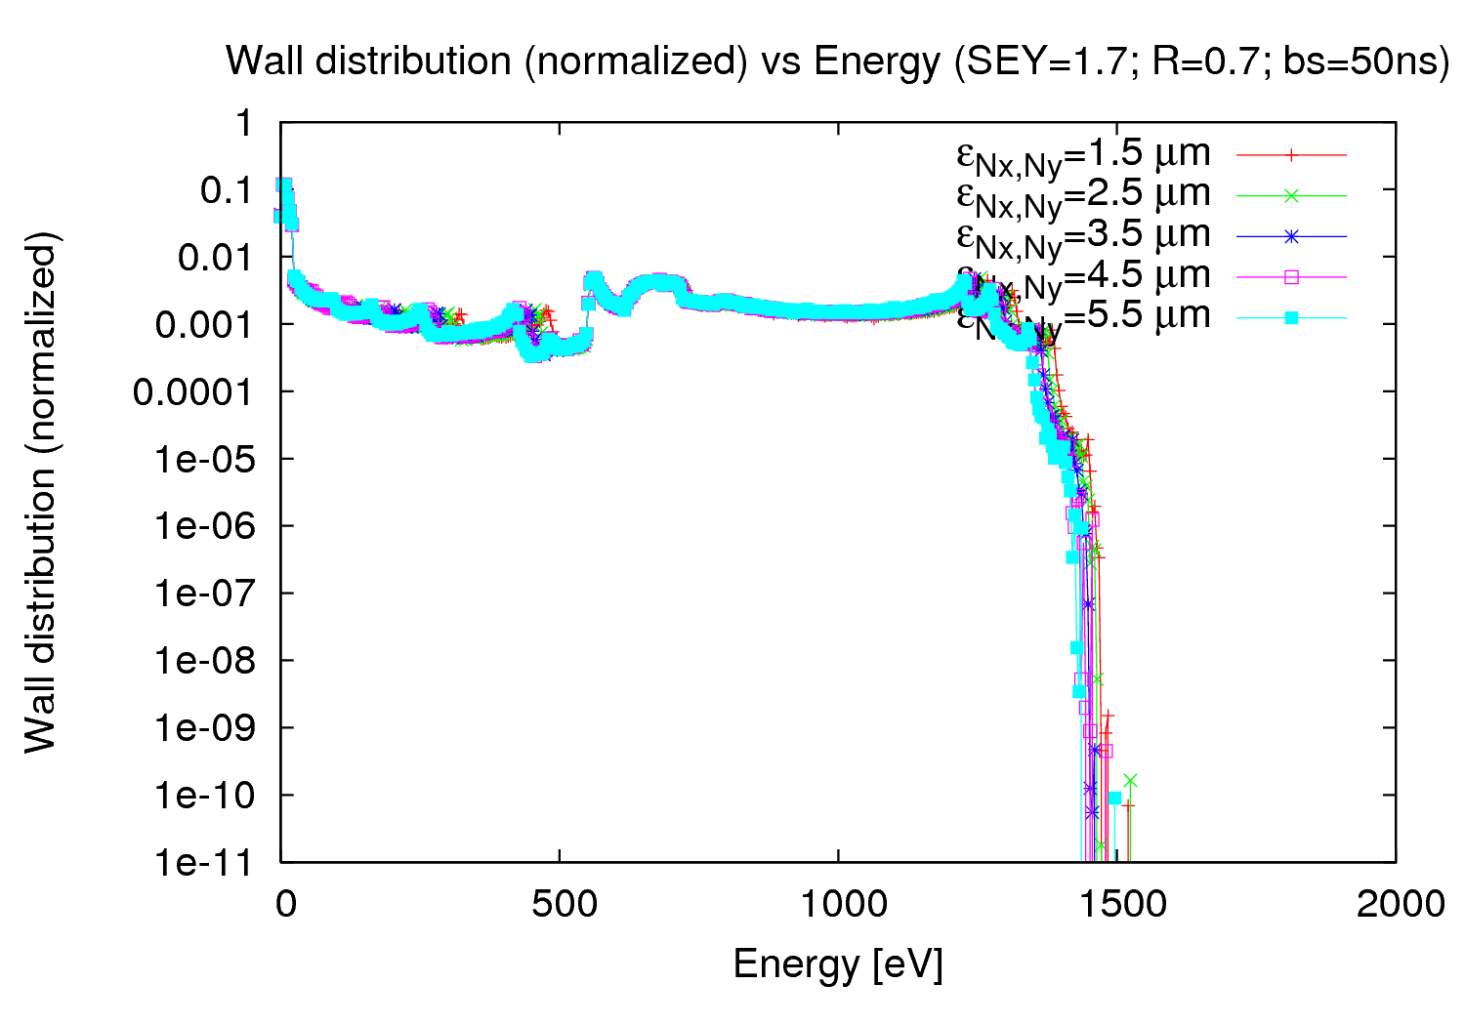
e⁻ energy distribution
6
14th December 2010 - e⁻ cloud simulations

Slide 7
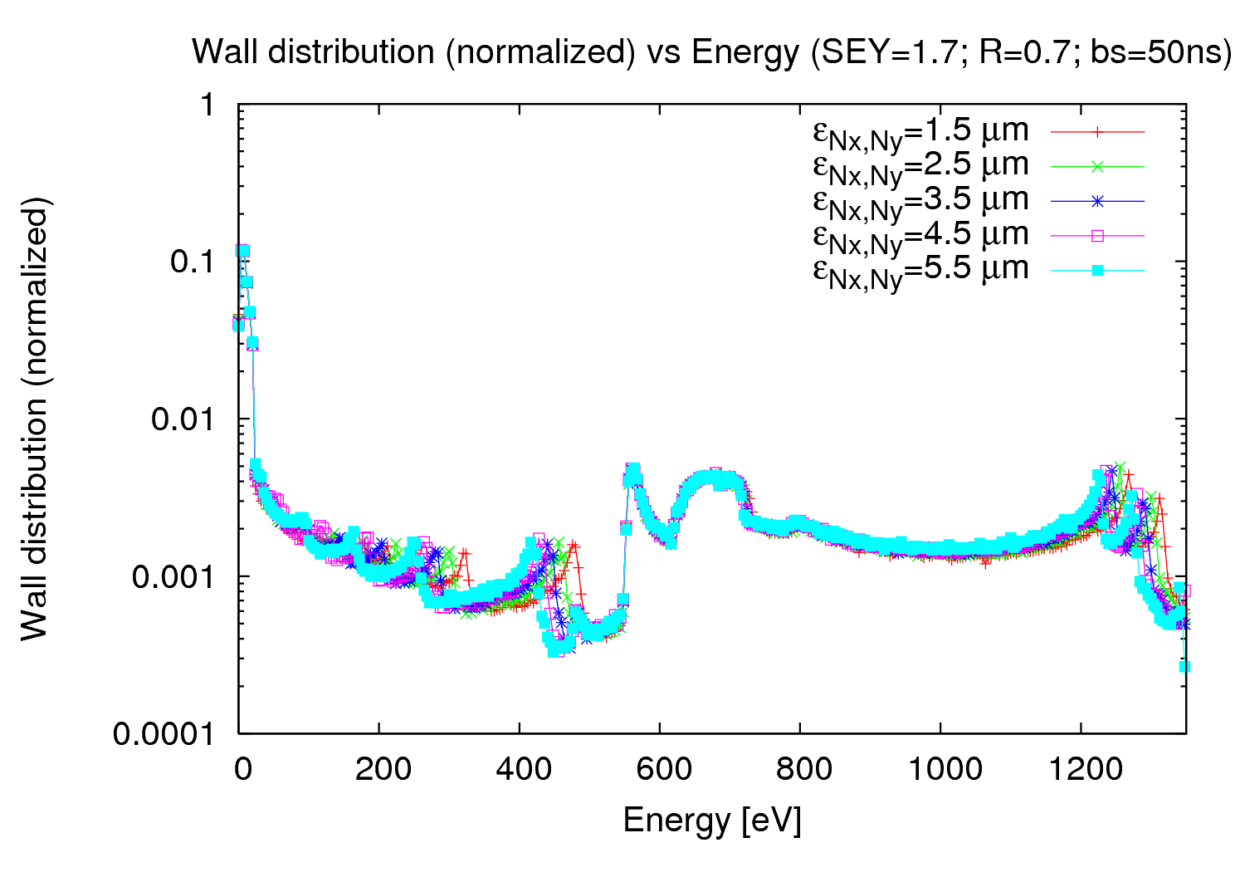
e⁻ energy distribution
7
14th December 2010 - e⁻ cloud simulations

Slide 8
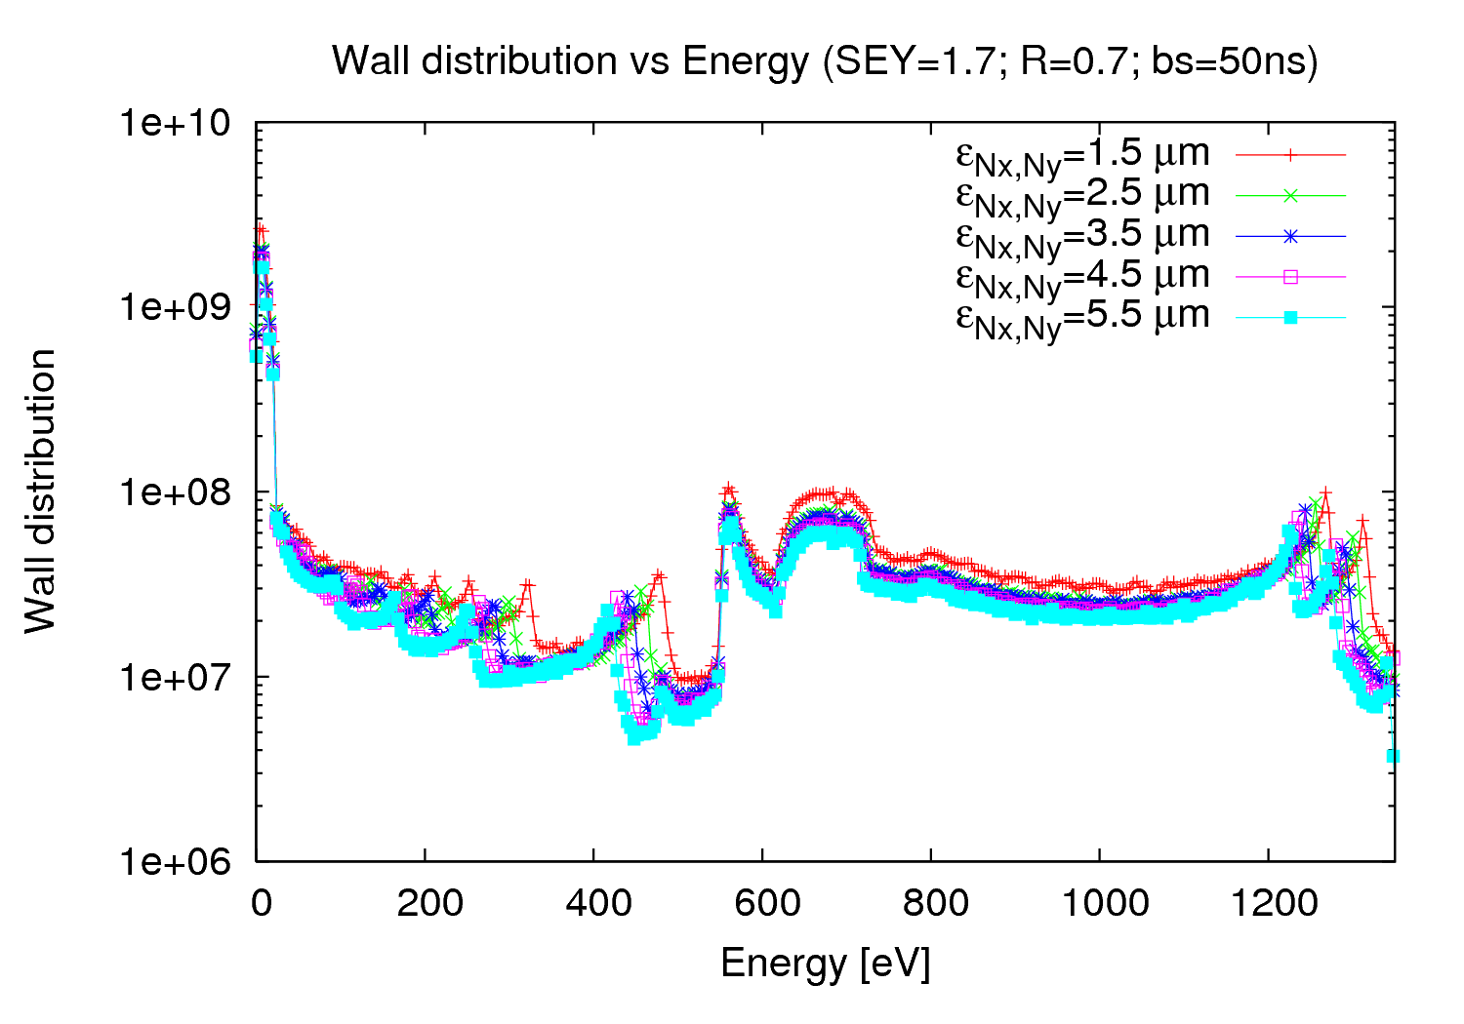
e⁻ energy distribution
8
14th December 2010 - e⁻ cloud simulations

Slide 9
SPS – ε scan – e⁻ cloud monitor
bs = 50 ns; ε_{max}= 230 eV; N_{b}=1.1 10¹¹ ppb; P = 9 nTorr;
R = 0.7; B = 0.117 T; σ_{z}= 11.8 cm;
ε_{Nx,Ny} [μm] | σ_{x} [mm] | σ_{y} [mm] | Onset
1.5 | 0.78912 | 029059 | 1.6
2.5 | 0.893224 | 0.37515 | 1.7
3.0 | 0.940968 | 0.410956 | 1.7
3.5 | 0.986403 | 0.443883 | 1.7
4.5 | 1.07151 | 0.503317 | 1.7
5.5 | 1.15033 | 0.556437 | 1.7
24.3 mm
e⁻ cloud monitor (elliptical approach)
70.0 mm
- Emittance scan for different LHC type of beams → Appreciable at this magnetic field
9
14th December 2010 - e⁻ cloud simulations

Slide 10
e⁻ cloud build up at B = 0.117 T
10
14th December 2010 - e⁻ cloud simulations

Slide 11
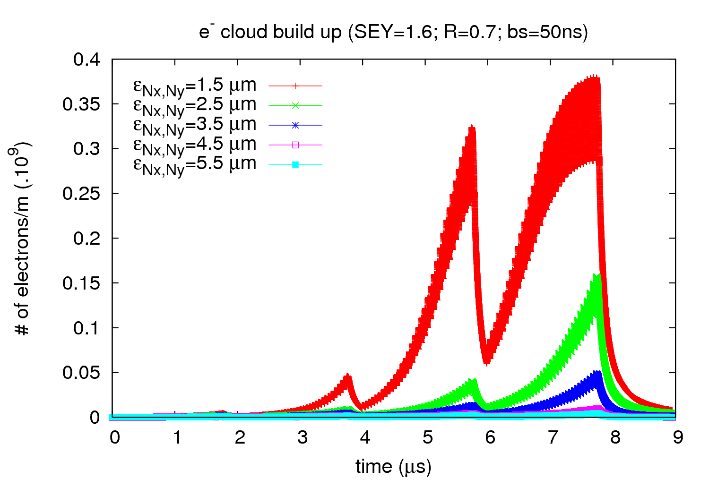
e⁻ cloud build up
11
14th December 2010 - e⁻ cloud simulations

Slide 12
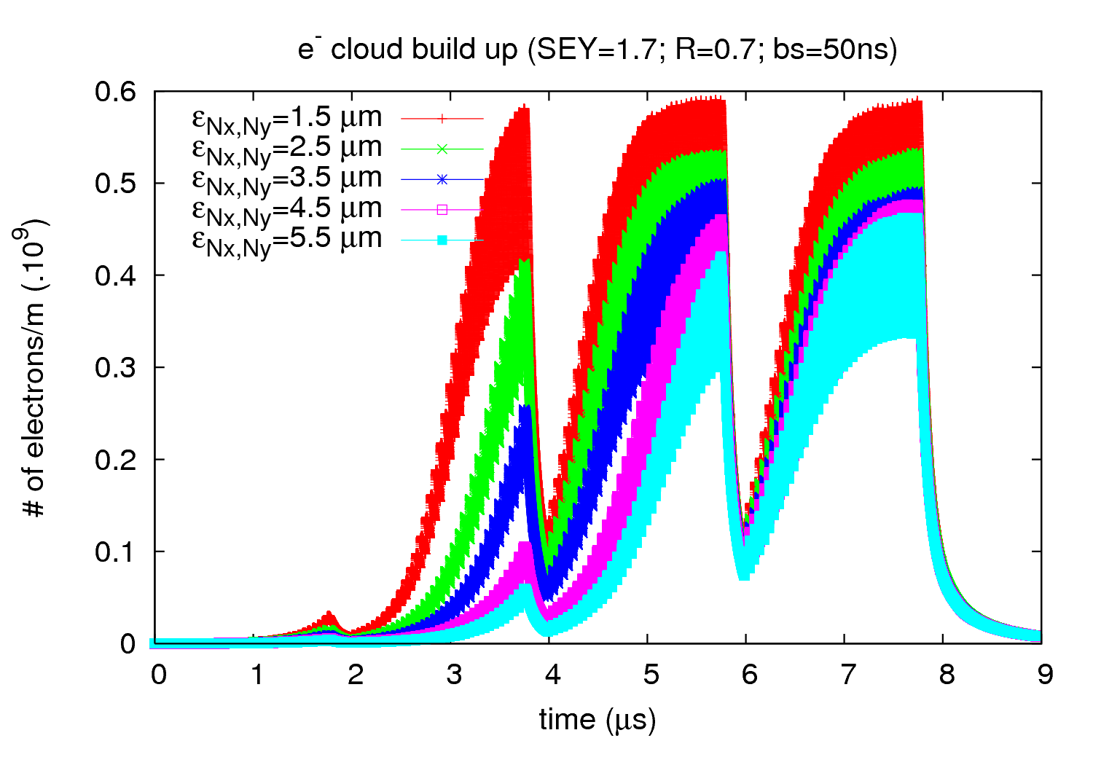
e⁻ cloud build up
12
14th December 2010 - e⁻ cloud simulations

Slide 13
e⁻ energy distribution at B = 0.117 T
13
14th December 2010 - e⁻ cloud simulations

Slide 14
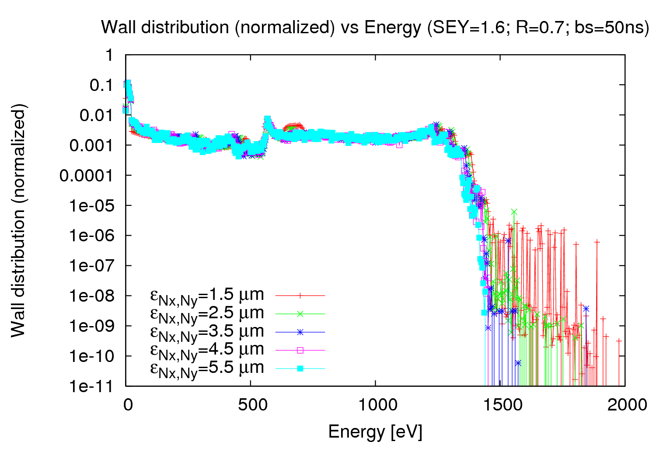
e⁻ energy distribution (SEY=1.6)
14
14th December 2010 - e⁻ cloud simulations

Slide 15
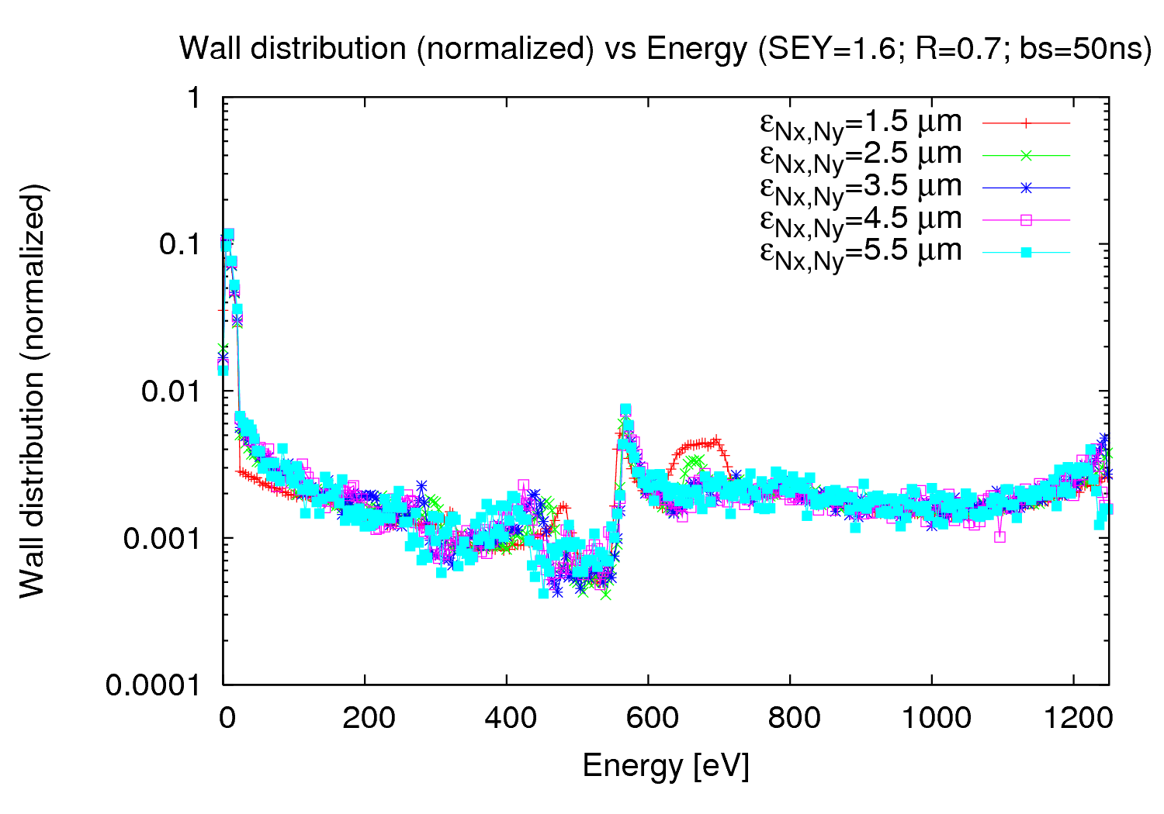
e⁻ energy distribution (SEY=1.6)
15
14th December 2010 - e⁻ cloud simulations

Slide 16
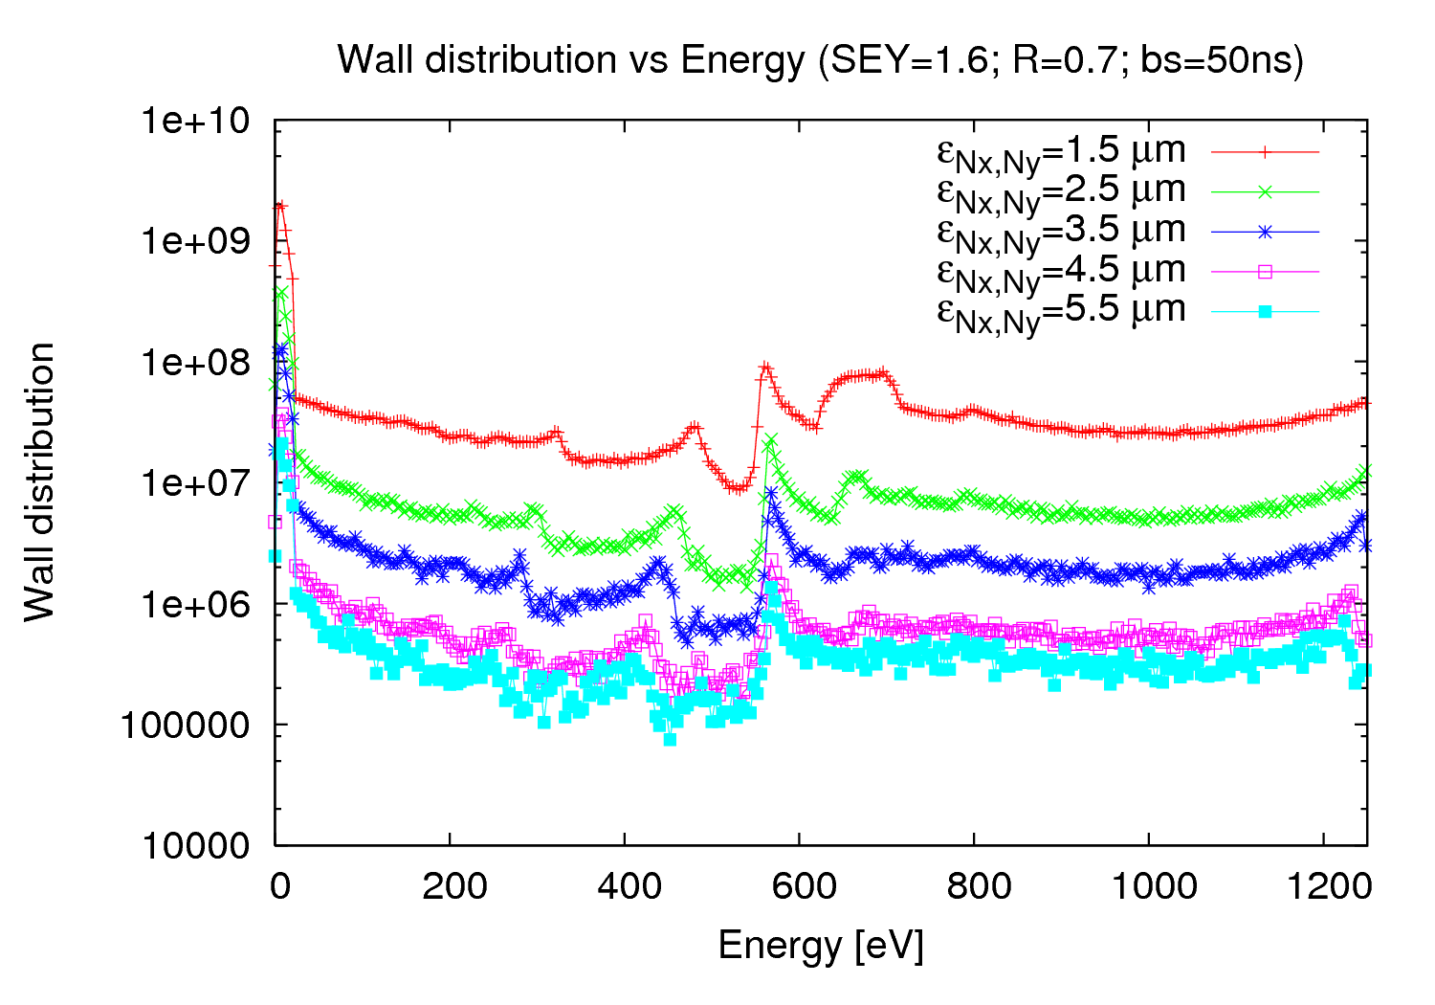
e⁻ energy distribution (SEY=1.6)
16
14th December 2010 - e⁻ cloud simulations

Slide 17
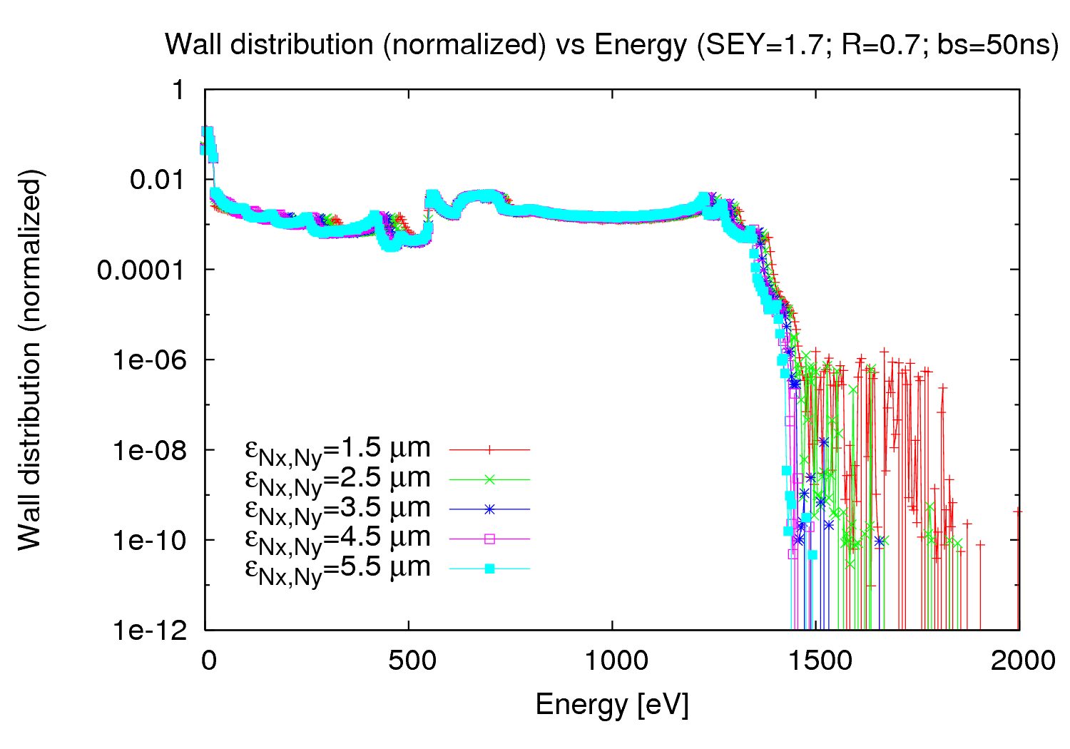
e⁻ energy distribution (SEY=1.7)
17
14th December 2010 - e⁻ cloud simulations

Slide 18
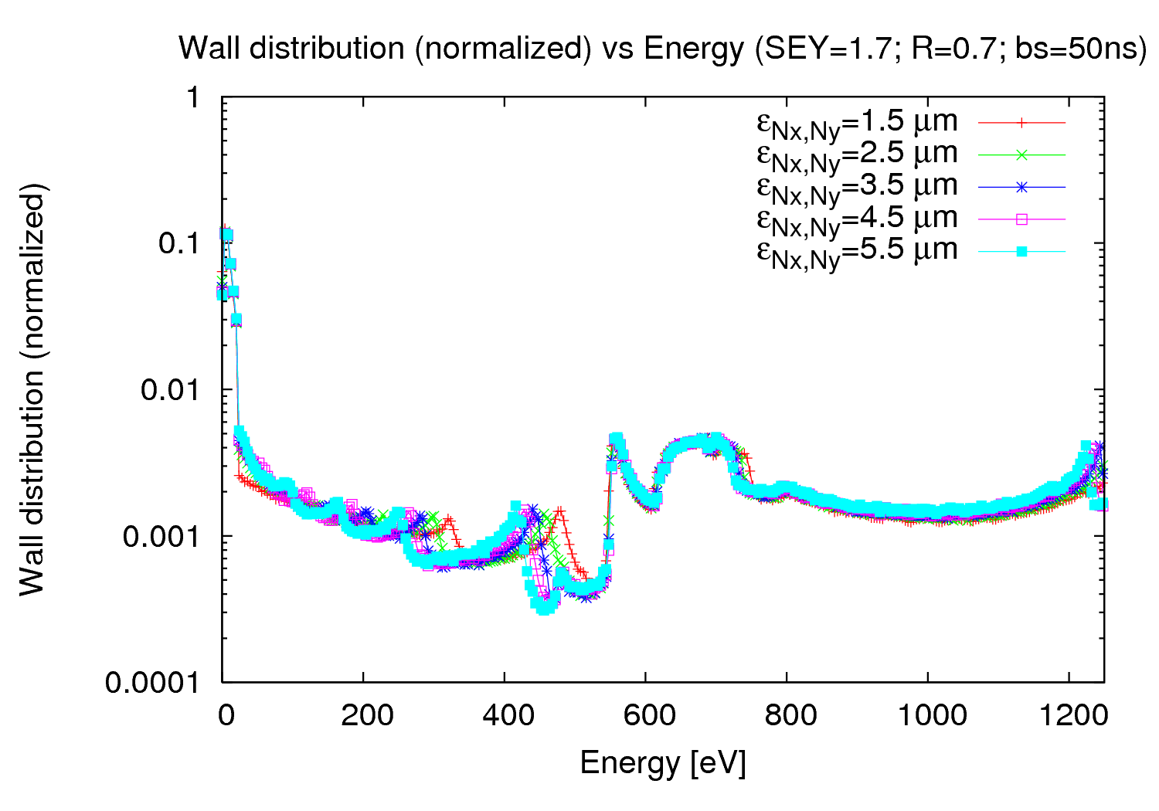
e⁻ energy distribution (SEY=1.7)
18
14th December 2010 - e⁻ cloud simulations

Slide 19
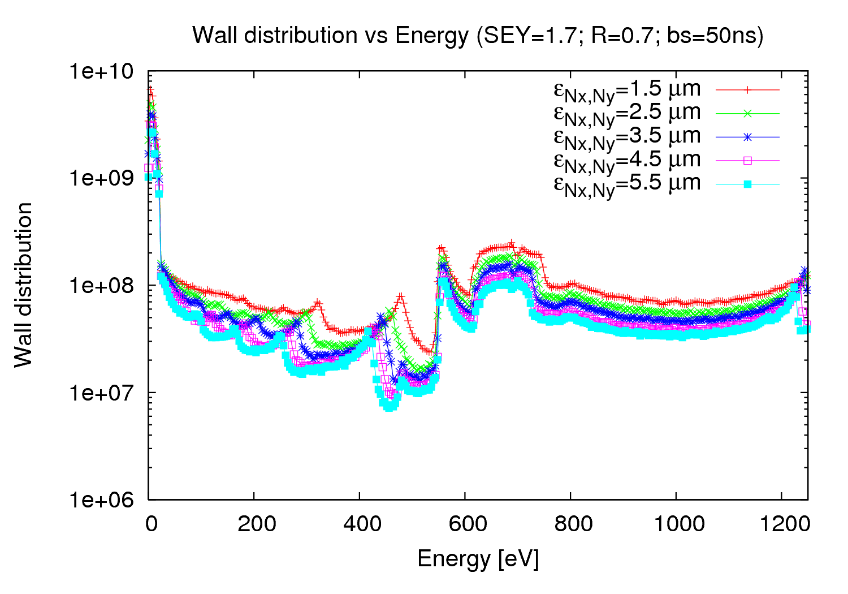
e⁻ energy distribution (SEY=1.7)
19
14th December 2010 - e⁻ cloud simulations

Slide 20
Conclusions
Emittance scan for different LHC type of beams:
→ Very small differences (negligible) for high fields (B= 2.025 T)
→ Important differences for lower fields (B = 0.117 T)
We find a sharp edge around 1500 eV, meaning that the
energy distribution finish there (no electron at higher
energies)
20
14th December 2010 - e⁻ cloud simulations

