Slide 1
Towards the coating of 3 MBB dipoles Status report
SPS-U

Slide 2
Coating tests on MBB 096 with liner
Test #1
Liner 2 meters, 2 cathodes, 1 anode, sputtering power 400 W (limited by geometry and arcs at the extremities)
Thickness non homogeneous
SEY non homogeneous as a consequence

Slide 3
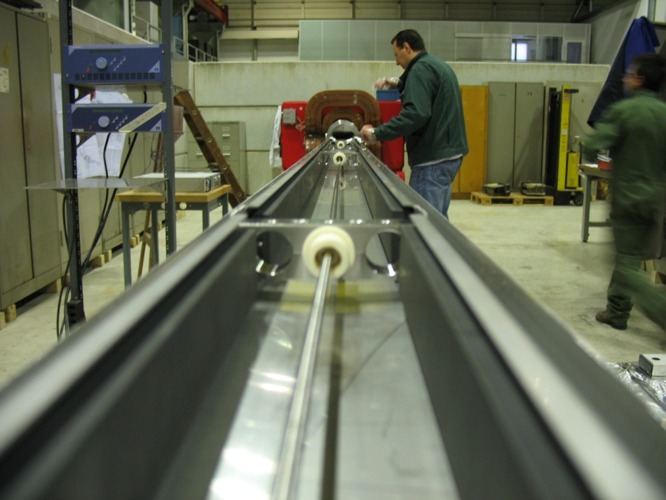
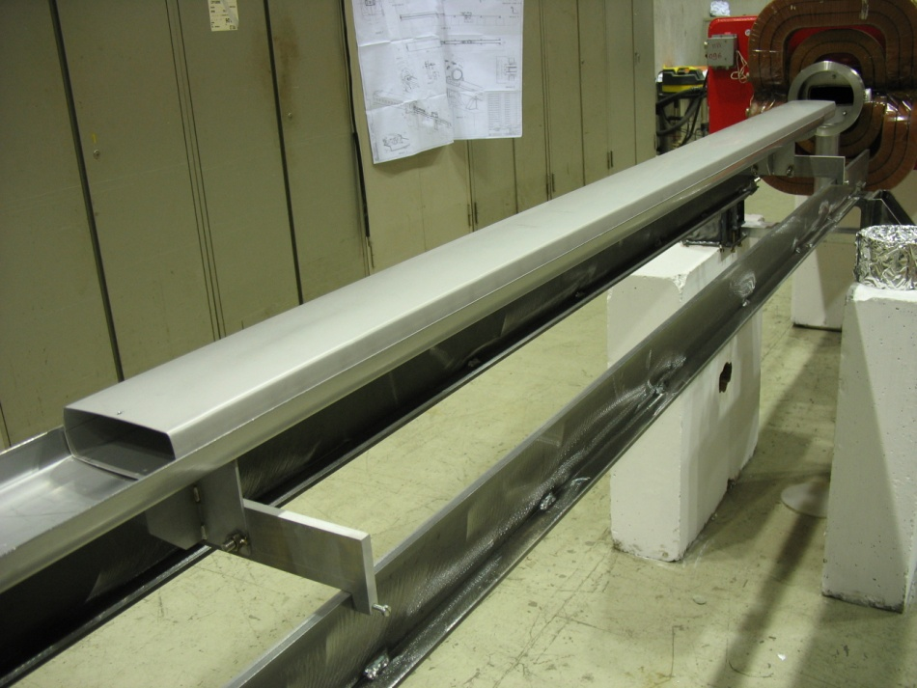
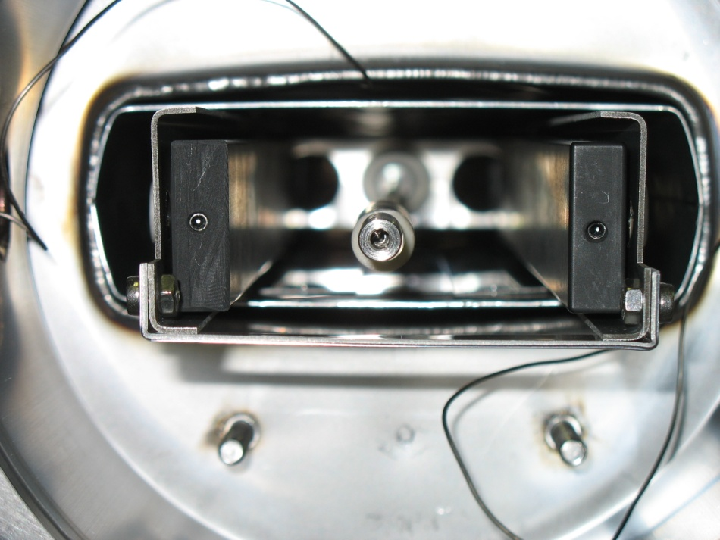
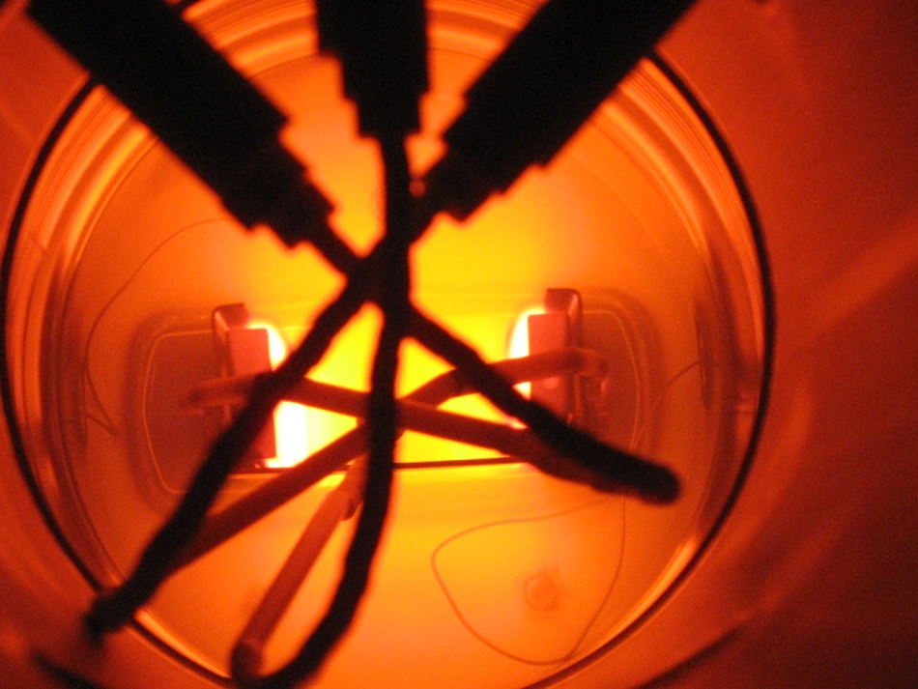
Test #1

Slide 4
Test #1

Slide 5
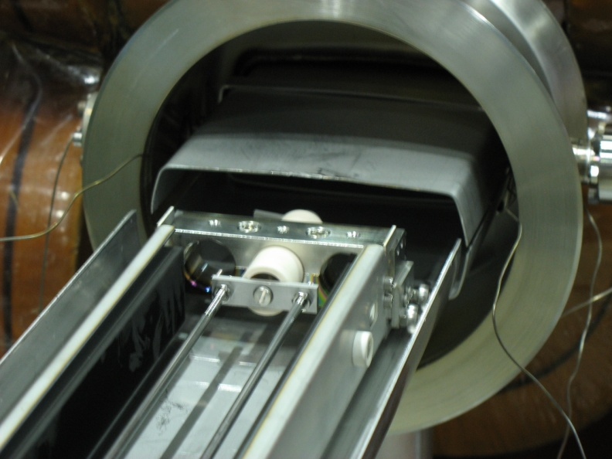
Coating tests on MBB 096 with liner
Test #2
Liner 2 meters, 2 cathode, 2 anodes, sputtering power 700 W
Max temperature on liner during coating 120 °C (specified for the vacuum chambers 150 °C at the sides, 300 °C on top)
More uniform dark colour
SEY:

Slide 6
SEY for test #2

Slide 7
Under way
Test #3
Liner 2 meters, 2 cathodes, 2 anodes
Better insulation of and shielding of feedthroughs and of cathodes extremities
Test for higher power sputtering and temperature limit.
Cleaning of MBB 085 and MBB 040
Si-O-Si and HC were detected on all three dipoles before cleaning
Cleaning of MBB 096 was successful but not 100% conform to UHV specs
Modification of vacuum chambers
Piquages on MBB 096, 085, 040 done
Piquages to be done on MBB 51470 and QD 51510 in the tunnel (week 10, 2-6.3)
Studs for RF shields being welded on MBB 085, 040 (MBB 096 done)

Slide 8
Coating plans
MBB 096
Start assembly 19.2
Coating
Dismount 24.2 (store under N2)
MBB 085
Start assembly 24.2
Coating
Dismount 27.2 (store under N2)
MBB 040
Start assembly 27.2
Coating
Dismount 4.3 (store under N2)
Last delivery date
Monday 9.3

Slide 9
Sample for C magnet, coated with a-C on 1.10.2008

Slide 10
Liners
Liner #1: inox
Liner #2: a-C coated from last year
We are still testing the Zr coating parameters for the liner #3
Problems in temperature control for obtaining the right “rough” zirconium
Liner #4 to be defined
Installation schedule to be defined both for C-magnet sample and for liners

