Slide 1
Results from MD week 33
Pressure of the coated versus uncoated magnets
Electron cloud current in the StSt liner as a function of B-field
M. Taborelli, C.Yin-Vallgren for SPSU team
SPSU 08 09 2009

Slide 2
Pressure measurements
Effect of noise from magnet ramp?
Compare shape of pressure rise in various MBB
Synchronization problems: seems ok within about 1s when taking short (<1h) files
change batch spacing to decrease e-cloud and compare magnets

Slide 3
Start of MD: differences in sudden conditioning
Pressure [mbar]
co-co
un-un
co-un
noise

Slide 4
Pressure rise and shape in various MBBs:
-the difference in shape between uncoated MBBs is larger than between coated/uncoated
-the magnitude seems roughly proportional to the static pressure (gauge calibration or pumping speed?)
un-un
un-un
un-un

Slide 5
First increse of number of batches
The first increase in the number of batches seems to favour clearly the coated magnets, but the situation is not reversible when decreasing the number of batches
Pressure [mbar]

Slide 6
Decrease in number of batches
At the end of the MD the coated magnets had always lower pressure rise for 1, 2 or 3 batches
Pressure [mbar]

Slide 7
Batch spacing: less pressure rise at larger spacing
The situation with more e-cloud slightly favors the coated magnets (at least peak pressure)
Decrease also for 3 batches equally spaced, less marked advantage for the coated

Slide 8
General remark (once more….)
We measure pressure in system which is
a mixture of coated and uncoated regions
a mixture of regions with different B-field
We measure e-cloud in the liners which are
-a region of homogeneous coating
-a region of homogenous B-field

Slide 9
E-cloud monitors measurements
From the comparison of the pressure measurements in the coated and uncoated magnets of the previous MD :
►influence of the uncoated regions in low B-field at the edge of the magnets and between the magnets?
►► Measure e-cloud for low B-field in the StSt liner

Slide 10
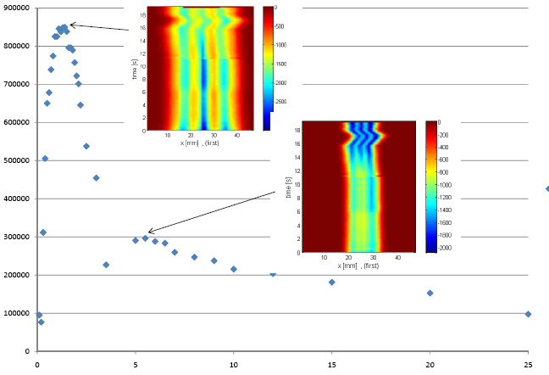
E-cloud monitor as a function of B. Stainless steel liner
Is it the real dependence of e-cloud on magnetic field or
a transmission effect of the holes in the liner?
Current/FBCT [arb. Unit]
Magnet
current [A]
0 5 10 15 20 25
Magnetic
field
[kGauss]
0.2
0.4
0.6
0.8
1
1.2

Slide 11
Simulation for e-cloud in the liner with a hole of 1mm radius
B(Gauss)
G.Rumolo

Slide 12
G.Rumolo

Slide 13
Energy range of affected electrons

Slide 14
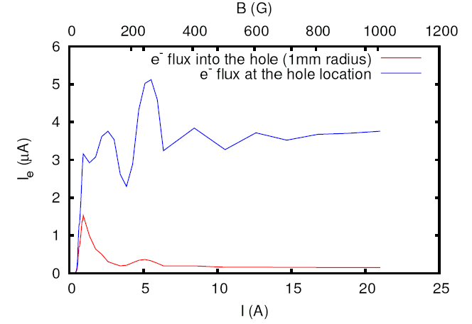
Comparison of e-cloud measured in the hole and
e-cloud without hole
G.Rumolo
From this one can extract a “calibration factor” for transmission as a function of B-field…but it is the current in the center, not integrated
The e-cloud at very weak fields (100G) is as strong as at 1.2kG

Slide 15
E-cloud normalized with transmission factor

Slide 16
Next:
The regions of low B-field are also important (from simulation): coating of the edges of the magnets and coating of the RF shields will possibly increase the difference coated vs uncoated and make the interpretation easier
We still do not have a measurements of pressure and e-cloud at the same site (dedicated system in the liner region ….)
Coatings: working on effects of plasma (O₂ and carbon based) during and after deposition of the coating and on coatings produced with bias

Slide 17
Noise level: effect of ramping the magnets
co-co
co-un
un-un
un-un

