Slide 1
Ecloud test installation (BA5) - further findings and observations
F. Caspers, S. Federmann

Slide 2
Contents
Further observations and confirmation on intermodulation effects
Analysis and explanation of the gain variation in the HTF during the magnetic ramp
Results and discussion

Slide 3
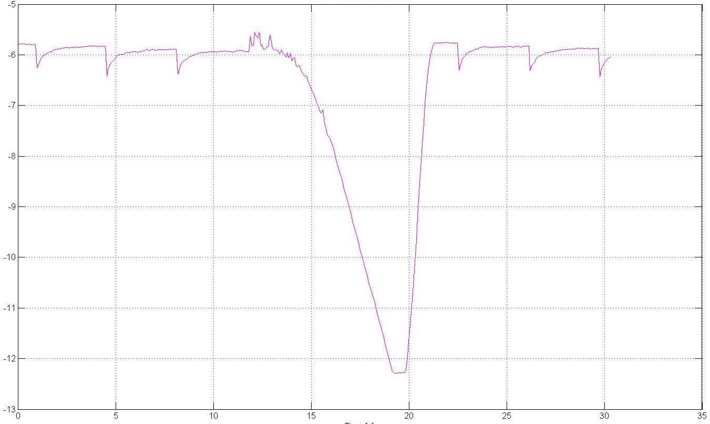
Observation
We did see the effect of the magnetic cycle on the amplitude of our CW signal:
Gain compression magnitude around 1 dB normally good enough, but in our case we have very small signals
need to change amplifiers
CW at 2.682 GHz
Data taken with conventional Spectrum Analyzer but also seen on VSA
Evolution of carrier over cycle with beam
Acceleration - Beam signals pass over CW frequency
Gain compression below 1 dB at injection from intermodulation
Reason for this behavior?
Magnetoresistive effects impact of fringe fields on the rf electronics and circulator in the tunnel?
dBm
Time [s]

Slide 4
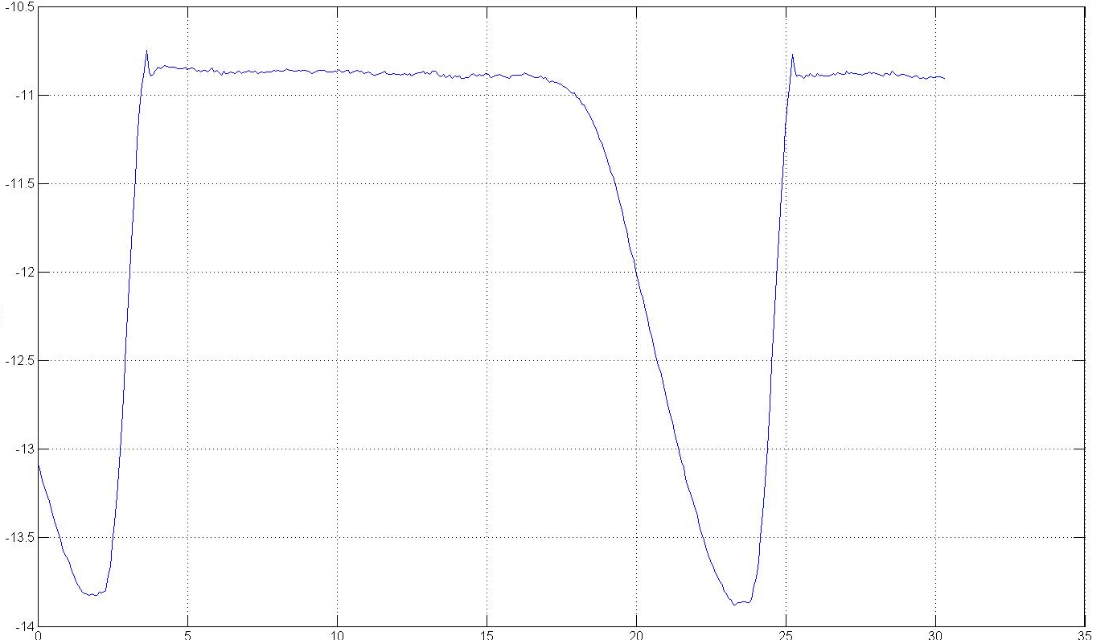
Observaton
Evolution of CW without beam:
Evolution of carrier over cycle without beam
No gain compression
we still see the magnetic cycle in the amplitude of the carrier
effect not related to presence of the beam
dBm
Time [s]

Slide 5
Analysis
First hypothesis: stray field of magnets effect the electronics in tunnel
Changes transfer properties of the circulators and amplifiers
As a check we measured the HTF by substituting the beampipe section with a cable and a 60 dB attenuator and leaving all the electronics in the tunnel (circulators, amlifiers etc.)unchanged
No effect on CW visible effect not due to stray fields on the electronics, but something MUST happen in the beampipe

Slide 6
Results
Cable HTF with 60 dB attenuator (no beam)
Signal on VNA [no DC block] with beam
Signal on VNA [no DC block] with beam
Signal on VNA [no DC block] with beam

Slide 7
Results
Cable HTF without attenuator (no beam)
Total HTF with electronic and filter (no beam)
CW HTF with beam and DC block at 2.68 GHz
This is clear evidence that we were perturbed by intermodulation via 43 kHz induced in the connecting cable (previous slide)
This is clear evidence that we were perturbed by intermodulation via 44 kHz induced in the connecting cable (previous slide)
Time (s)

Slide 8
Analysis
Next step: measurements on a standalone magnet in bldg. 867 performed (4. 9. 09)
Objective: Can we reproduce it?
Two possible theories:
Magneto resistance
Deformation (a few 10 micron) of the beampipe due to magnetostriction of the magnet iron during the ramp

Slide 9
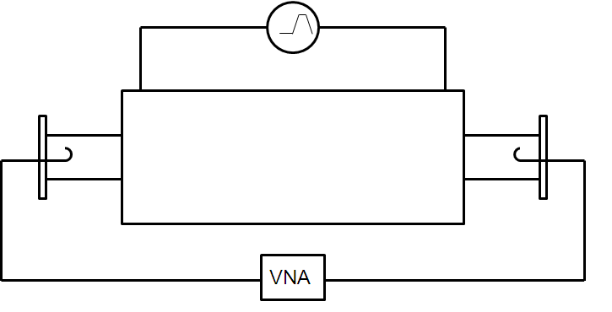
Analysis
Schematic drawing of experimental setup:
Power supply 0 – 1000 A
coupling loops
Magnet
VNA

Slide 10
Results
S21 for testmagnet in bldg 867 at 0 Ampere (4. 9. 09)

Slide 11
Results
Transmission in the test magnet (4 different current levels: 0, 500, 1000, 1500 Ampere)
This is a very strong indication for modification in the interference pattern due to faint mechanical deformation

Slide 12
Results
1000 Ampere
f = 2.673 GHz
0 Ampere

Slide 13
Conclusion
Gain of amplifier during injection at 1 dB compression point – not acceptable for the measurements of small signals. Change of amplifiers was necessary (done)
Evidence for absolute need of DC blocks in the tunnel and on the surface (43 kHz intermod; done)
Visible reduction of CW amplitude with magnetic cycle is not due to stray fields of the magnets. We have not seen any visible change of the properties of the electronics, filters and circulators
Variation of CW amplitude over cycle most likley caused by beam pipe deformations due to magnetostriction of the magnet iron

Slide 14
Next Steps
Check for limits of validity of the Lawson Woodward theorem in our case;
We probably can not exclude categorically a direct interaction of the beam with the microwave transmission in the magnet

