Slide 1
E-cloud in SPS dipoles
K. Cornelis
Acknowledgements to S. Cettour-Cave, J. Bauche

Slide 2
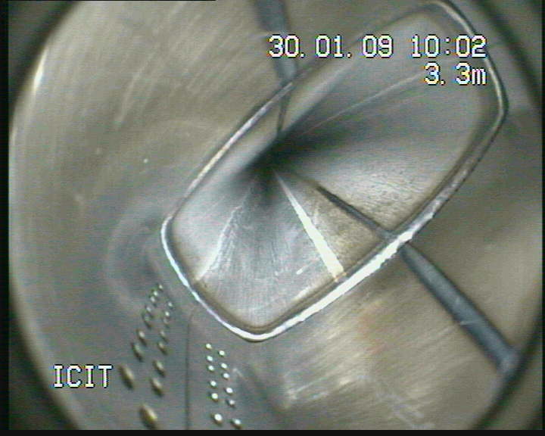

Slide 3
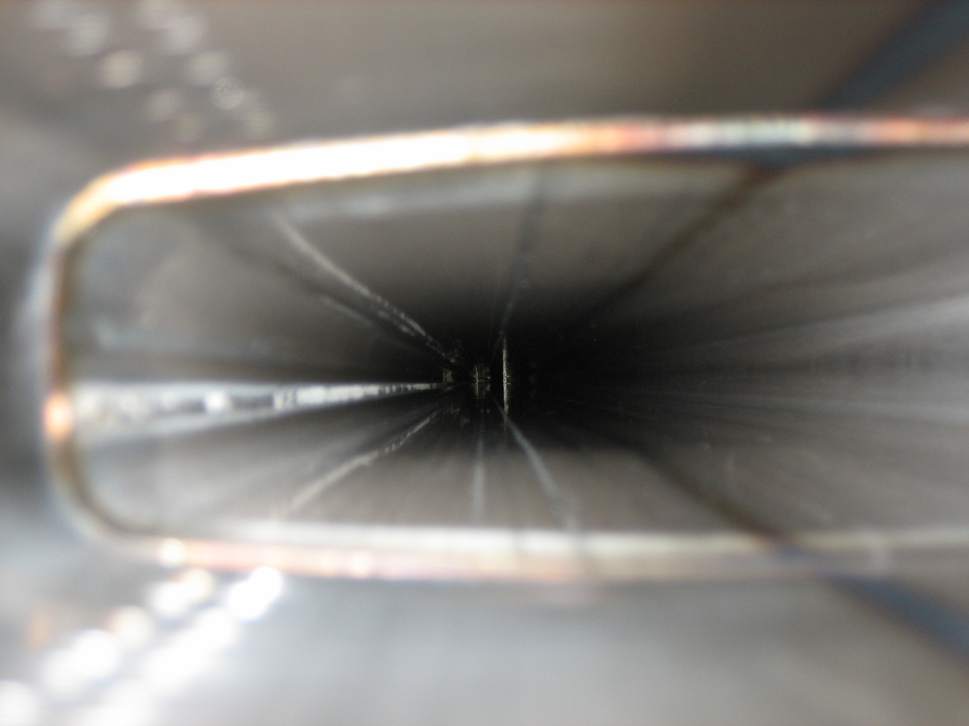

Slide 4
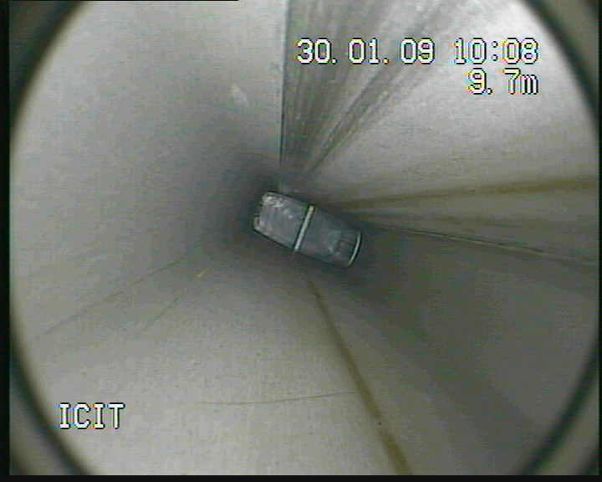

Slide 5
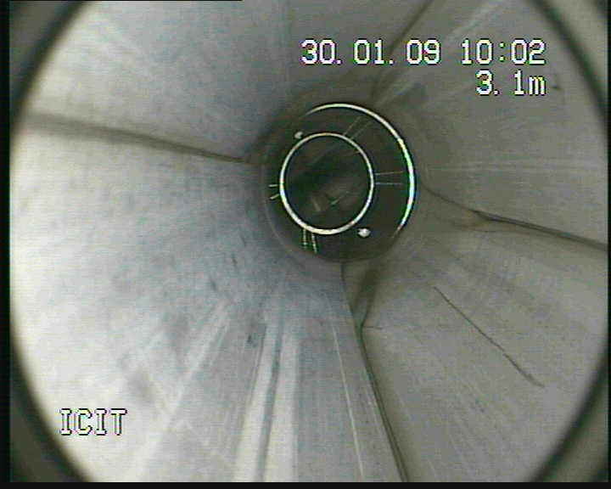

Slide 6
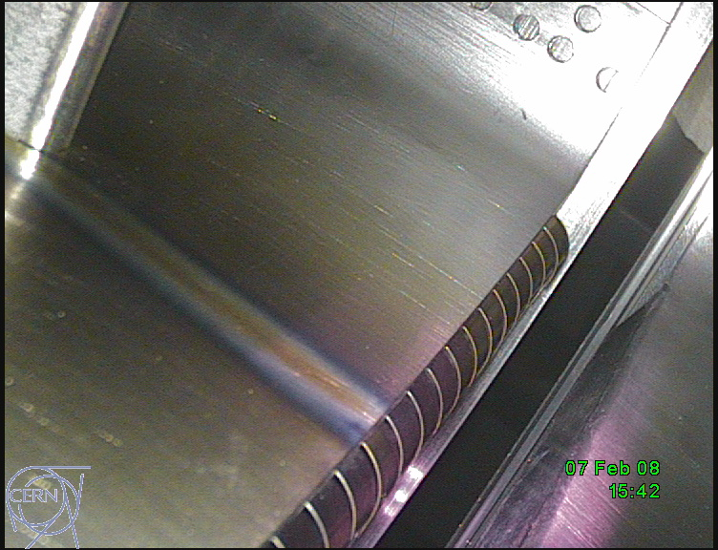

Slide 7
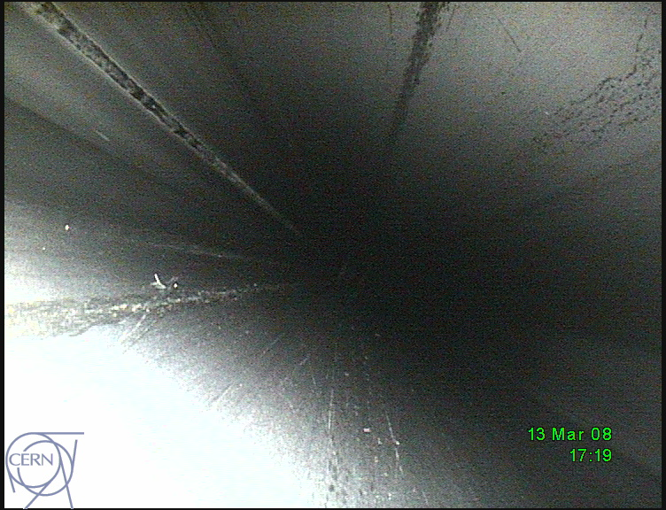

Slide 8
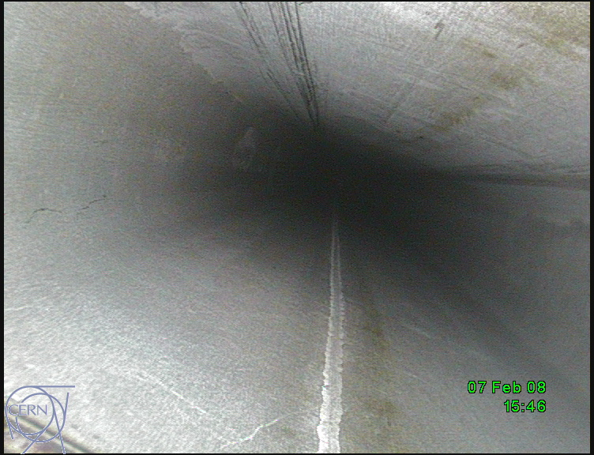

Slide 9
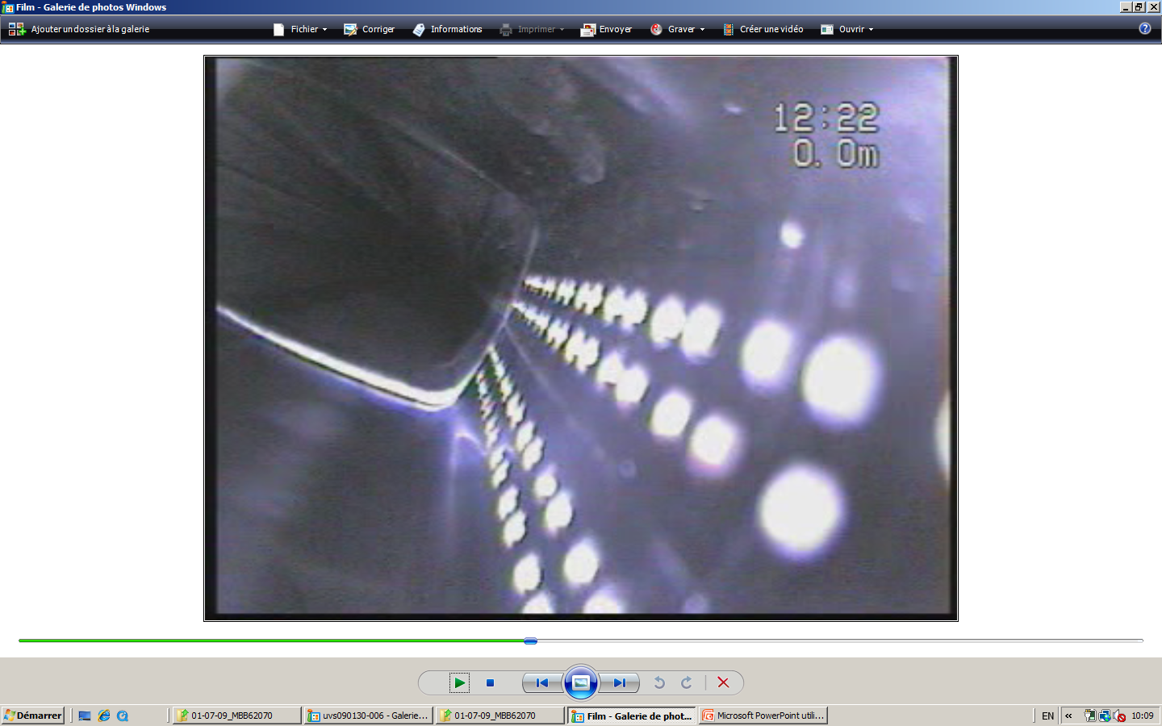

Slide 10
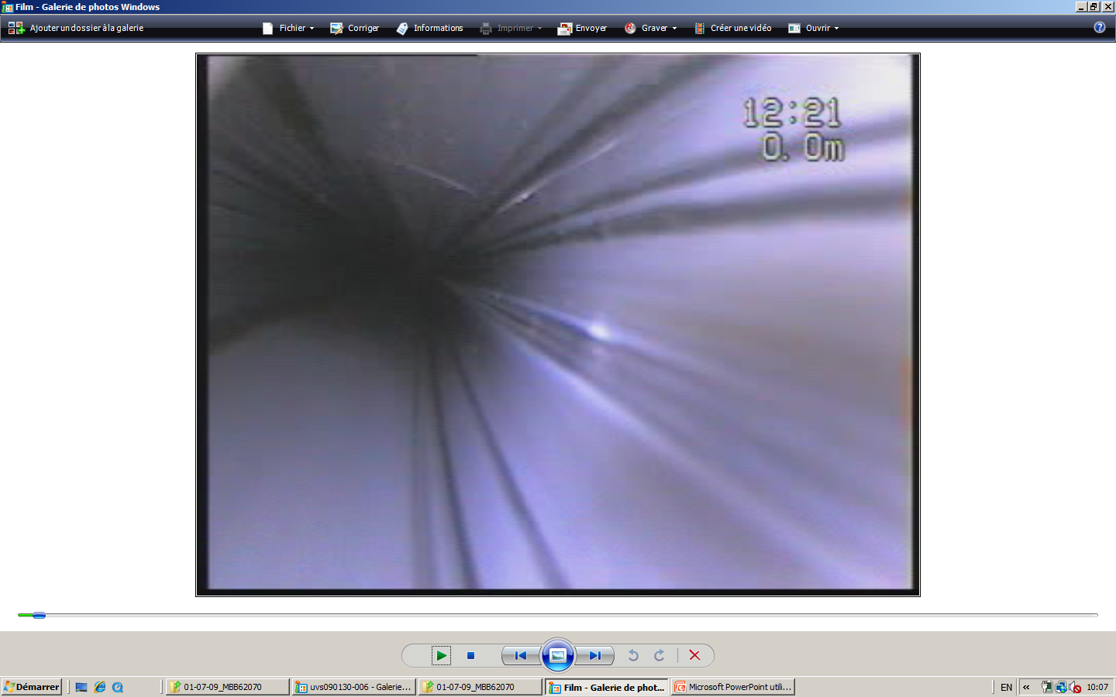

Slide 11
Observations on stripes in vacuum chamber
Stripes in pumping ports look bluish on a very shining surface.
In the magnets they look brownish on a mat surface.
In some magnets the lines are week and in others they are strong.
Remark : all dipole chambers in SPS are very old.

Slide 12
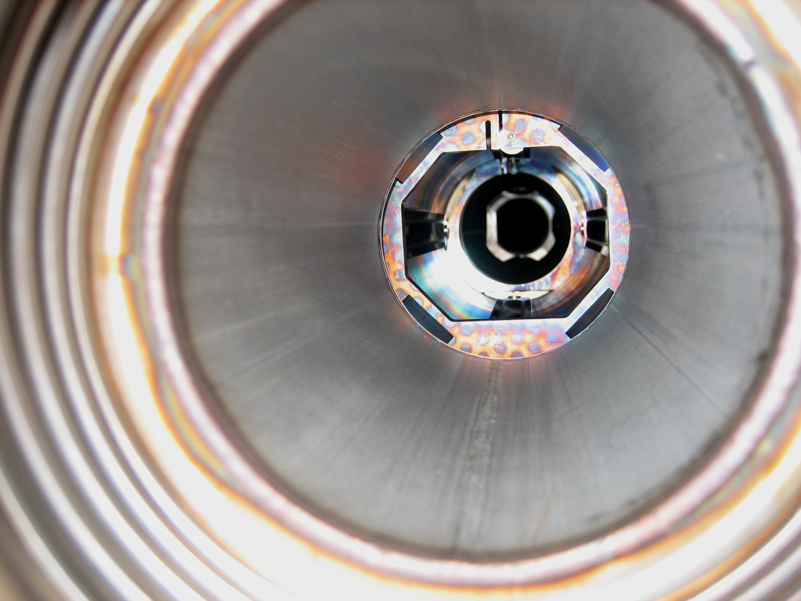

Slide 13
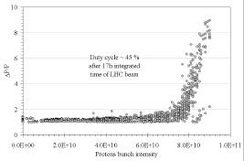
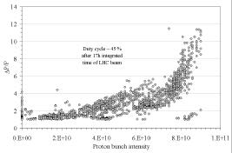
Vacuum pressure rise in field
free region.
MBB vacuum chamber
Vacuum pressure rise in MBB
Region.
These measurements were before
pumping port installation.

Slide 14
Observations during early scrubbing runs
In field free region threshold at 8x10E10/bunch.
In dipole region threshold at 5x10E10 for the same conditions.

Slide 15
Remarks on strip line detector
Device was designed to measure spatial distribution of electron cloud NOT the absolute e-cloud density.
The efficiency depends strongly on magnetic field, but also on bunch intensity and density.

Slide 16
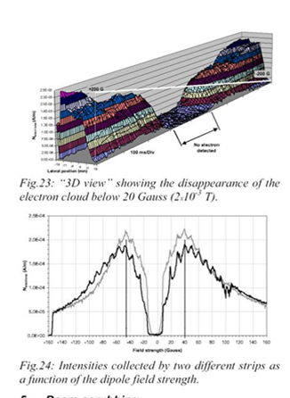

Slide 17
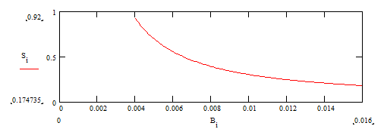
Detection efficiency B=40 to 160 Gauss

Slide 18
Conclusions from strip line detector
Stripes move with field as predicted
Strip line detector confirms threshold higher without field.
30 Gauss was enough to bring the threshold down the level observed in the arcs.
Beware : strip monitor efficiency varies with field.

