Slide 1
Results from the SPS run week 41
SPS MD run 6.10 – 8.10 with 25ns, 50ns and 75ns LHC beam
SPSU-team
TS-MME, AT-VAC, AB/OP-RF-BI-ABP

Slide 2
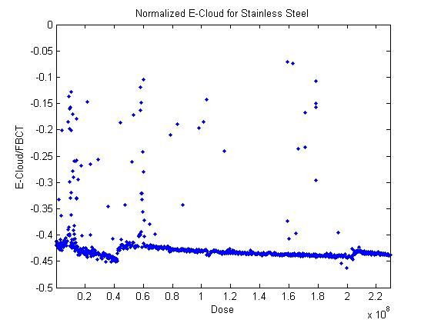
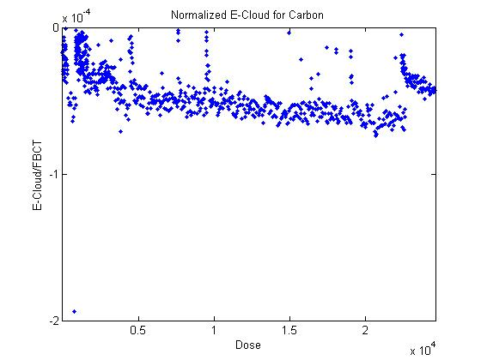
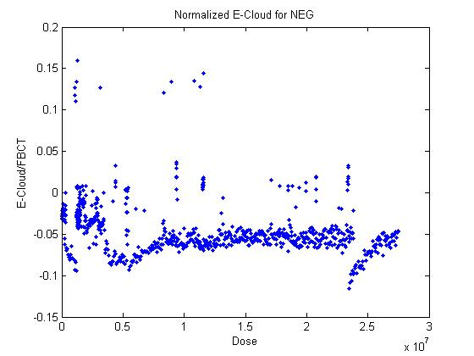
Results SPS MD run week 41: 25 ns spacing LHC beam
Stainless steel
Normalized current
Carbon
The same as the previous measurement.
A factor of 10 lower
than the previous measurement.
NEG
5 times higher than the previous measurement.

Slide 3
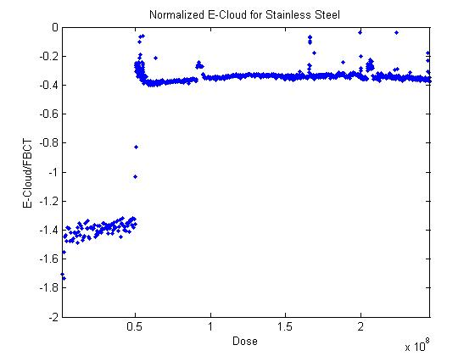
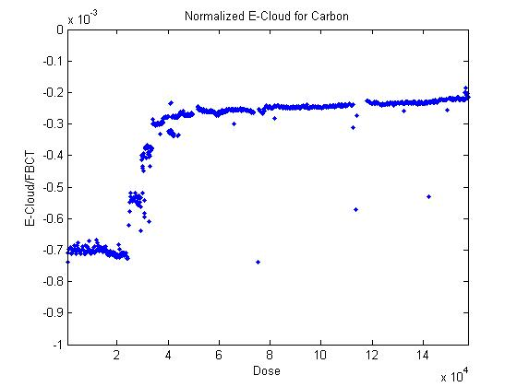
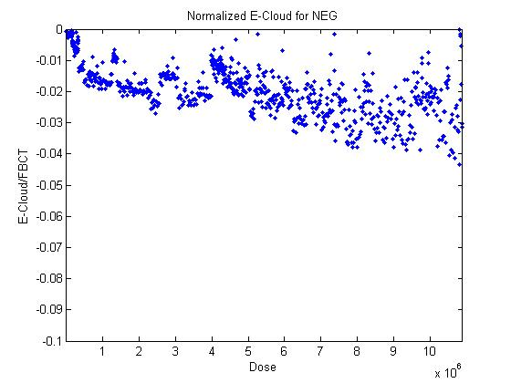
Results of previous MD run (12.8) at 25 ns spacing for comparison
X10⁻³
Normalized current
Normalized current
Stainless steel
CARBON
x10⁸
x10⁴
Dose [nClb]
Dose [nClb]
magnet on
X10⁻³
0
-50
-100
Normalized current
NEG
Effect of bad vacuum?
Dose [nClb]
x10⁶

Slide 4
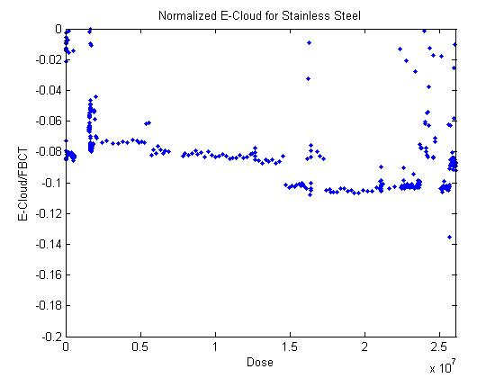
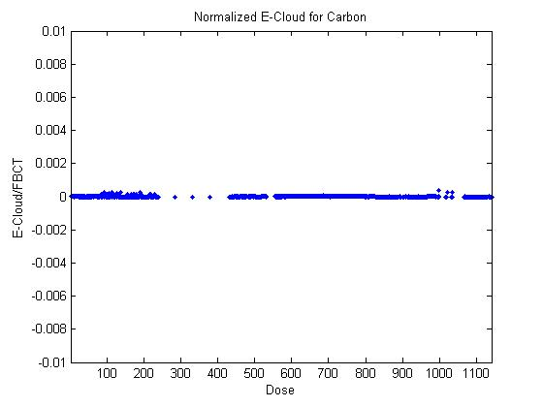
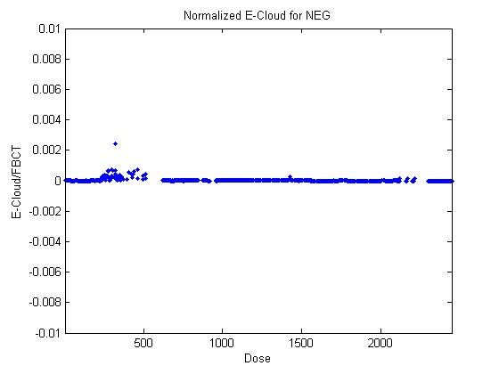
Results SPS MD run week 41: 50 ns LHC beam
Normalized current
Stainless Steel
Carbon
Carbon
e-cloud (5 times lower current than at 25 ns)
No detectable e-cloud
-No e-cloud effect with 50ns
- noise?
NEG

Slide 5
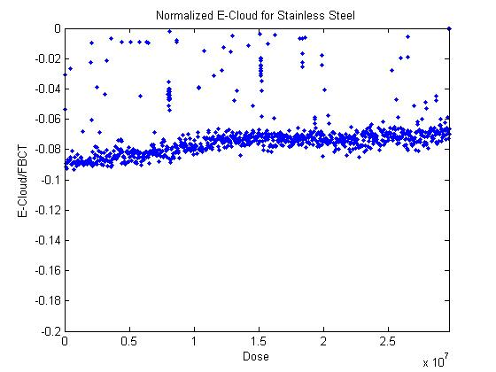
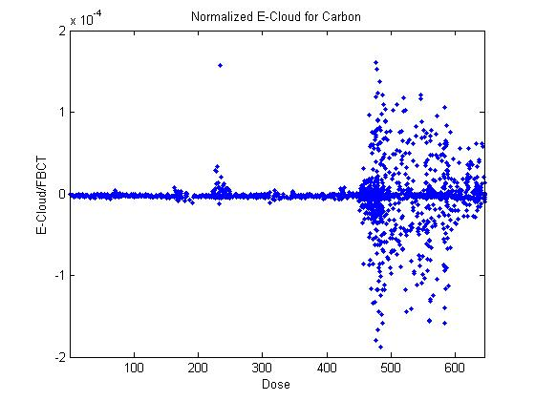
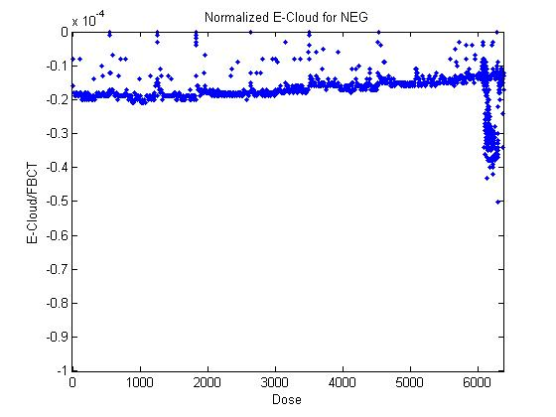
Results SPS MD run with 75 ns spacing LHC beam
Normalized current
Stainless Steel
Carbon
E-cloud, current as for 50 ns
(5 times lower than at 25 ns)
No detectable e-cloud
Weak but detectable
(1000 times less than at 25 ns)
NEG

Slide 6
Conclusions for liners left in the SPS for 2 months:
On C:
-decrease of normalized e-cloud current at 25 ns spacing compared to previous run with same liner
No detectable current at 50 ns and 75 ns
On stainless steel
Same current as before at 25 ns spacing
5 times less current at 50 ns and 75 ns
On NEG:
-5 times more current than before at 25 ns
-not measurable at 50 ns (?)
- 10000 times less at 75 ns than at 25 ns

