Slide 1
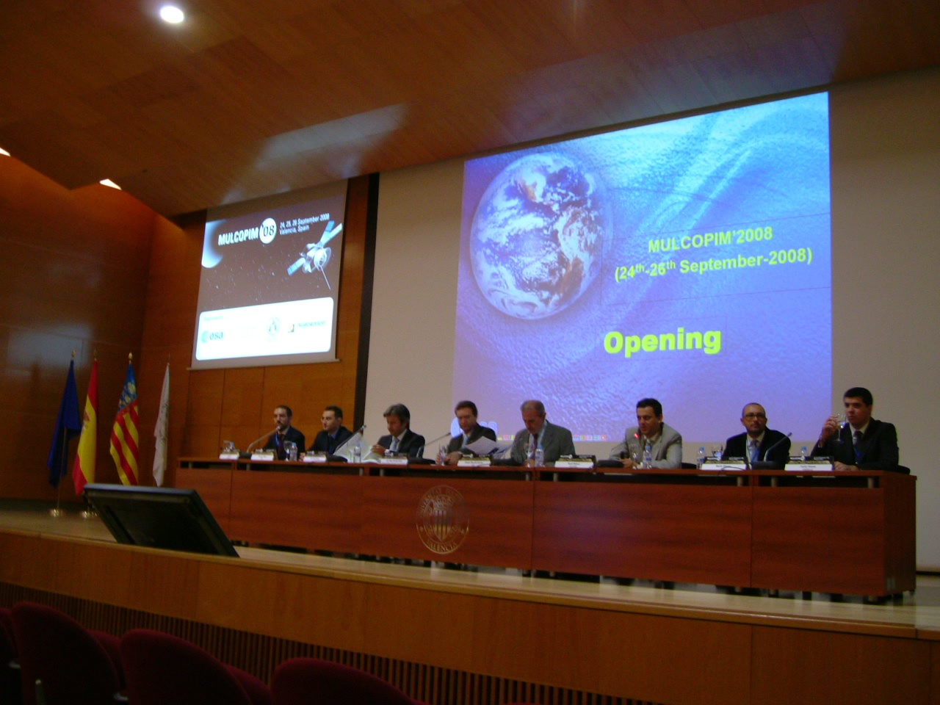
report from MULCOPIM’08
Frank Zimmermann
SPSU Meeting, 14 October 2008
We acknowledge the support of the European Community-Research Infrastructure Activity under the FP6 "Structuring the European Research Area" programme (CARE, contract number RII3-CT-2003-506395)

Slide 2
organization & statistics
multipactoring, corona and passive intermodulation in high-power microwave systems for satellite applications
workshop series of ESA/ESTEC; every 2 or 3 years; 1st time outside Netherlands
MULCOPIM’08 jointly organized by ESA, Polytechnical University of Valencia, U. of Valencia & AURORASAT
130-140 participants, 50 accepted abstracts, only plenary talks: 35 on multipactoring; 7 & 8 on corona & PIM
sponsors: Thales Alena Space, Rhode & Schwarz Espana, Agilent Technologies, INTA – Spanish Ministry of Defense, Alava Ingenieros, Generalitat Valenciana, Spanish Ministry of Education and Science

Slide 3
sessions
Opening
Multipactor 1: Dielectrics
Multipactor 2: Theory, Multipactor 3: Theory II
CPI visit – Polytechnic City of Innovation, iTEAM Clean Room Facility for High-Power Measurements
PIM 1, PIM 2
Multipactor 4: Accelerators
Multipactor 5: SEY
Corona 1, Corona 2
Multipactor 6: Multicarrier
Multipactor 7: Testing
24.
25.
26.

Slide 4
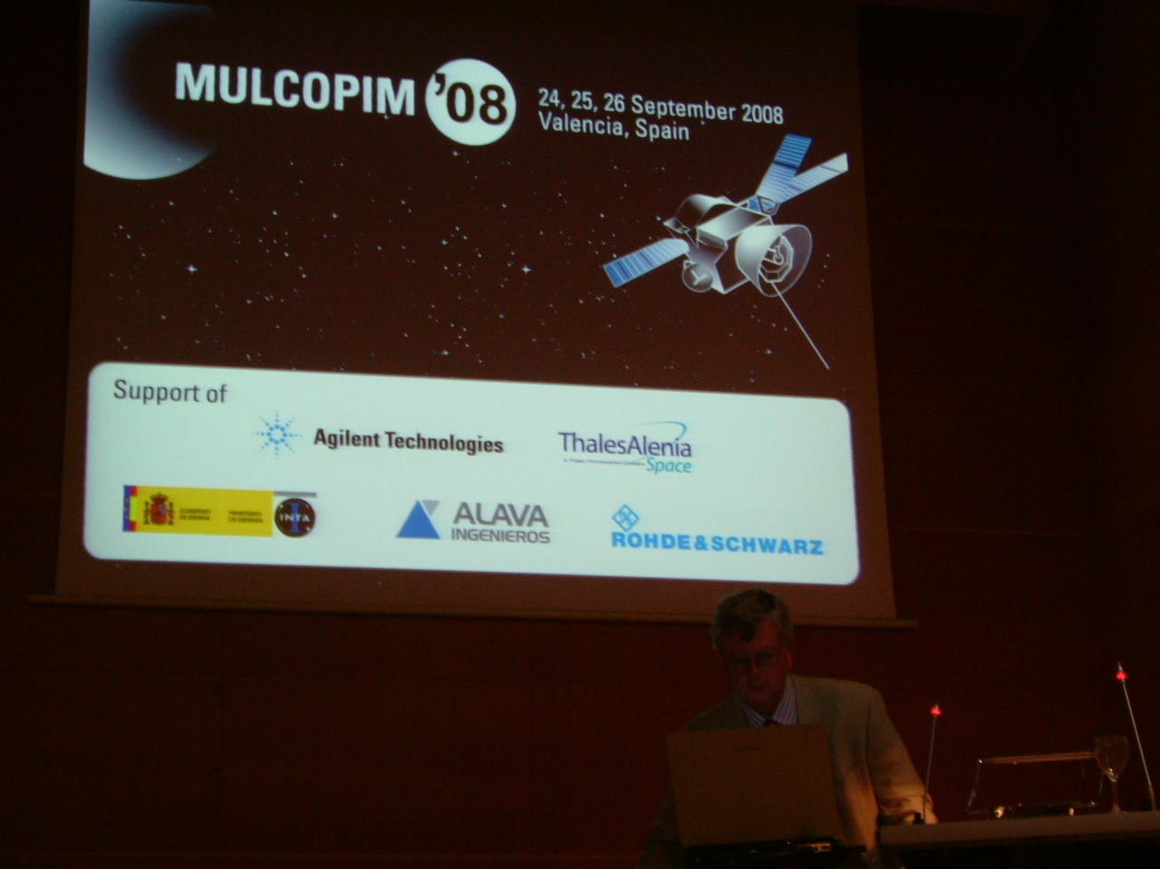
accelerator involvement
1st time accelerator community was invited (3 papers)
3 CERN participants supported by CARE-HHH: Fritz Caspers, Giovanni Rumolo, Frank Zimmermann
invited paper: F. Caspers, G. Rumolo, W. Scandale, F. Zimmermann, “Beam-Induced Multipactoring and Electron-Cloud Effects in Particle Accelerators”
Roberto Cimino from INFN Frascati
Frederick Le Pimpec (formerly CERN & SLAC; now PSI)

Slide 5
multipactoring - surfaces
waveguides, coaxial lines, and microstrip lines
main ESA mitigation strategy: modification of SEE properties
preferred cure: coating that do not change over time: POROUS COATINGS ! (examples)
do not rely on tabulated SEE properties!
run prediction software only with related measured SEY data => SEY DATABASE (under construction)
examples of treated surfaces, >9 db improvement in multipacting threshold, no sensitivity to time exposure.
concerns: contamination and poor coating

Slide 6
multipactoring - tests
ESA has enhanced R&D resources for this activity
advanced testing techniques
e- seeding by various means: beta emitter, UV flash lamp (120 Euro), regulated e- gun
ESA standard - ECSS-E-20-01 A “multipactor design and test”
multicarrier operation gives cloud evolution similar to e-cloud build up in accelerators (examples)
multicarrier test facility is built up at ESA

Slide 7
multipactoring - simulations
simulations codes: FEST3D, MEST, Multipactor Calculator
FEST3D: CAE tool for design of passive waveguide systems; based on integral equations, BI-RME, method of moments, network theory; fast computation, arbitrary geometries
database for software under construction
harmonization and standardization – benchmarks for simulations and measurements
MEST & CEST – simulating the transition from multipactoring to corona regime (increasing vacuum pressure); friction and scattering forces, algorithms

Slide 8
multipactoring - theory
theoretical and analytical studies by teams in Russia, Sweden and Northern Ireland
statistical theory of multipactor discharges between two parallel plates with different emission parameters
non-resonant or “poly-phase multipacting” – similar to our case in accelerators
wedged wave guide similar to rectangular wave guide, both have unstable stationary trajectory, little improvement in multipacting threshold
velocity spread of secondary e- important
secondary emission yield description often similar to ours; sometimes other historical formula from Vaughan

Slide 9
ideas & follow up
contacts with ESA, PUV, EPFL etc.
Fritz “solved” satellite multipactoring !
proposed modification of FEST3D to include particle beam & static magnetic fields
simulate microwave e-cloud diagnostics
simulate suppression or enhancement of e-cloud by microwave injection near cyclotron resonance
simulate “magnetron” effect
verify effect of ions
benchmark CERN simulation codes

Slide 10
some highlights from talks
overview, databases for SEY & simulation codes (D. Raboso)
novel porous coatings with low SEY (L. Galan)
ESA multipactoring standard (Christoph Ernst)
transition from multipacting to corona (L. Conde)
multicarrier multipacting (S. Anza)

Slide 11
D. Raboso

Slide 12
D. Raboso

Slide 13
D. Raboso

Slide 14
D. Raboso

Slide 15
D. Raboso

Slide 16
D. Raboso

Slide 17
D. Raboso

Slide 18
D. Raboso

Slide 19
New Coatings of Silver and Gold with Strong Surface
Roughness for Significantly Reducing Multipactor Effect in RF Components.
L. Galan et al ., Departments of Applied Physics and Chemical Analysis, Universidad Autonoma
de Madrid, CSIC, TESAT Spacecom GmbH, ESA/ESTEC
part of research program “Porous Inert Metal Coatings for Controlling Secondary Electron Emission”, extension of ESA AO 4025
new research line on reliable low-secondary-emission coatings based on surfaces with strong roughness of high aspect ratio
general goal: improve on the performance of the Alodine coating
Techniques for anti-multipactor coatings:
Magnetron Sputtering Deposition at High Pressure and High Rate, Copper
Thermal Evaporation Deposition at High Pressure and High Rate, Silver
Ion Etching (Sputtering) Assisted by Sputtering Deposition of Masking Material, Gold and Titanium
Electrochemical Oxidation (Anodization) plus Sputtering Deposition, Aluminium and Gold
Chemical Etching, Silver
Chemical Etching plus Sputtering Deposition, Silver and Gold
L. Galan et al, Madrid

Slide 20
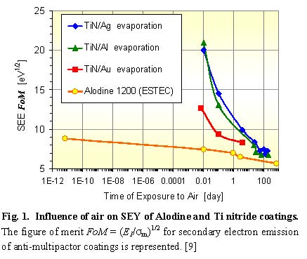
L. Galan et al, Madrid
Alodine: reference anti-multipactor coating for ESA since several decades;
goal of R&D: to develop even better coating

Slide 21
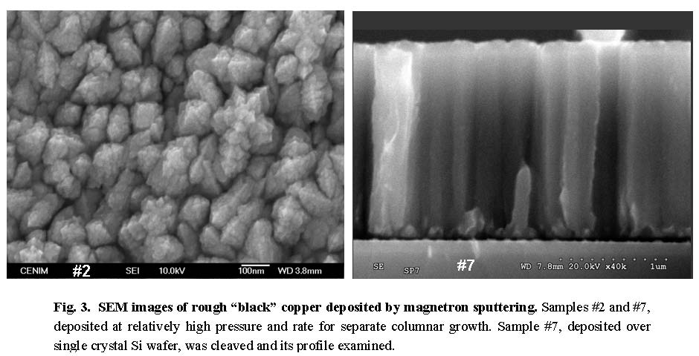
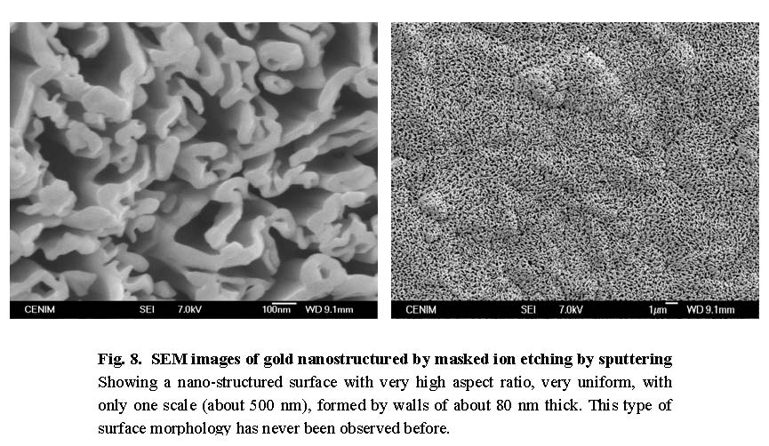
black copper deposited by
magnetron sputtering
nano-structured gold
produced by masked
Ion etching
L. Galan et al , Madrid

Slide 22
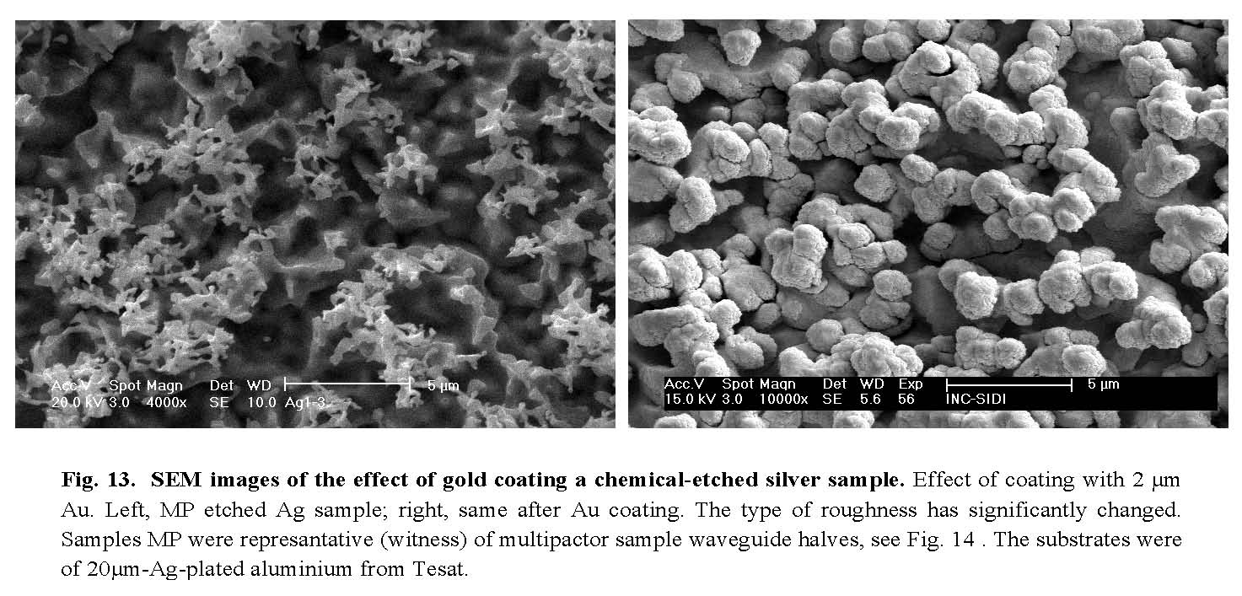
chemical etched silver
chemical etched silver
coated with gold
L. Galan et al , Madrid

Slide 23
intermediate conclusions
from ESA coating research line
New anti-multipactor coatings with strong surface roughness of high aspect ratio which have abnormally low SEY for low primary electron energies.
Gold coatings have more stable SEY than silver ones and could be preferred in spite of their lower surface conductivity.
A particular silver-gold coating specially structured, but simple to prepare, has probably suppressed multipacting completely.
The profile of the surface roughness, and not only low SEY, could be of great importance for multipactor effect. Thus multipactor tests become crucial for verifying the behaviour of a potential coating of low SEY.
Future research should address the improvement of coating adherence and mechanical properties.
L. Galan et al , Madrid

Slide 24
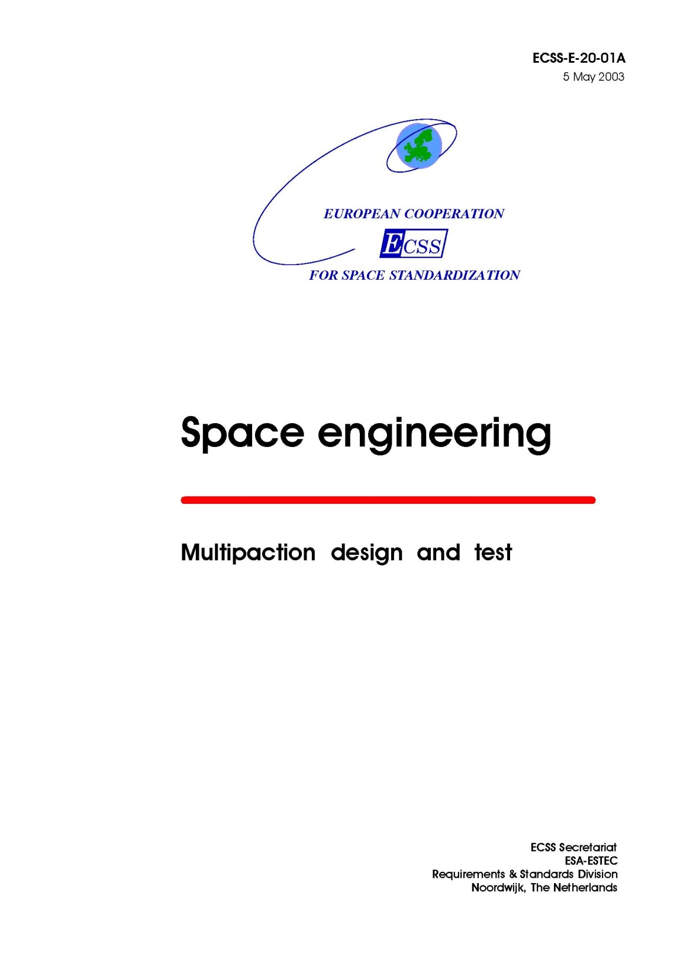
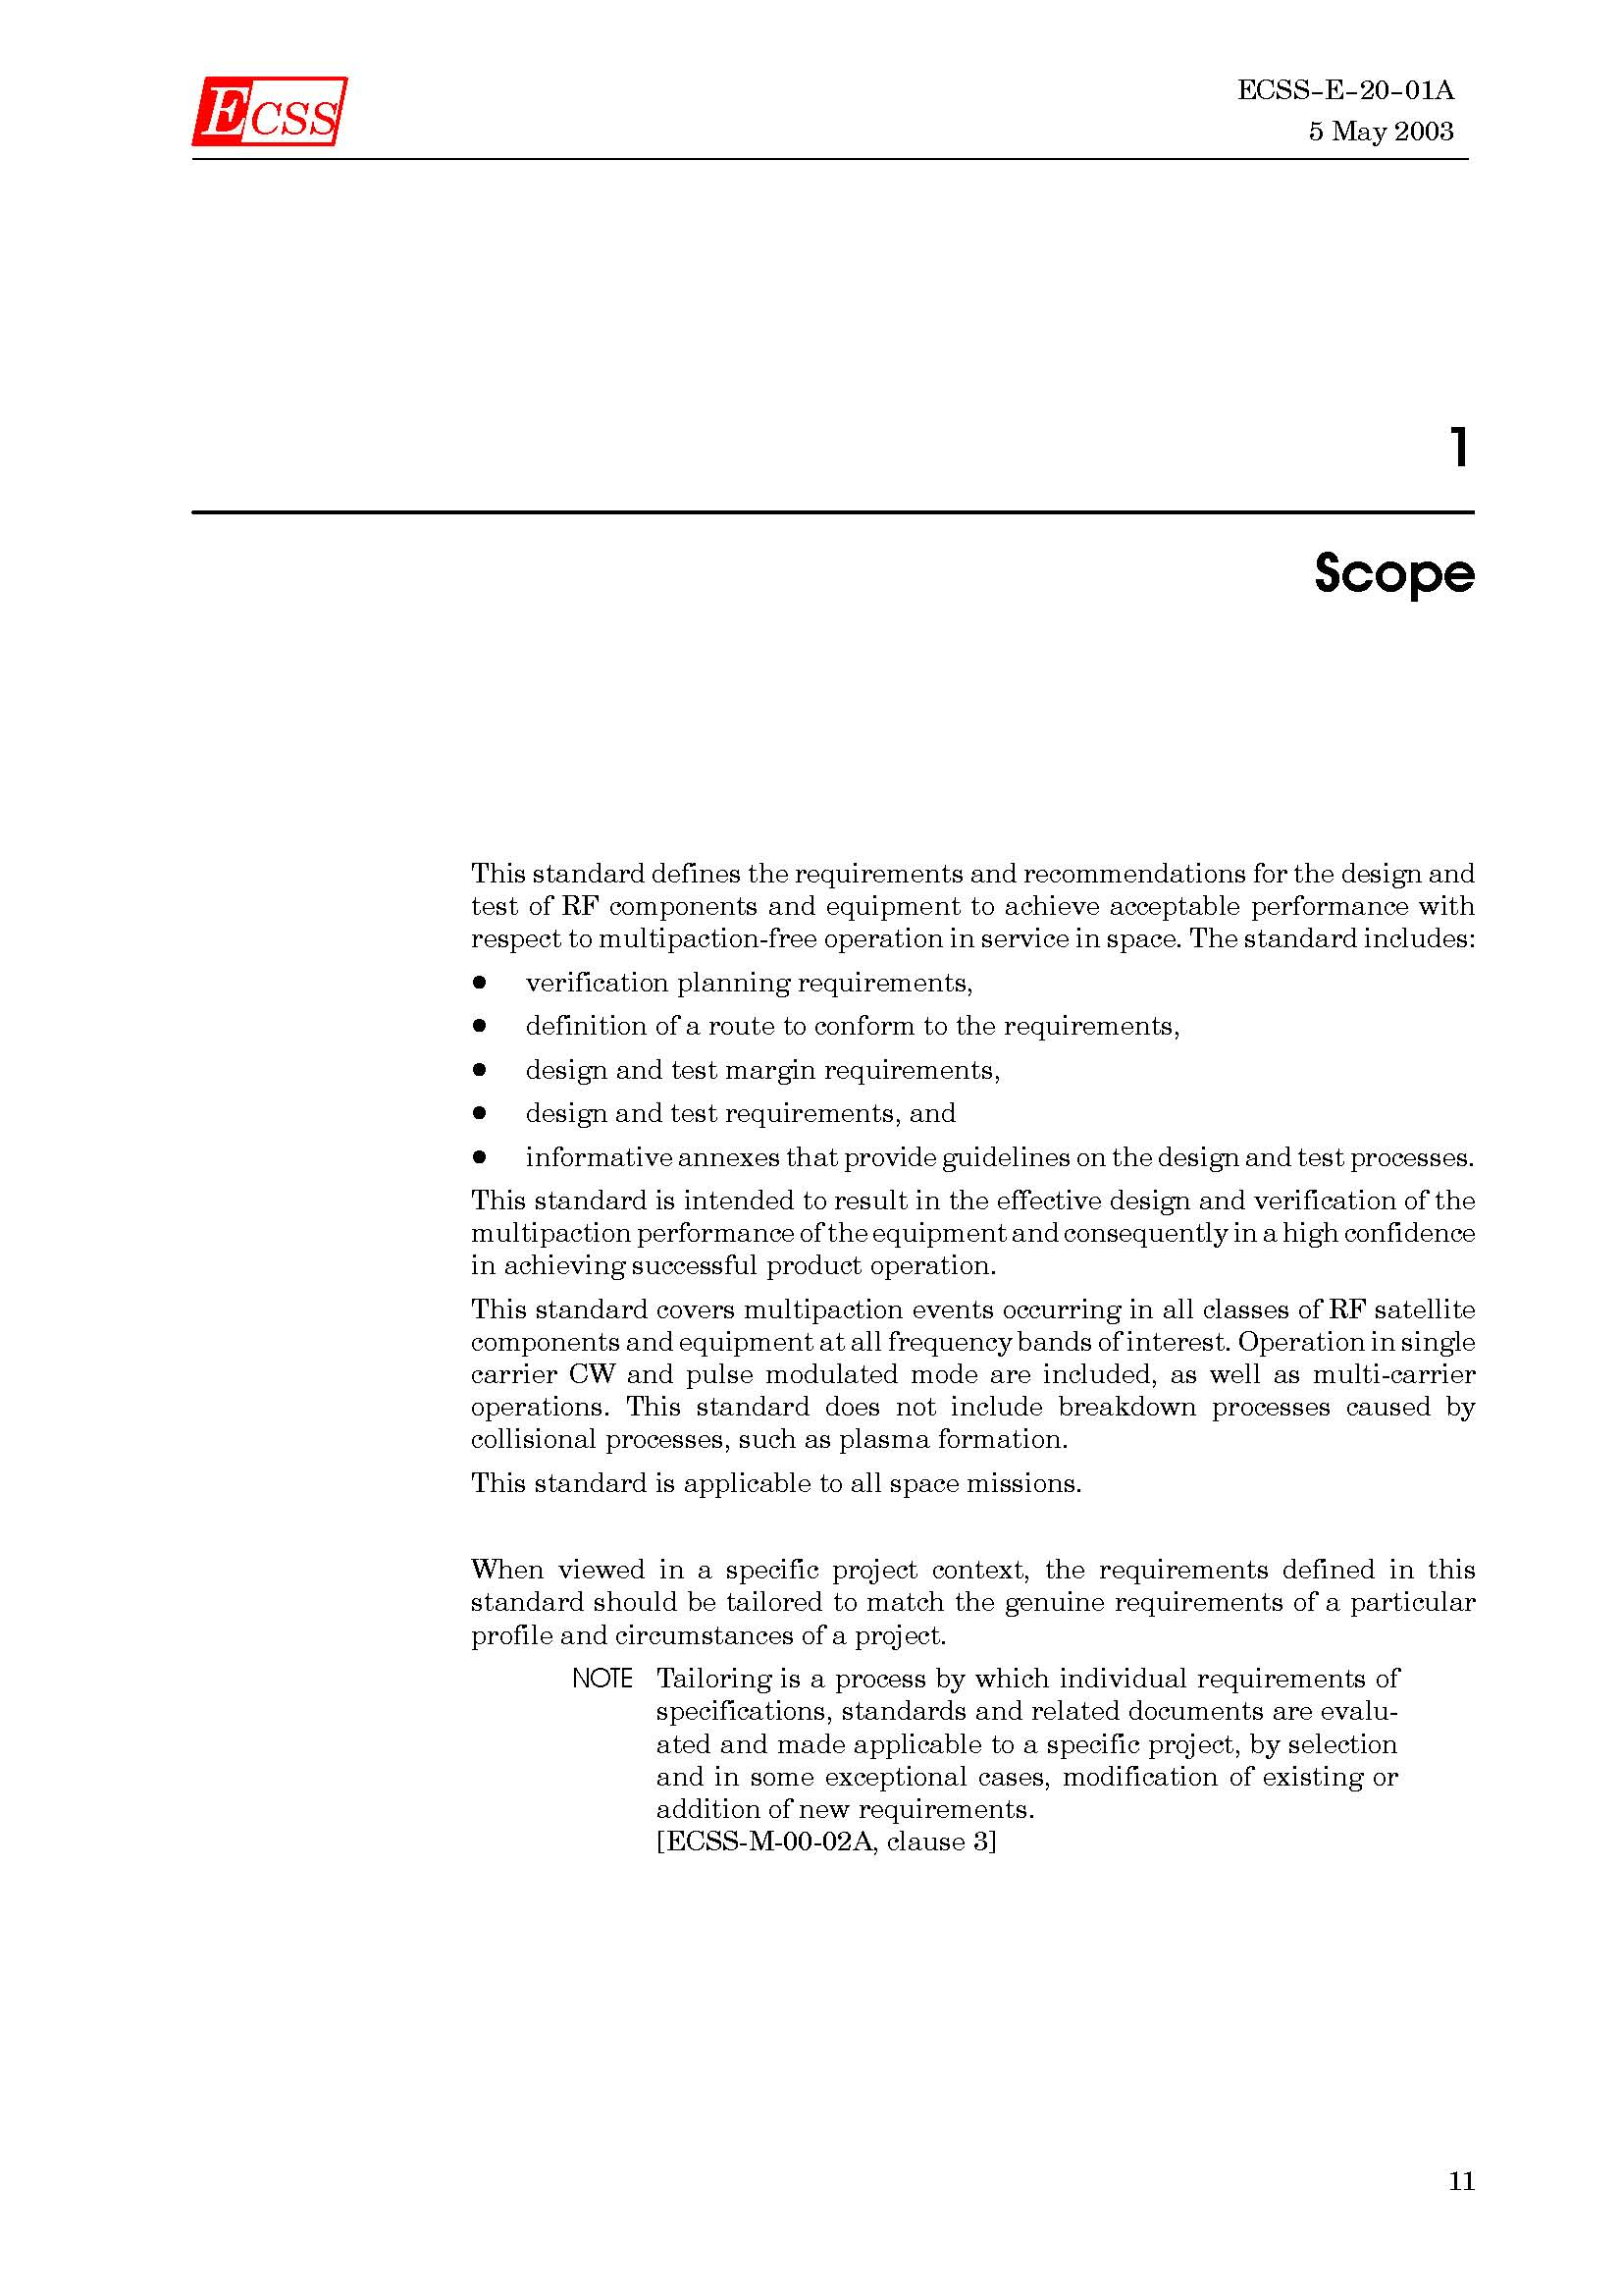
D. Raboso, C. Ernst
“ESA multipactoring standard”

Slide 25
L. Conde

Slide 26
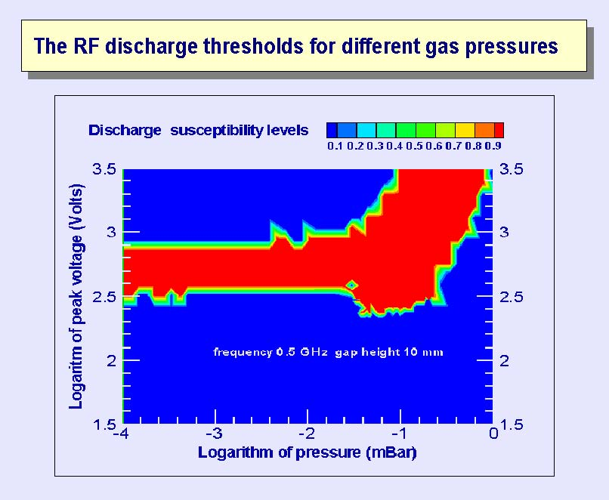
L. Conde

Slide 27
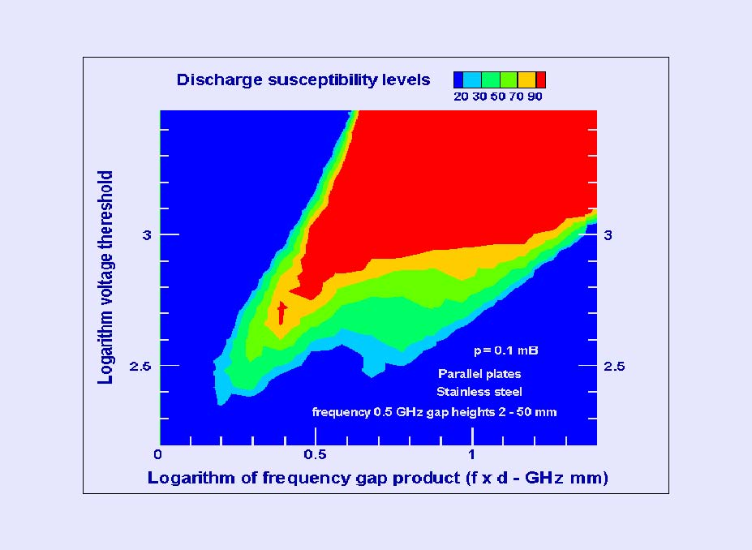
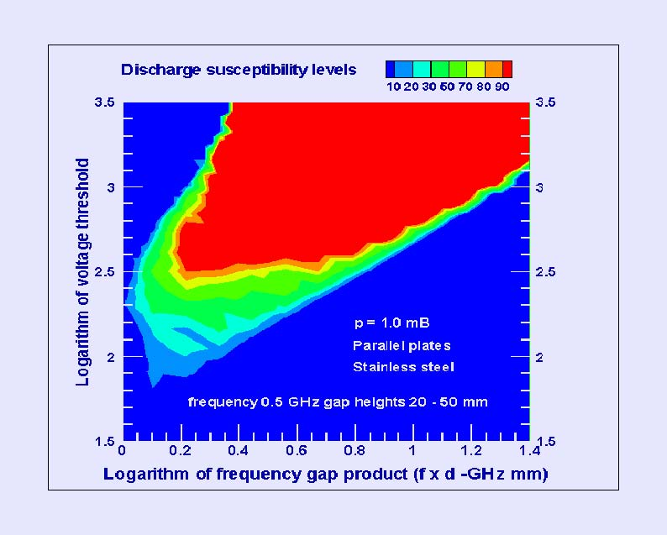
L. Conde

Slide 28
multicarrrier multipacting
S. Anza

Slide 29
multicarrier multipacting resembling beam-induced multipacting
S. Anza

Slide 30
S. Anza

Slide 31
S. Anza

Slide 32
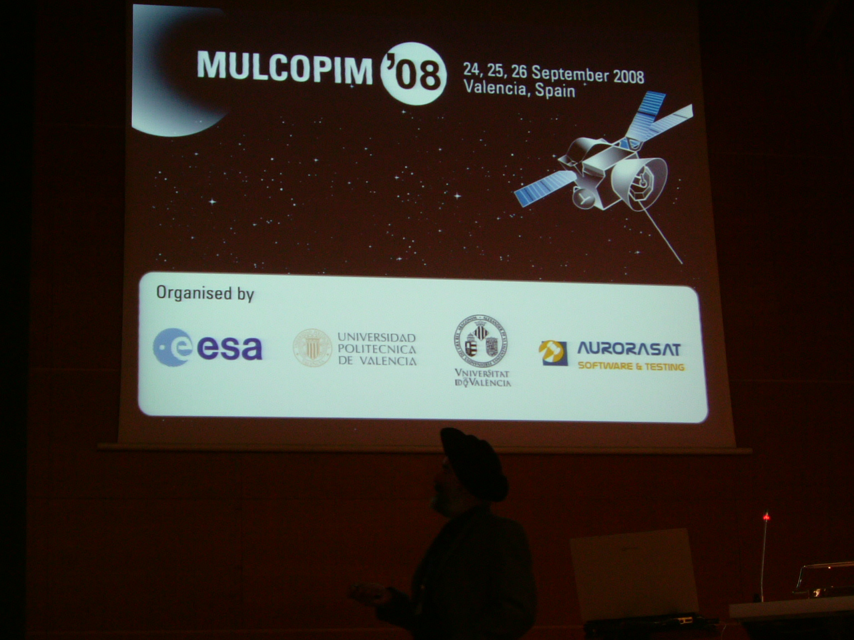
the end
we are trying to invite some satellite e-cloud colleagues to CARE-HHH
mini-workshop on e-cloud mitigation, CERN 20-21 November 2008

