Slide 1
The LHC ACS RF power couplers for testing magnetic SEY suppression F.Caspers, E.Montesinos, SPSU Dec 2009
Large Hadron Collider
Accelerating Cavities Superconducting
400 MHz 300 kW CW coupler

Slide 2
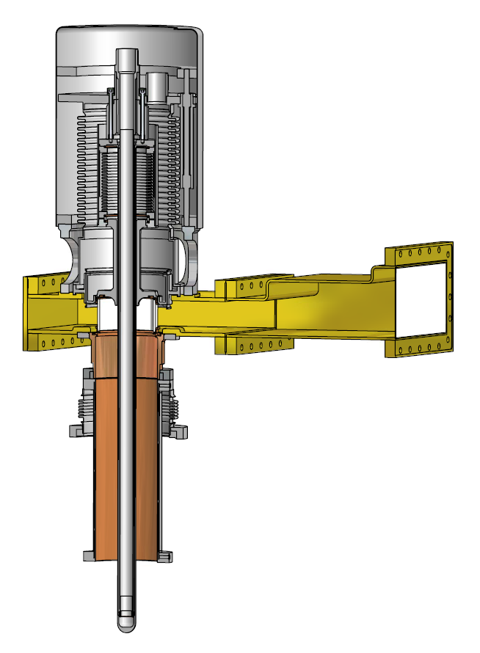
LHC couplers (layout)
The LHC power coupler is a 400 MHz mobile RF power coupler with very high power requirements :
Continuous : 250 kW
Pulsed : 300 kW fwd + 670 kW rev, including beam loading, i.e. 1.85 MW local peak power.
Challenge
To design a mobile RF power coupler without sliding contacts for these very high power levels.
Main design features
A Cylindrical ceramic window with solid copper rings brazed to the ceramic ends, placed in the waveguide-to-coaxial transformer, provides vacuum integrity.
To suppress multipactor during operation two DC bias levels are applied:
2.6 kV, to the low impedance 7 Ω λ/4 line transformer, isolated from ground by a coaxial capacitor in the waveguide.
2.6 kV + 400 V, to the antenna, isolated from the λ/4 line transformer by a disk ceramic capacitor between λ/4 line transformer and bellows.
Air cooling is provided on the window and other critical elements of the coupler, such as the antenna.
A Vacuum gauge is located close to the window and is used for coupler conditioning and interlock.
Air inlets
Displacement mechanism
Bellows λ/4 line
Disk ceramic capacitor for second polarization
Low impedance 7 Ω λ/4 line
Main coaxial capacitor for polarization
Reduced height waveguide
Main cylindrical ceramic window
Open ended 75 Ω coaxial line under vacuum:
Outer conductor double walled
Inner conductor copper antenna

Slide 3
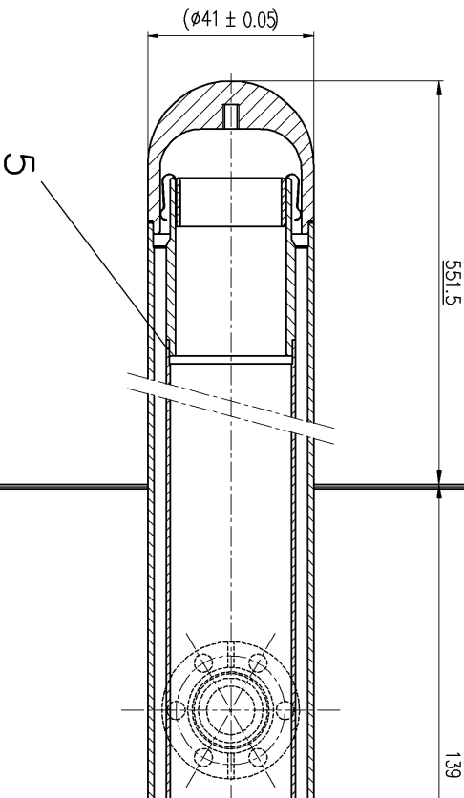
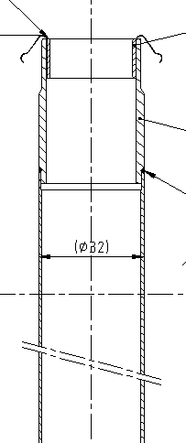
LHC couplers - where to install a double coil
First idea was to apply a nickel layer on the
outer surface of this coupler, coated with 10 micron
copper…but we need multipacting during the “conditioning
in phase“ thus we require a „switchable“ SEY..
we need the double coil inside
Copper antenna :
external diameter = 41 mm
internal diameter = 38 mm
Inner air cooling cane
external diameter = 32 mm
Space for winding = 3 mm
Note that this coupler appears like an anti-cryostat.. warm air inside.. warm copper in an SC cav

Slide 4
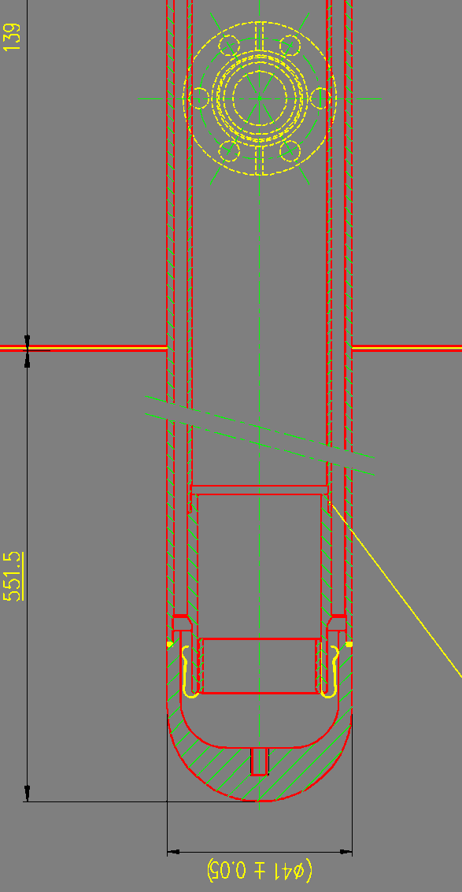
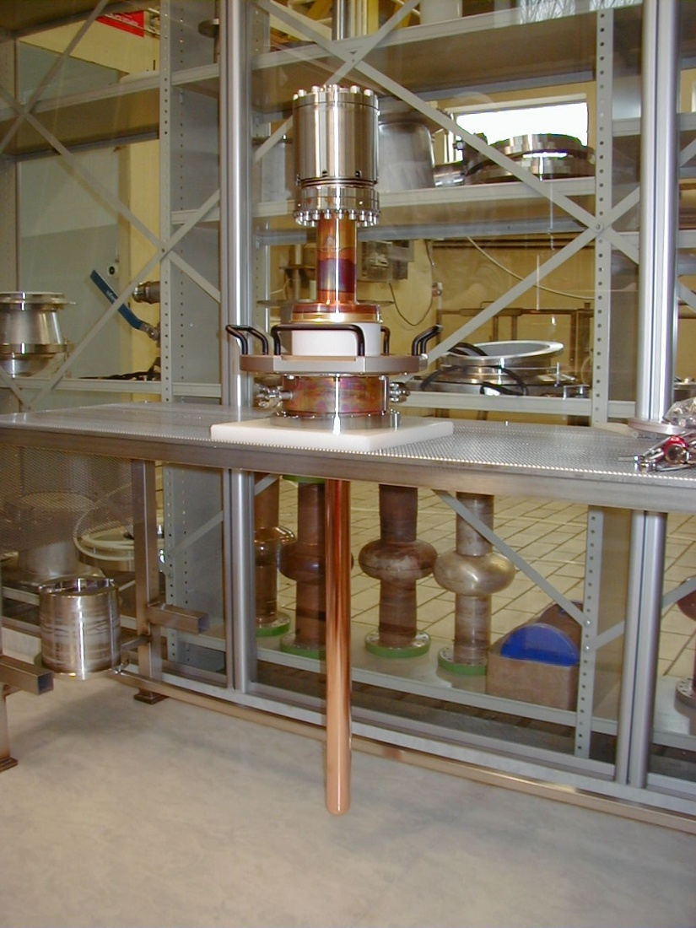
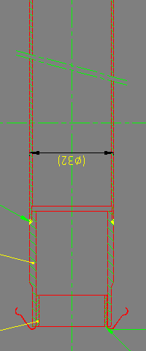
LHC couplers
Inner copper antenna with inner air cooling cane

