Slide 1
Scrubbing Run Results of E-cloud
Christina Yin Vallgren
Many thanks to all the members of the SPS-U working group and Elena Benedetto!

Slide 2
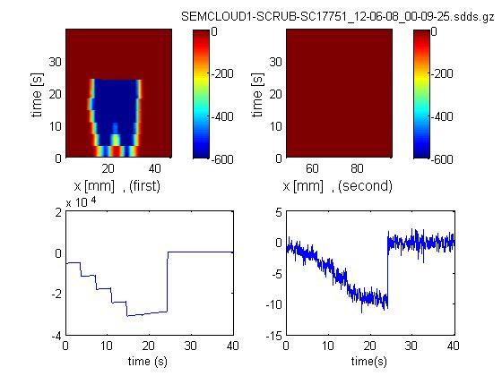
SEMCloud monitor 1
Stainless Steel
NEG

Slide 3
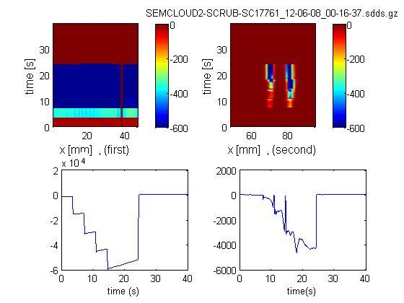
SEMCloud monitor 2
Quad strop
Carbon

Slide 4
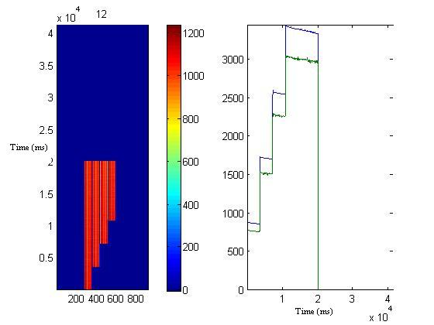
FBCT monitor

Slide 5
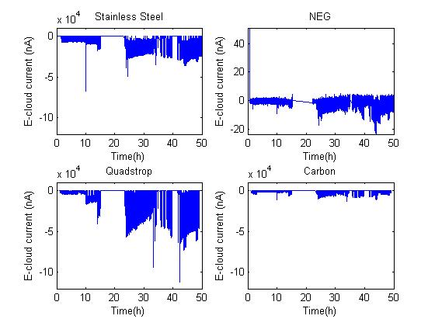
Results - EC
Stainless steel has δ_{max} = 2.5
Completely activated NEG has δ_{max} = 1.1.
The yield of the C coating which was in that liner is estimated 1.4.

Slide 6
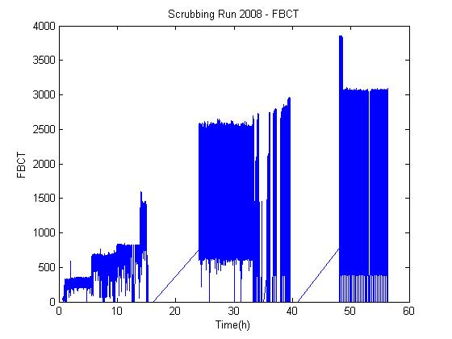
Result - FBCT

Slide 7
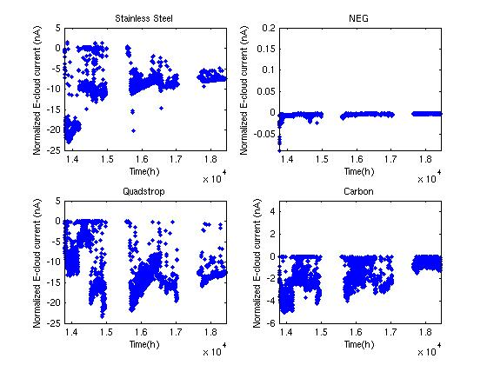
Result – Normalized EC
|E-Cloud|_{max} / FBCT_{max}

Slide 8
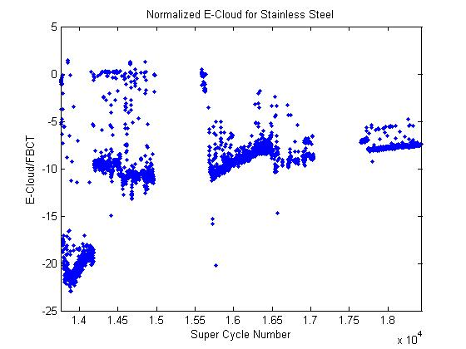
Results in detail
E-Cloud in Stainless Steel has been reduced by nearly a factor of 2.

Slide 9
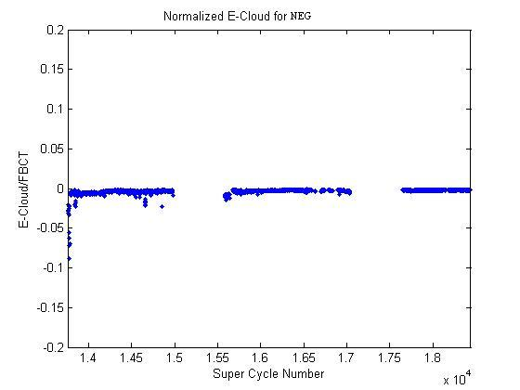
Results in detail
E-Cloud in NEG showed no activity.

Slide 10
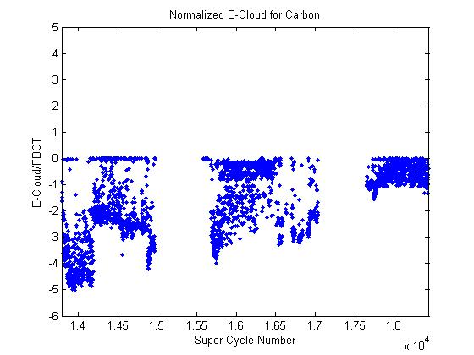
Results in detail
E-Cloud in Carbon was found to change by nearly a factor of 5.

Slide 11
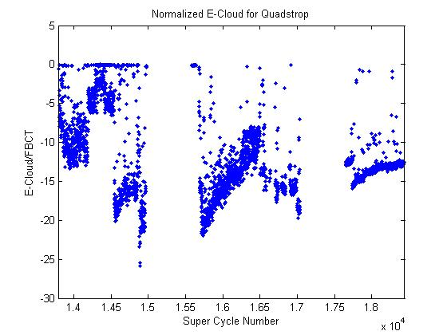
Results in detail
???

Slide 12
we are ready with a liner with carbon coating and lower SEY than the previous one.

