Slide 1
Results E-cloud Measurements BA5 MD Week 29
Fritz Caspers, Silke Federmann, David Seebacher

Slide 2
Outline
Current measurement setup
Sources for IMD (Inter Modulation Distortion)
Measurement results coated/uncoated

Slide 3
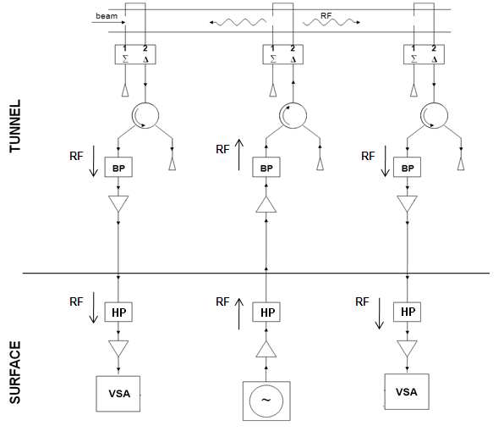
Current Measurement Setup
Only the coated/uncoated section was measured (one cable of the other section was used for DC power supply in the tunnel)
High pass filters were installed at the (surface) end of the coaxial cables to suppress the induced 44kHz EMI (Electromagnetic Interference) signal form the beam
Such filters should also be installed in the tunnel as well

Slide 4
Sources for IMD
3.)
44 kHz spaced Beam Harmonics
44 kHz ecloud
IMD (Inter-Modulation Distortion) caused by the induced 44kHz on the power supply lines entering via power supply input of the amplifiers
IMD caused by the 44kHz on the cables at the amplifiers input and output
IMD caused by the Beam Harmonics (around 2.68GHz) at the input and output of the amplifiers
1.)
2.)
44 kHz on power supply
44 kHz on the cables

Slide 5
IMD by power supply
44 kHz ecloud
The power supply voltage for the amplifiers in the tunnel was found to be contaminated with a induced 44 kHz signal
Undesired Modulation (AM and PM!) occurs in the amplifiers in the tunnel
Tests showed that the PM is by the order of at least a magnitude smaller than AM
AM from the transmitter amplifier may cause PM signals via AM/PM conversion caused by different side band attenuation on the track (slope of the Hardware Transfer Function HTF)
44 kHz on power supply

Slide 6
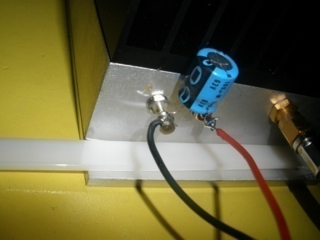
Removal of power supply IMD
To reduce the IMD, filters have been inserted to attenuate the 44kHz signal
Capacitors have been connected in parallel to the amplifiers DC power input. Test proved that this reduces the IMD entering this way by ~40dB
It was also found that a slightly increased supply voltage (5-10% above nominal) reduces IMD sensitivity on this path. This is due to a better (internal) voltage regulator performance, when having a higher voltage drop across this regulator
without capacitor
with capacitor

Slide 7
44kHz on the cables
44 kHz ecloud
The 44kHz on the cables cause IMD in all amplifiers used
The signal can easily be suppressed by a simple High-Pass-Filter
This has been done at the surface and still needs to be done in the tunnel!
44 kHz on the cables

Slide 8
Beam Harmonics IMD
44 kHz spaced Beam Harmonics
44 kHz ecloud
The Beam Harmonics cause IMD
This happens in both (tunnel and surface) receiver amplifiers and may also occur at the VSA input to a certain extend
In the transmitter amplifier IMD can’t be entirely excluded, but should be less relevant due to the attenuation of the circulator in reverse direction
We assume that the circulator itself does not cause any IMD
IMD in the transmitter path should be seen on both receivers in the same amount
?

Slide 9
Removal of Beam Harmonics IMD
It turned out that this is the most important and also the most difficult point
To reduce the IMD two approaches can be made. The first is to reduce the amount of Beam Harmonics power, that reaches the amplifiers. This can be done by placing very narrow band filters.
Narrow band filters with less than 1Mhz bandwidth and a flat transmission characteristics (AM/PM conversion) in the pass band are hard to produce for such small bandwidth. Temperature dependent frequency drift between them has to be kept in mind as well in this case
Now we have a single resonator with 16Mhz 3dB bandwidth and not very steep slopes
For the amplifiers usual engineering approaches can’t be applied, they have to be operated very far below the typically used 1dB compression point!
In fact we have to operate about 20dB below this value (or 0.01dB compression)

Slide 10
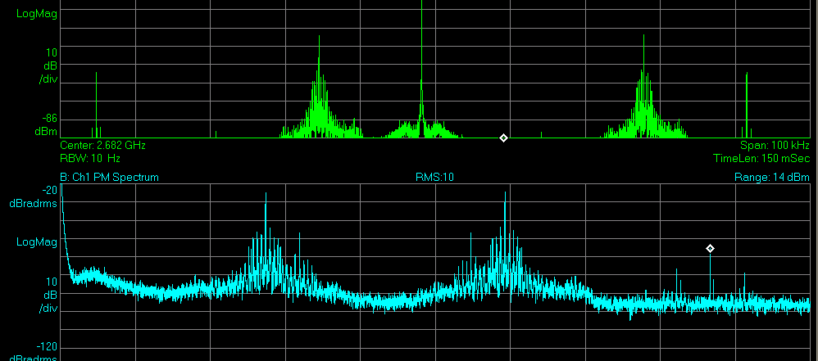
Hints for Beam Harmonics IMD
The Beam Harmonics themselves are not a very narrow line, they contain many spectral components
Therefore the IMD caused by them is not just a single frequency, but rather a number of lines. This makes them easier detectable, but also more dangerous as those lines add up coherently
It’s the same type of problem, which has prevented successful bunch beam stochastic cooling for many years in the SPS and at Fermilab (this has cost several millions in the end)
After injection, when the beam harmonics are high the largest IMD occurs
Main modulation line
Injection
IMD related peaks
Spectrum
Beam Harmonics
PM Demodulation
IMD related peaks

Slide 11
Summary IMD
44 kHz base band IMD can be easily reduced by placing the correct filters (blocking capacitors at the 15V input and high-passes in the signal cables)
Beam Harmonic IMD is very complicated and can be reduced by very narrow band filters and/or alternate amplifiers with much higher IP3-points (hard to find)
Most likely we need a good/realistic combination of both methods of mitigation
The signal levels in the receiver path have to be set very accurately and highest vigilance to IMD has to be paid.
Keep in mind that modulation is a vectorial quantity, hence modulation (IMD) at two different locations may interfere constructively or destructively and any value in between, depending on the phase!

Slide 12
Measurement Results
The evaluation was very difficult, as it had to be made sure not to be fooled by IMD signals, which are present to a very large extend
To quantify IMD the carrier, beam harmonics, AM and PM demodulation have been observed vs. time
It was found that most of the traces are severely contaminated by beam harmonics related IMD, where the AM correlates very well with the intensity of the beam harmonics
The amount of residual modulation by the base band 44kHz signal on the cables can’t be determined (no high pass filters at the input and output of the amplifiers in the tunnel) We consider that 44kHz via the 15v-Inputs have been successfully mitigated.
For the first time in this measurement campaign lower AM than PM was observed! This shows that we made progress on EMI problem

Slide 13
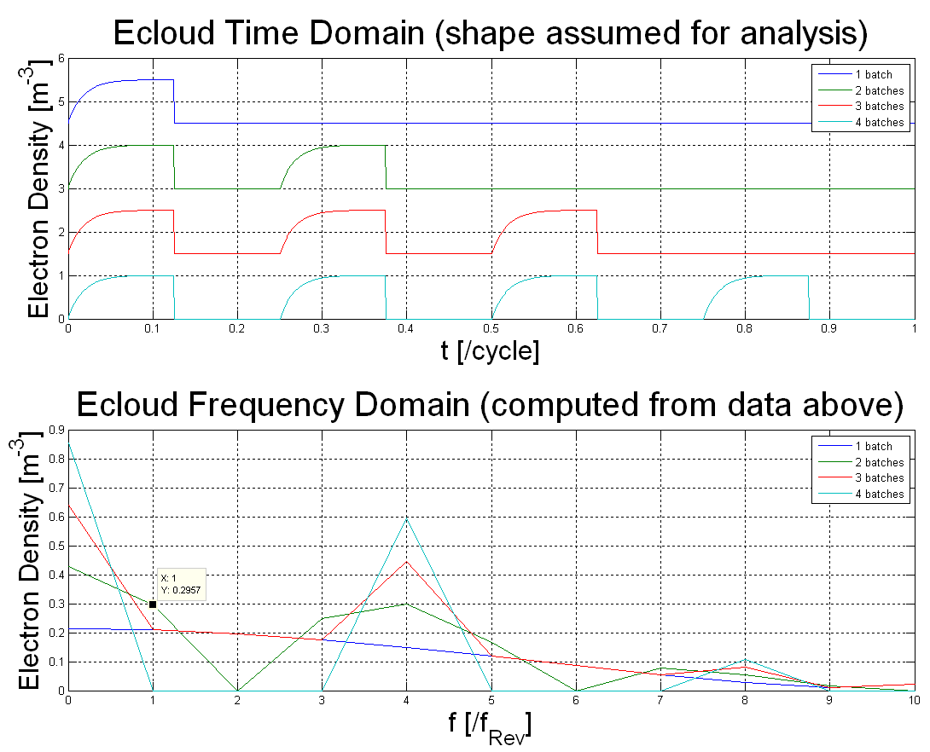
What quantity of the ecloud is measured?
The carrier is modulated by the ecloud (shape relative unknown) in time domain. The modulation repeats as the ecloud every revolution
What we seen on our instrument is the peak value of the fundamental wave of the modulation (ecloud)
Measured value has to be multiplied with an, shape dependent and not precisely known factor to get the peak value in time domain!
Offset
Harmonics
Fundamental

Slide 14
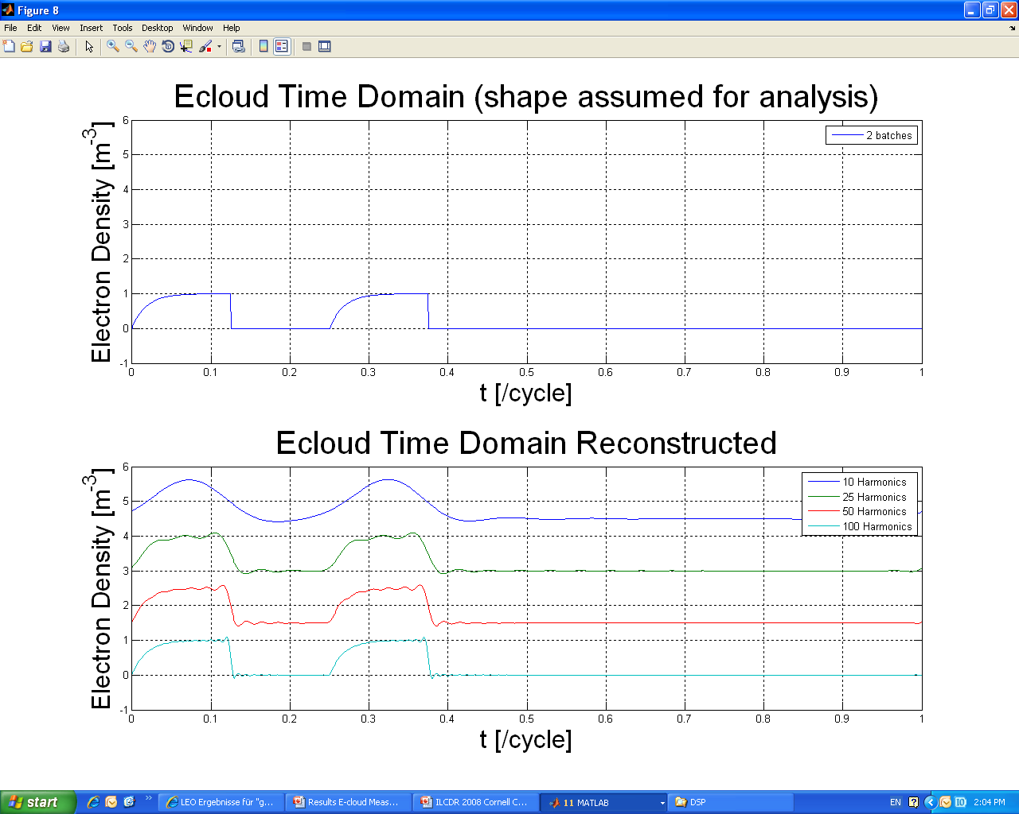
Bandwidth needed for Time Domain Analysis
To display the original signal a certain amount of bandwidth is needed to let the higher harmonics pass
On the right synthetic data can be seen, which has been plotted below with containing only a limited number of harmonics (low pass filtered)
50 Harmonics correspond to a bandwidth of our band-pass filter of 4.4 MHz as we need both, upper and lower side bands
The demand for relative wide band filters to observe the modulation in time domain is contrary to the obligatory narrow band filtering to reduce beam harmonics power and IMD
data shifted vertically for better reading

Slide 15
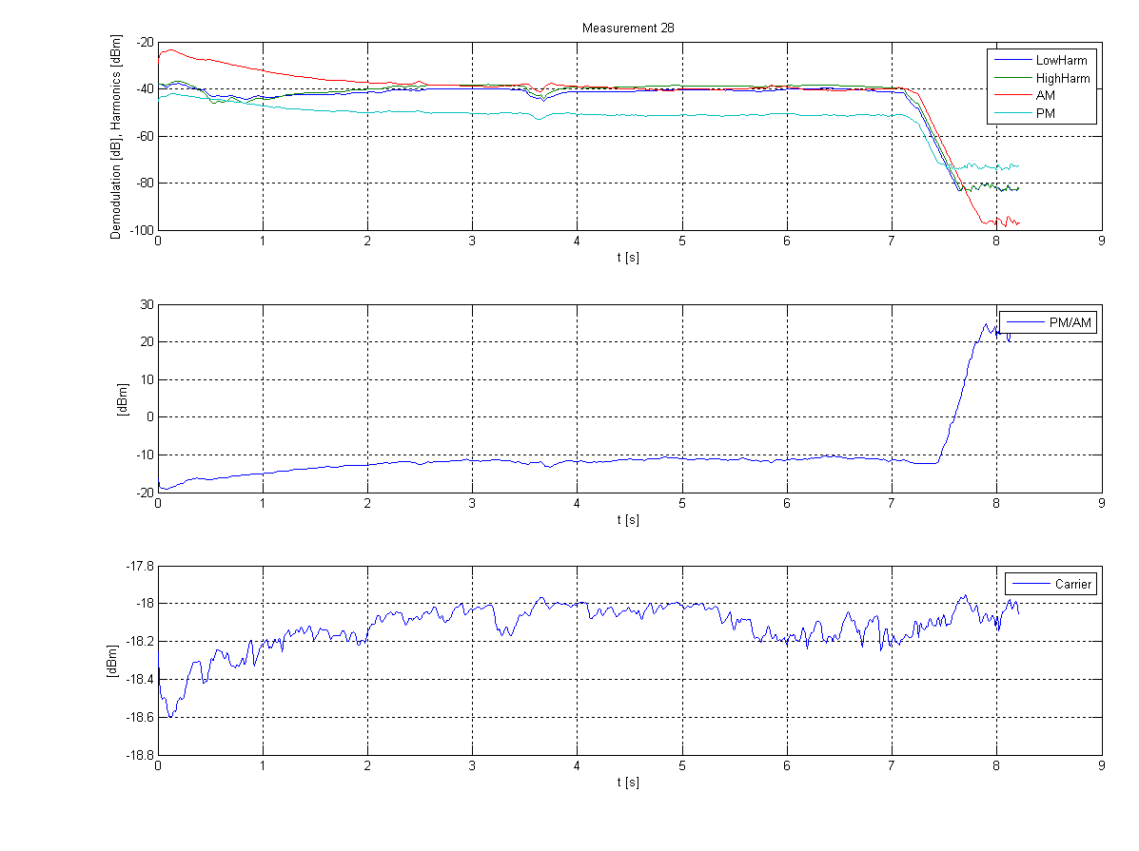
Results Uncoated Magnet
All traces of the uncoated magnet are contaminated with IMD, mainly caused by Beam Harmonics
The AM is larger than the PM and their time gradient is the same and they have a rather constant PM/AM-ratio
The small change in the PM/AM ratio gives hints that somewhere below the actual e-cloud signal is overlaid
AM and PM show a related intensity vs. time
Noise floor
PM/AM ratio is rather constant after amplifier saturation has decayed
amplifier saturation, vert. scale .1dB/Div
We are still below the 1dB compression point

Slide 16
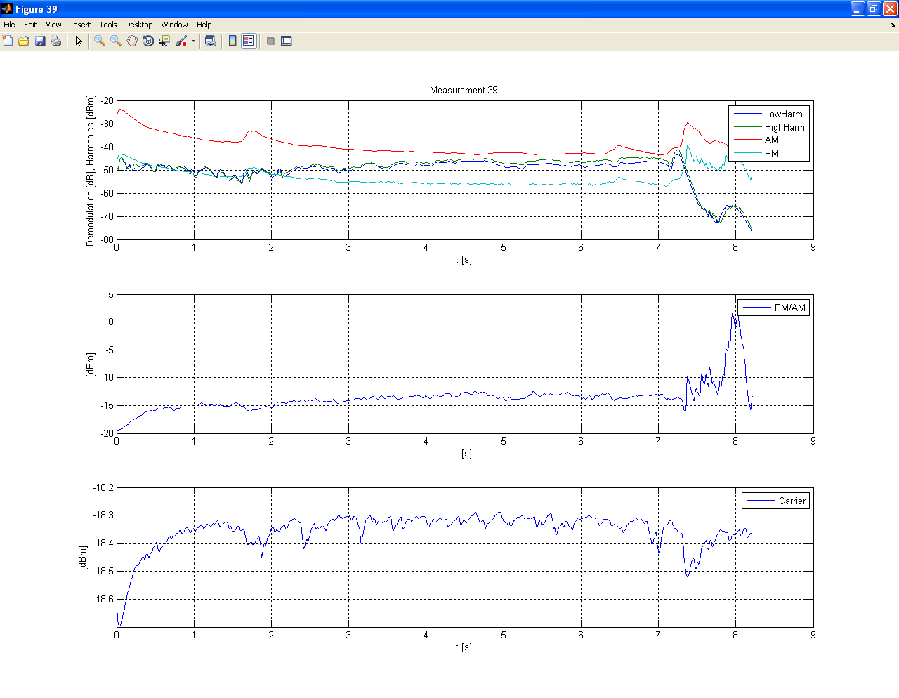
Results Uncoated Magnet
Another measurement, which shows the same trends
After the injection of the second bath it can be seen that the amplifier is driven to saturation by the beam harmonics
This means that at this point we have the highest IMD and measurements are only possible after a suffient decay time
AM and PM show a related intensity vs. time
PM/AM ratio is rather constant after amplifier saturation has decayed
amplifier saturation

Slide 17
Results Uncoated Magnet
All traces of the uncoated magnet show have the Beam harmonics related IMD peaks beside the narrow main modulation line
It is impossible to distinguished between e-cloud signals and IMD
Main modulation line
IMD related peaks

Slide 18
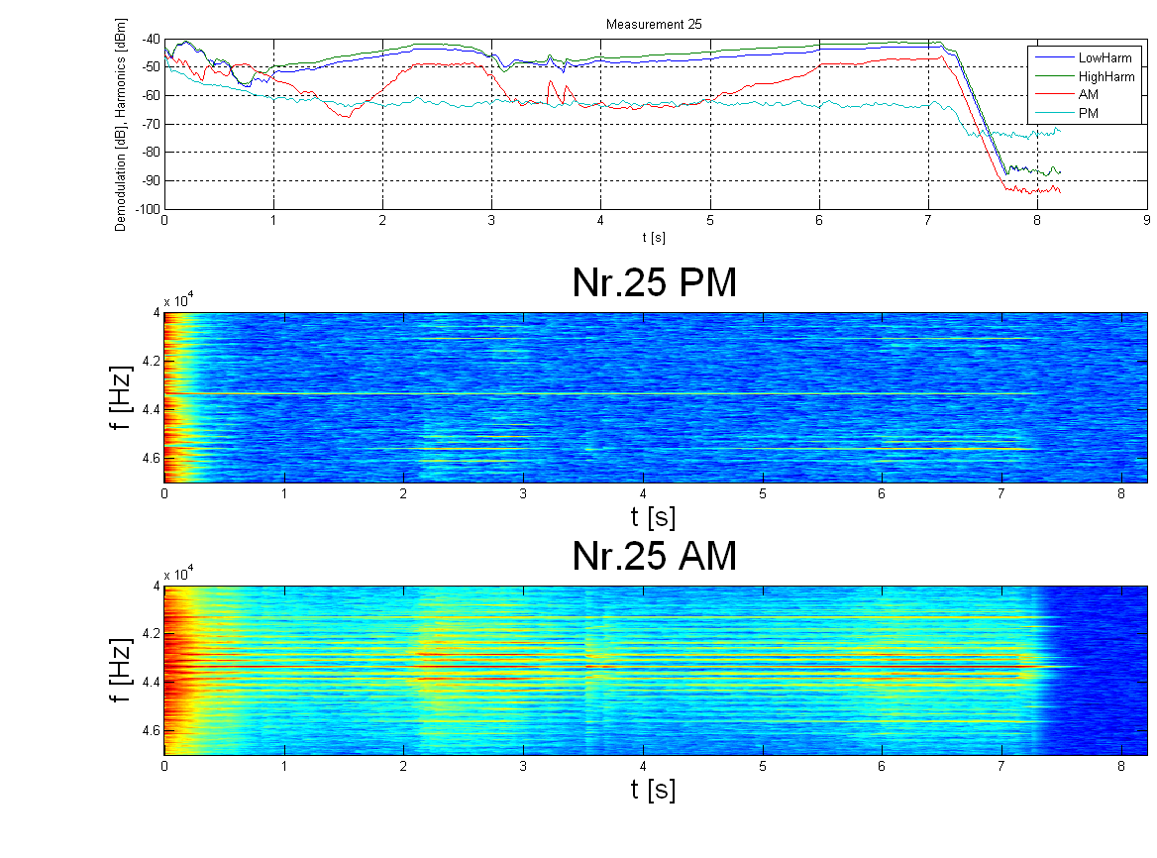
Results Coated Magnet
Most of the traces of the uncoated magnet are IMD contaminated as well
The AM is partly smaller than the PM
The harmonics correlate very well to the AM and the beam harmonic IMD side peaks in the demodulation
The beam harmonic IMD depends cubical on the harmonics
The PM does NOT correlate with the AM!

Slide 19
Results Coated Magnet
All traces of the uncoated magnet are IMD contaminated, for the coated magnet to a large extend
The AM is partly smaller than the PM
Test showed that for the basic 44kHz IMD the AM is by at least an order of magnitude higher than the PM. From the uncoated magnet we learnt that the PM/AM ratio is relative constant at approx. -15dB, and the PM shows throughout IMD side peaks
When applying the above mentioned to the data from the coated magnet only a few moments, were the AM is smaller than the PM and no IMD side peaks are visible, are left!

Slide 20
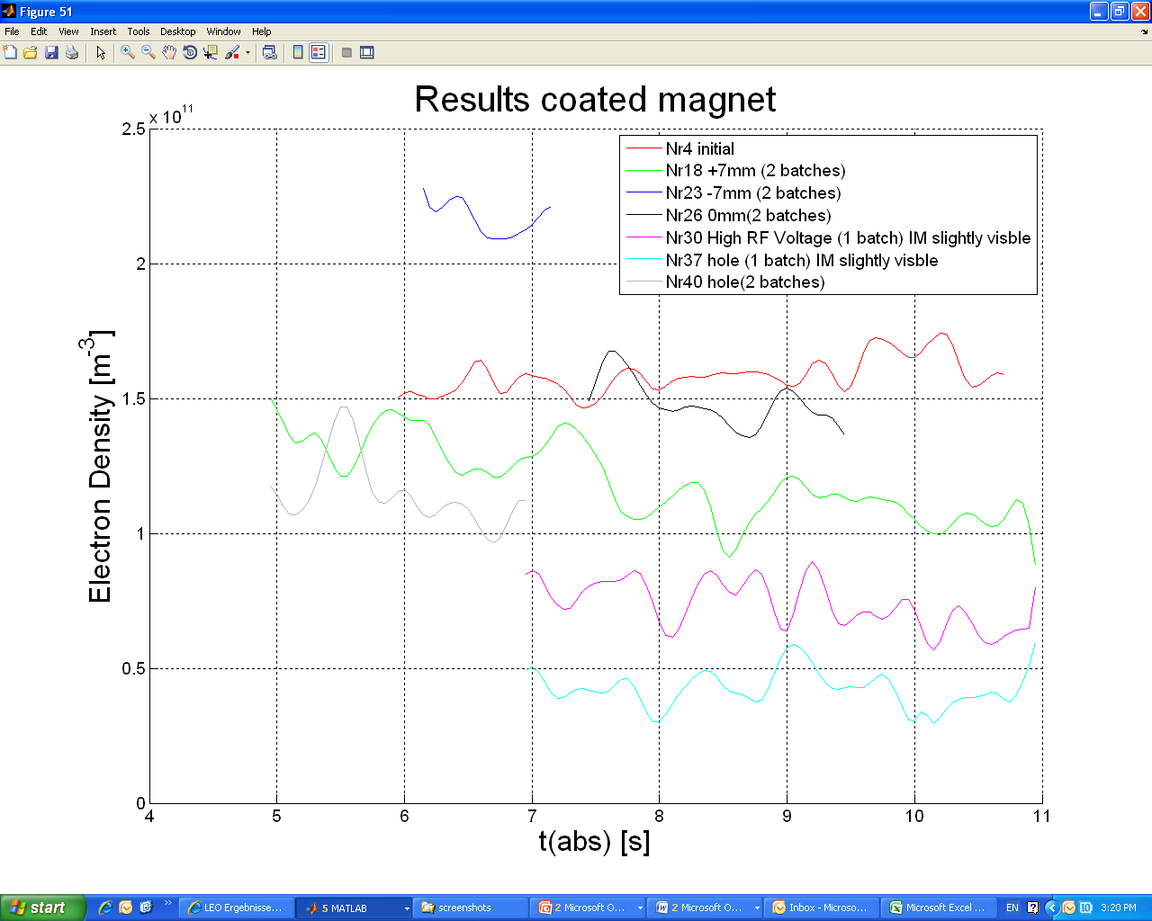
Results Coated Magnet
The results have been compared with the data from the ecloud monitors of Stainless steel
The order of the different measurements is in good agreement
For the different distances from center the ecloud monitor display was constant and there is a difference according to position of the beam (magnet not fully coated)
The initial measurement shows the same values as the one made later (0 mm shift)
For the two smallest traces slight IMD is visible and when comparing the difference of the ecloud monitor display the suspect of small contamination is confirmed
Keep in mind that the values given are the peak values of the fundamental wave

Slide 21
Comparison with E-cloud Monitor
Small negative spike @ approx 7.6s visible on the ecloud monitor and the measured data
At the same time the “side lines” of the AM get narrower and the AM increases slightly
The harmonics get “narrower” at this time
This can be small change of the harmonics was seen on many other traces as well

Slide 22
Summary Results
For the uncoated magnet the ecloud signal was not distinguishable from IMD
The PM/AM ratio is constant for IMD and AM is higher than PM
The coated magnet is also contaminated by IMD signals, but partially no signs for IMD are visible and AM is up to 10dB smaller than PM
It was learnt that the AM has to be sufficient smaller than the PM and no beam harmonics “side peaks” are allowed to be seen
The order of the intensity of the measured data corresponds to the order of the ecloud monitor data. During the displacing of the beam the ecloud monitor showed constant values and a different signals for the coated magnet, due to the partial coating, have been observed

Slide 23
Preliminary conclusion
For the first time in this measurement campaign lower AM than PM was observed and the PM measured at the coated magnet corresponds well to the data of the ecloud monitors
The hardware has to be improved to reduce IMD. This includes high-pass filtering of the signal at all input and outputs of the amplifiers to avoid base band signal IMD.
IMD caused by beam harmonics is the biggest problem and just can be removed by narrow band filtering (with some restrictions) and better amplifiers including working far below the 1dB compression point
The coupling to the beam-pipe has to be improved to reduce the losses
Magnet cycle seen on the phase and amplitude of the carrier still an open point

