Slide 1
Summary of measurement data from E-cloud monitors in MD run week 45
Comparison with the previous MD runs
SPSU-meeting
2009-12-15

Slide 2
Content:
Overview of the MD run week 45.
Compare e-cloud data of StSt, C with different bunch spacing: 25ns, 50ns and 75ns.
Compare StSt from week 25 to week 45 => Conditioning.
Look at fast conditioning with low magnetic field.

Slide 3
1. Overview of the MD run week 45
10:30 – 18:00: 25ns (1,2,3,4 x72)
18:00 – 20:00: 50ns (1,2,3,4,5 x36)
20:00 – 21:30: 75ns (1,2,3,4 x24)
21:00 – end: back to 50ns (1x36)

Slide 4
Results 1. Stainless Steel

Slide 5
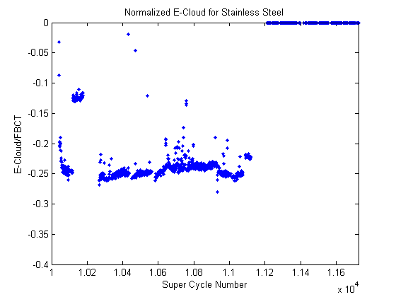
the reason is the cleaning of the ring from protons circulating out of the “buckets”
(Pressure also decreases, see Mauro’s presentation from the previous meeting)

Slide 6
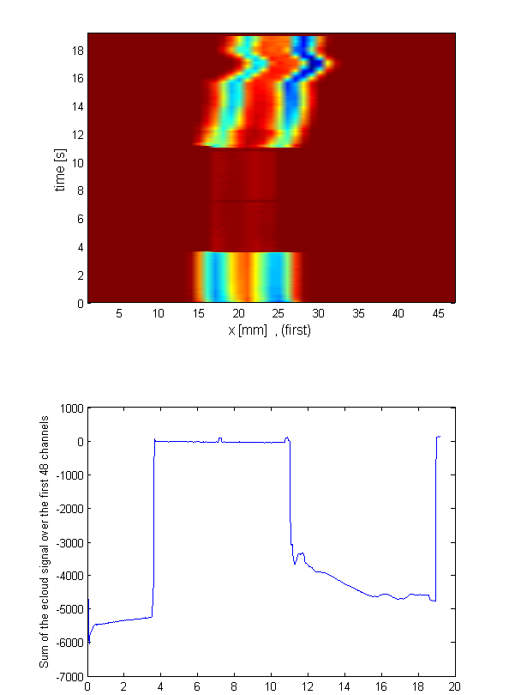
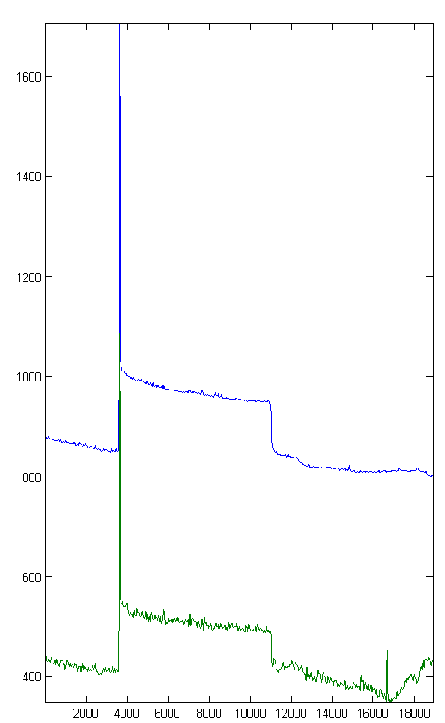

Slide 7
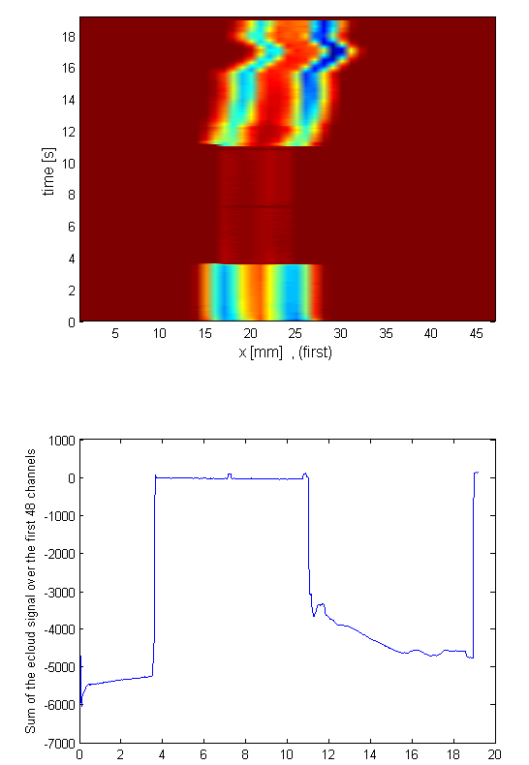
Difference in pressure!!

Slide 8
This behavior tells us:
The pressure of the uncoated magnet is related to e-cloud, whereas the pressure of coated magnet is not obviously simply related to e-cloud. (something else?)
More studies on the relationship between e-cloud and pressure rise will be done next year.
See Mauro’s talk about the modification of e-cloud monitors.

Slide 9
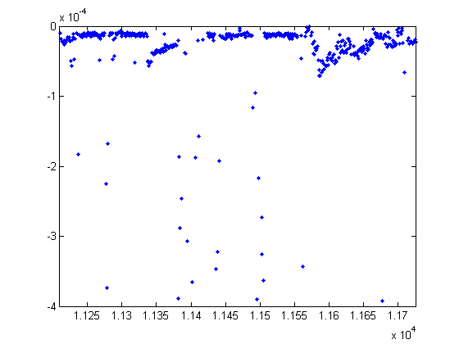
18:31
20:40
21:32
50ns
75ns
50ns

Slide 10
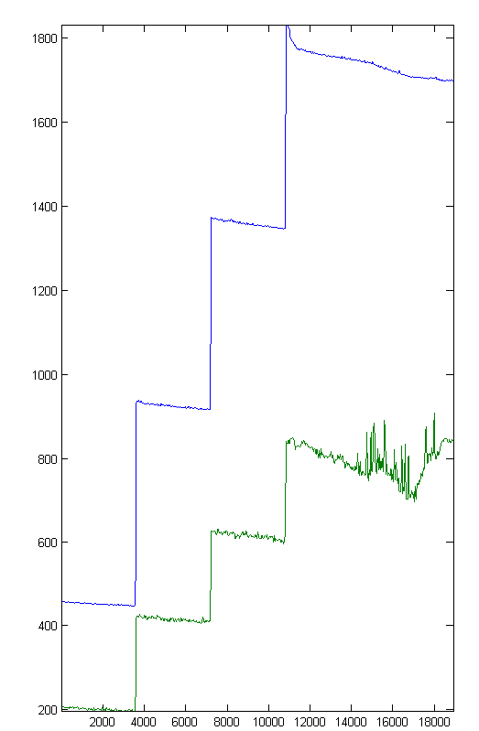
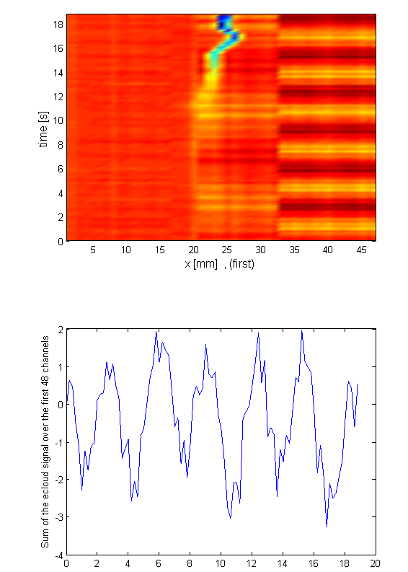
18:31
20:40
21:32
50ns
75ns
50ns
4x36

Slide 11
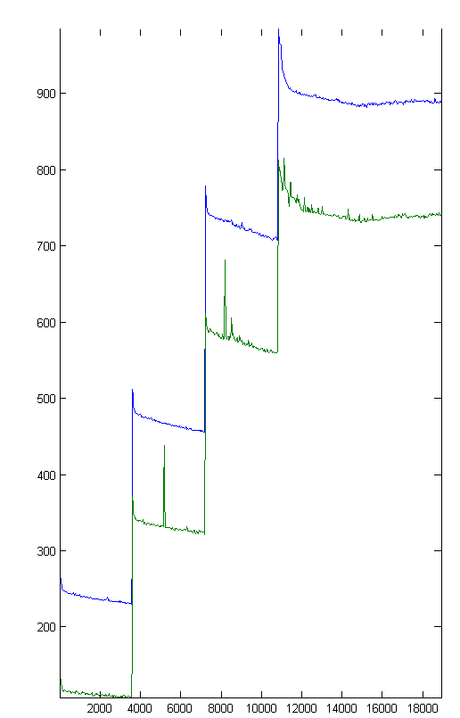
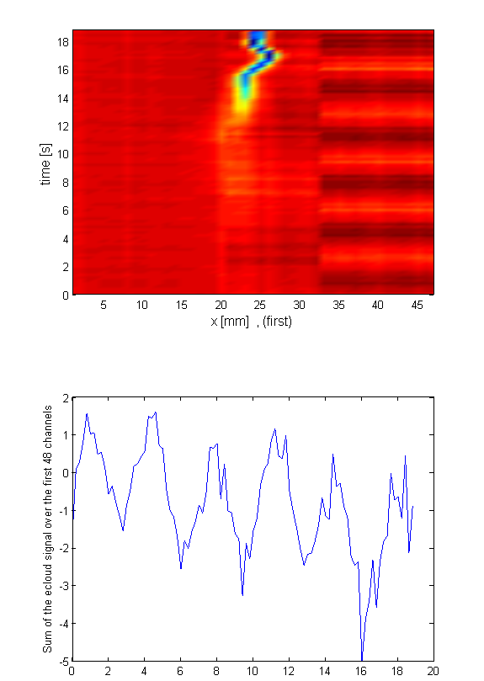
18:31
20:40
21:32
50ns
75ns
50ns
4x24

Slide 12
Results 2. Carbon coated liner / CNe13

Slide 13
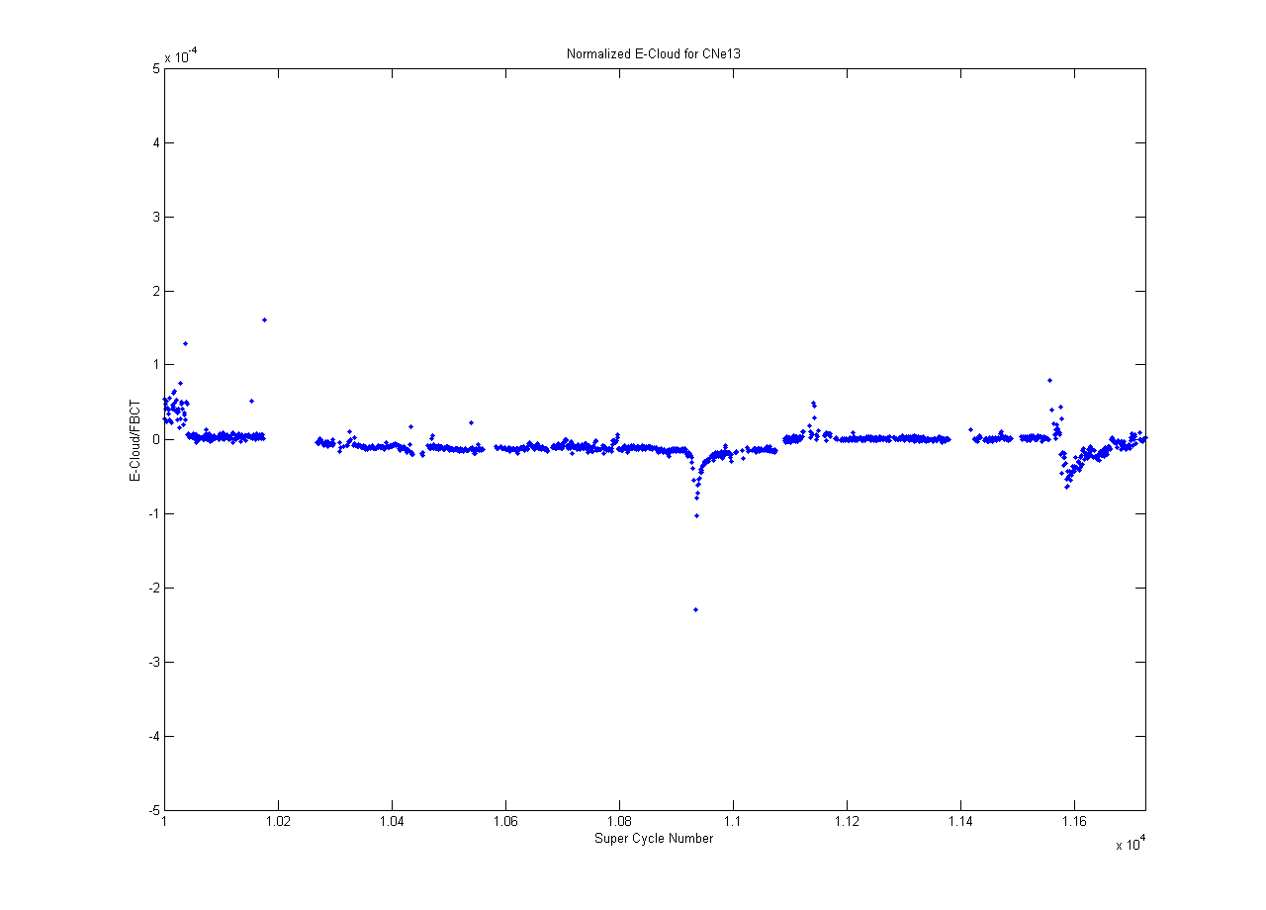
4x24
25ns
50ns
75ns
50ns

Slide 14
Results 2. StSt v.s Carbon

Slide 15
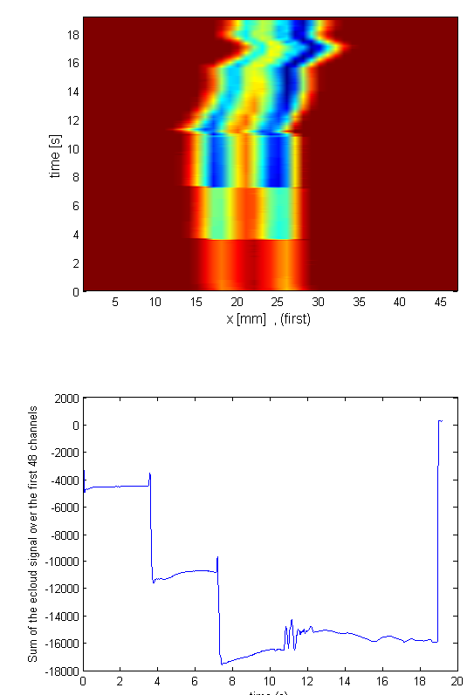
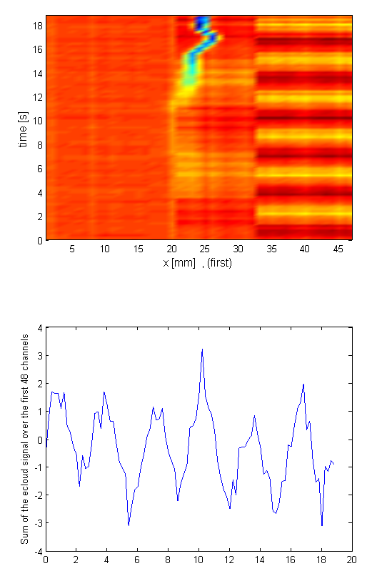
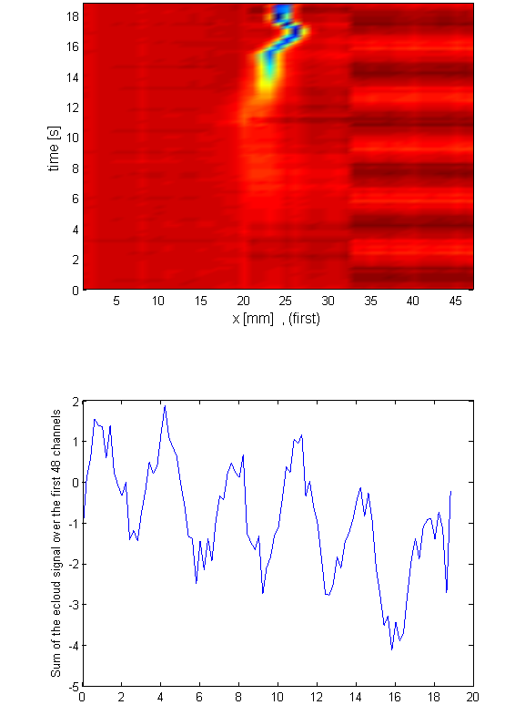
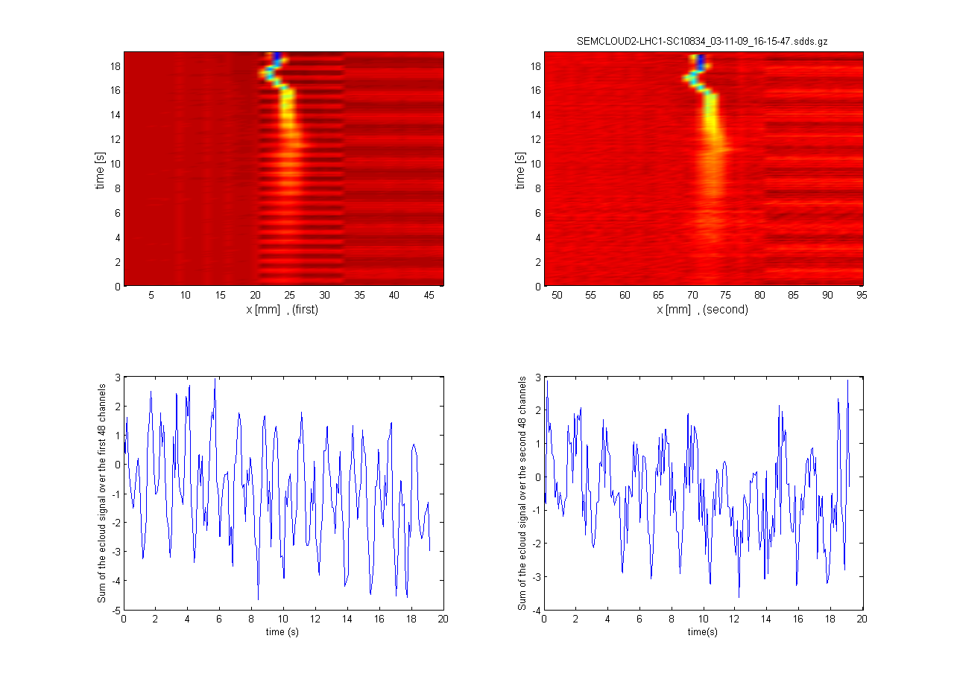
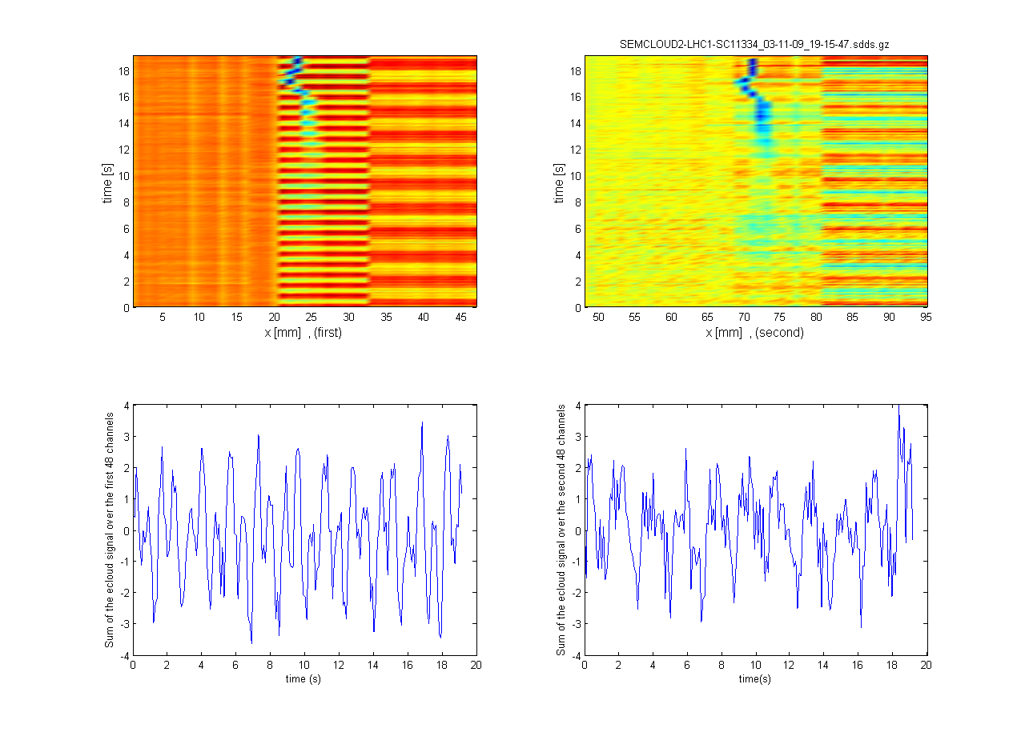
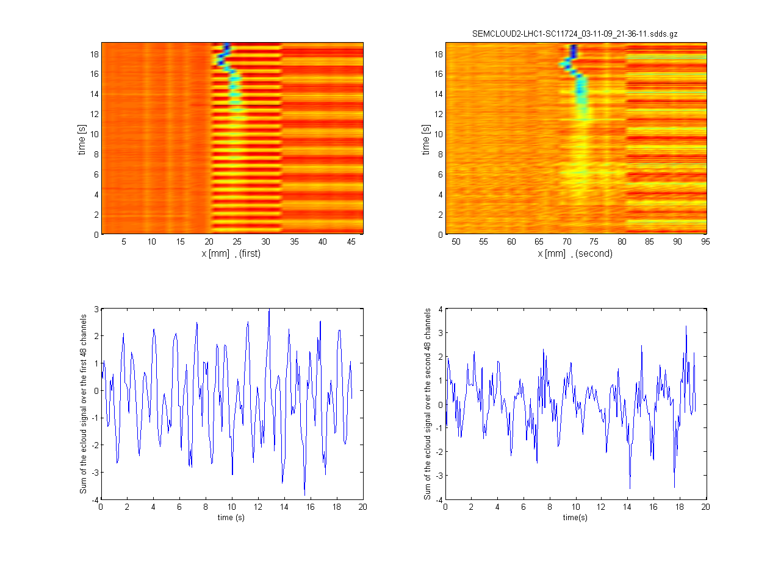
25ns
50ns
75ns
StSt
Carbon

Slide 16
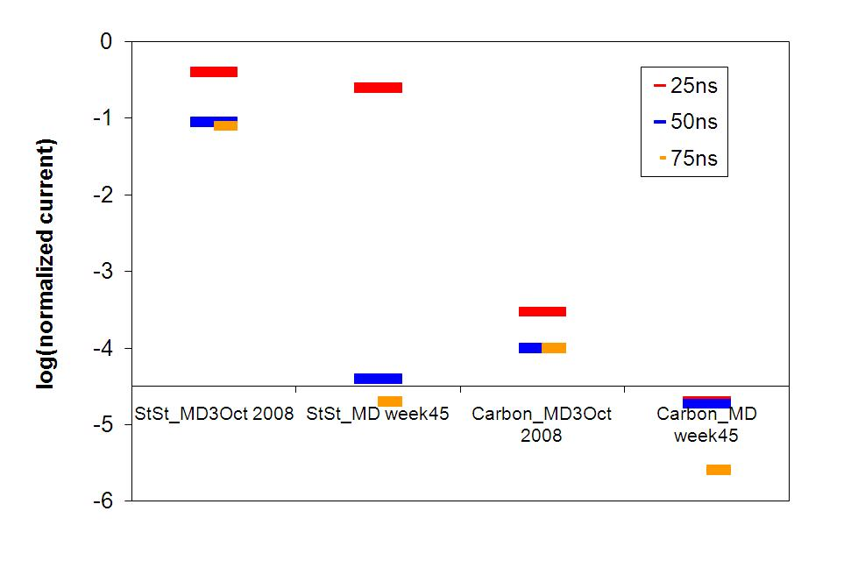
Compare with MD3 Oct 2008
E-cloud is bunch spacing dependent. Longer bunch spacings, lower e-cloud.
Conditioned StSt and carbon.

Slide 17
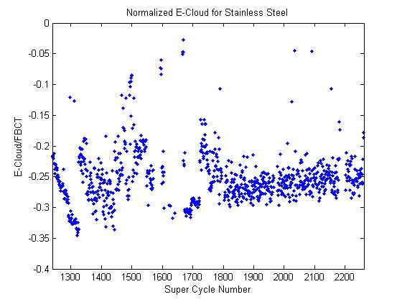
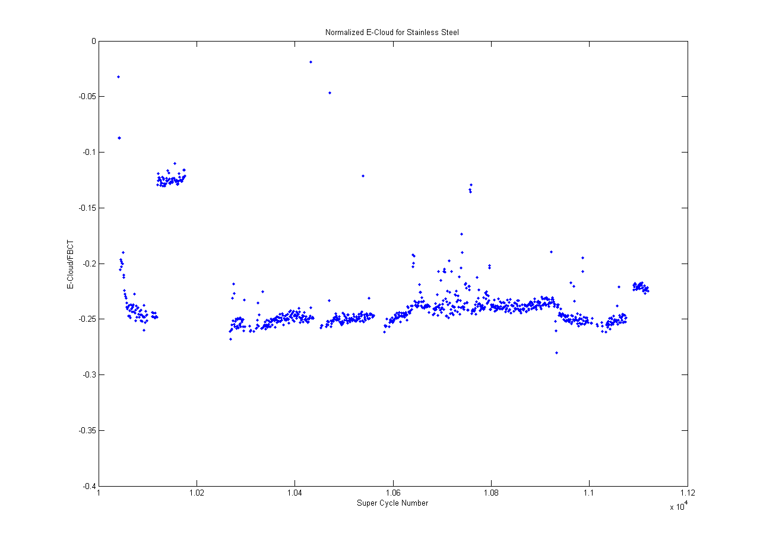
Conditioning of StSt
Normalized e-cloud signal v.s supercycle number.
Week 25, 2009
First MD 2009
-0.35
StSt: 30% conditioning after 1 year MD in machine.
Week 45, 2009
Last MD 2009
-0.25

Slide 18
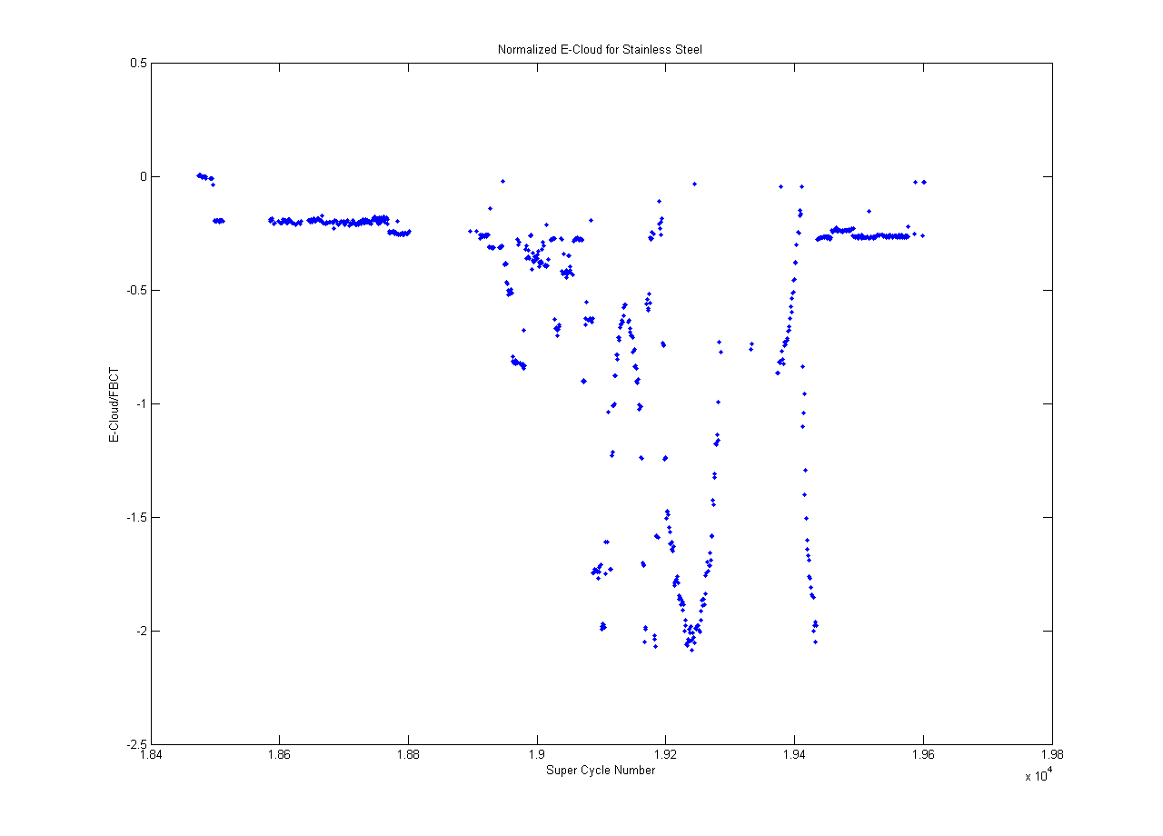
Fast conditioning with low B-field?
StSt, MD week 33
Changing B-field…
Before changing
B-field.
After changing
B-field.
No difference in the e-cloud before and after changing of B-field=>
No clear support for the fast conditioning with low B-field is found yet!!

